Slide 1
The cognitive style of powerpoint
Adapted from Edward Tufte

Slide 2
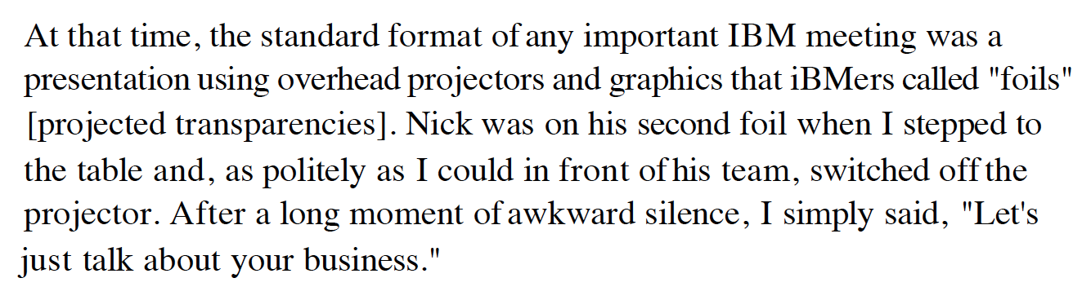
Lou Gerstner IBM

Slide 3
Issues of Slideware
More for the presenter than the audience
  Reduce evidence and thought
  Low resolution
  Single path, single model for all content
  Small narrative fragments
  Single model for all presentations
  Tendency to make everythig into a sales pitch

Slide 4
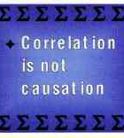
Lo-Fi
This slide from a statistics course shows a seriously incomplete statement.
Probably the shortest true statement that can be made about causality and correlation is "Empirically observed covariation is a necessary but not sufficient condition for causality."
Or perhaps "Correlation is not causation but it sure is a hint."

Slide 5
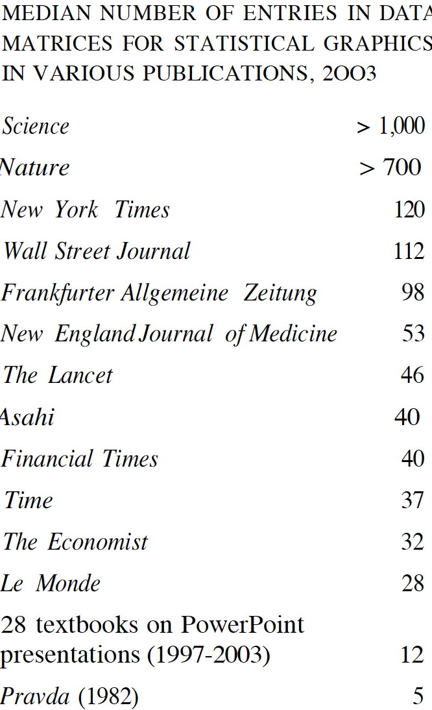
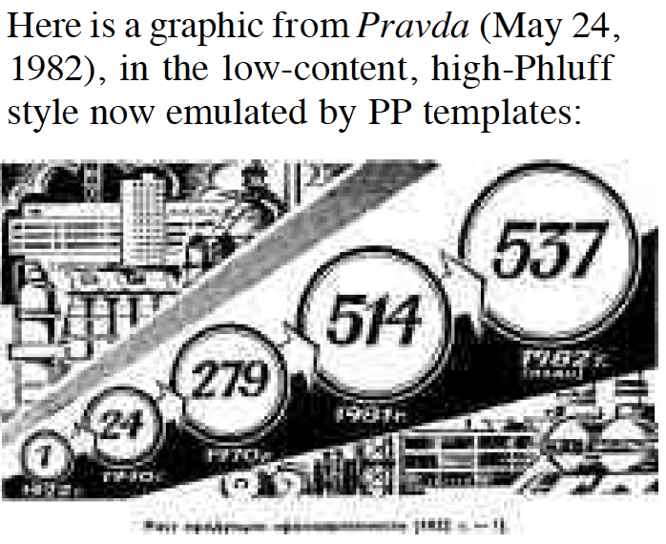
Lo-Fi Data

Slide 6
Bulleted Lists are Lazy
In every company we know, planning follows the standard format of the bullet outline... [But] bullet lists encourage us to be lazy in three specific, and related ways.
Bullet lists are typically too generic. They offer a series of things to do that could apply to any business....
Bullets leave critical relationships unspecified. Lists can communicate only three logical relationships:
  sequence (first to last in time);
  priority (least to most important or vice versa);
  or simple membership in a set (these items relate to one another in some way, but the nature of that relationship remains unstated).
And a list can show only one of those relationships at a time.

Slide 7
Example
What does this mean:
  Increase market share by 25%.
  Increase profits by 30%.
  Increase new-product introductions to ten a year.
What are reasonable interpretations of this list?
Talk to your neighbour and come up with more than one.

Slide 8
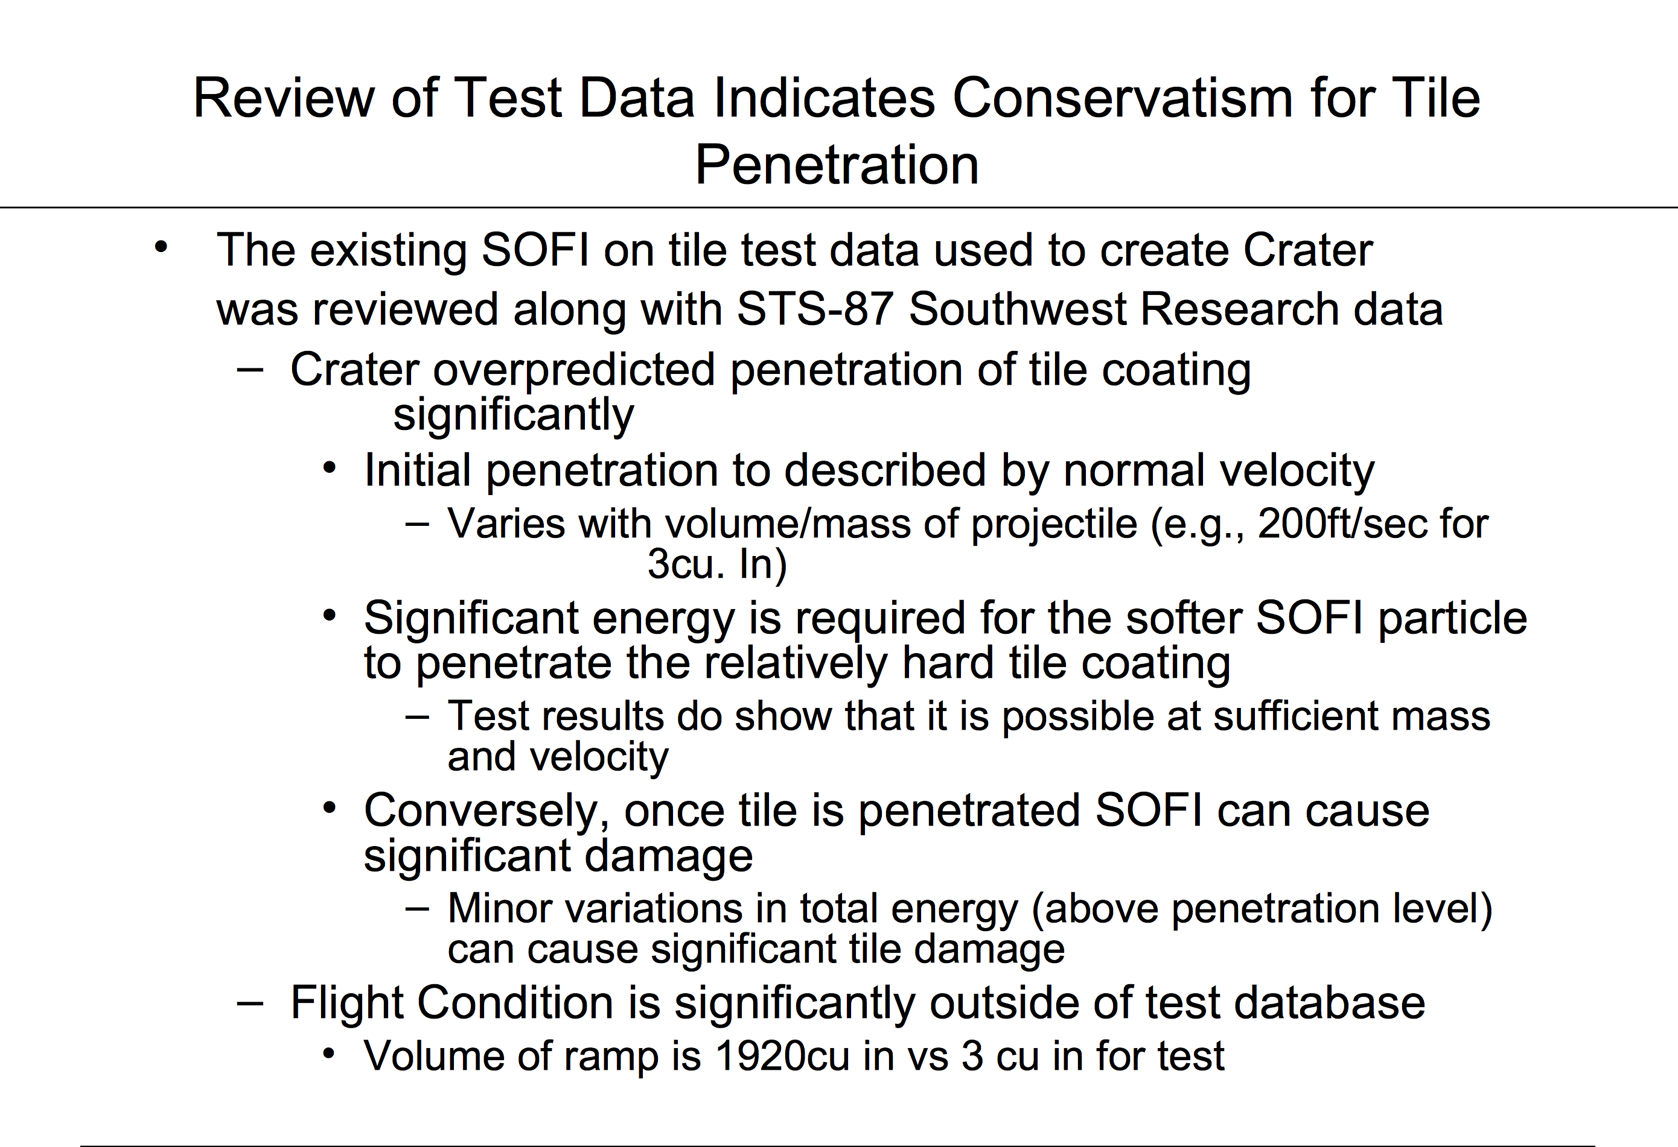

Slide 9
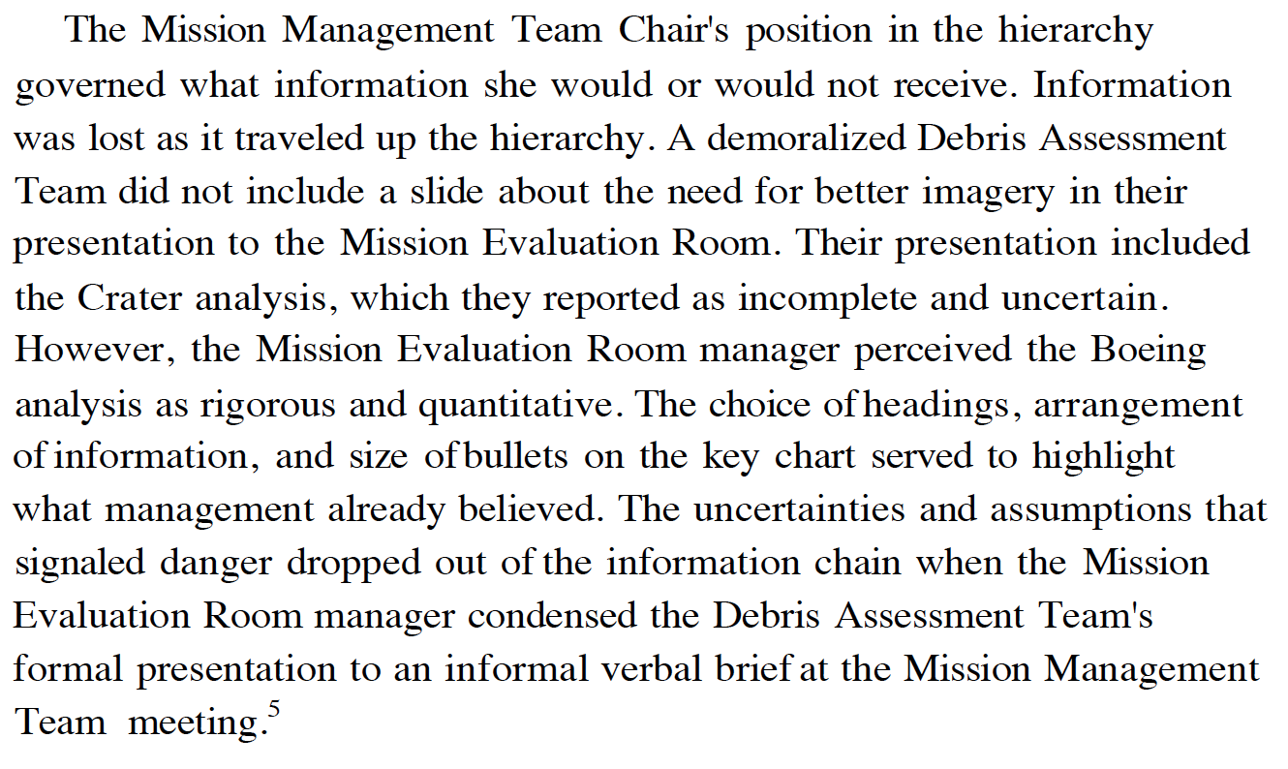
Powerpoint shapes the Organisation

Slide 10
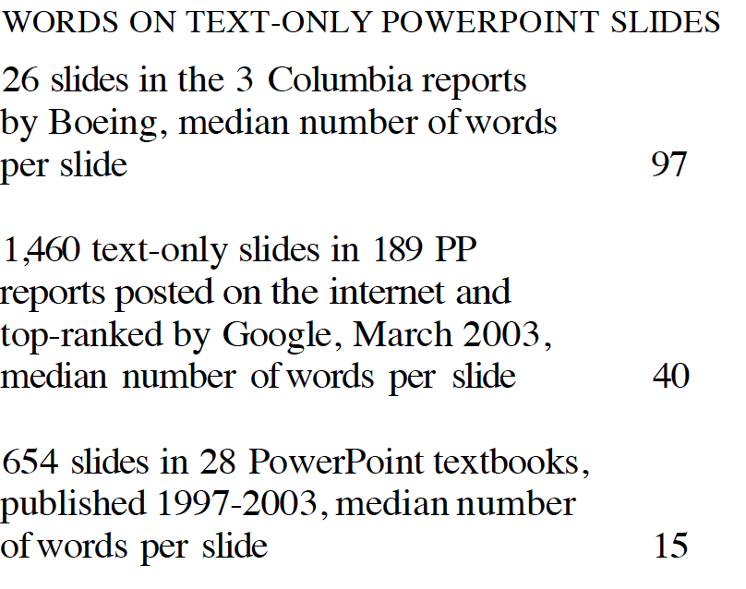
A picture is worth a 1000 words
The artist Ad Reinhardt said, "As for a picture, if it isn't worth a thousand words, the hell with it."
People can quickly look over tables with hundreds of numbers in, say, financial or sports pages in newspapers.
People read 300 to 1,000 printed words a minute,
and find their way around a printed map or a 35mm slide displaying 5 to 40 MB in the visual field.
Often the visual channel is an intensely high-resolution channel.

Slide 11
Why is Powerpoint so Lo-Fi?
Design styles often use 60% of the available space
Projection means powerpoints use big fonts.
Maybe the presenter doesn’t have much to say…
Better to use paper with more detailed information…
In areas like art, typography, cartography more detail adds clarity…

Slide 12
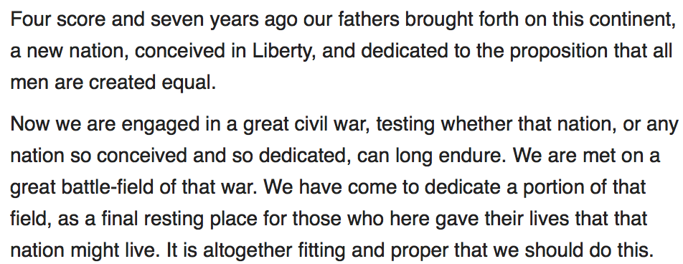
Gettysburg Address

Slide 13
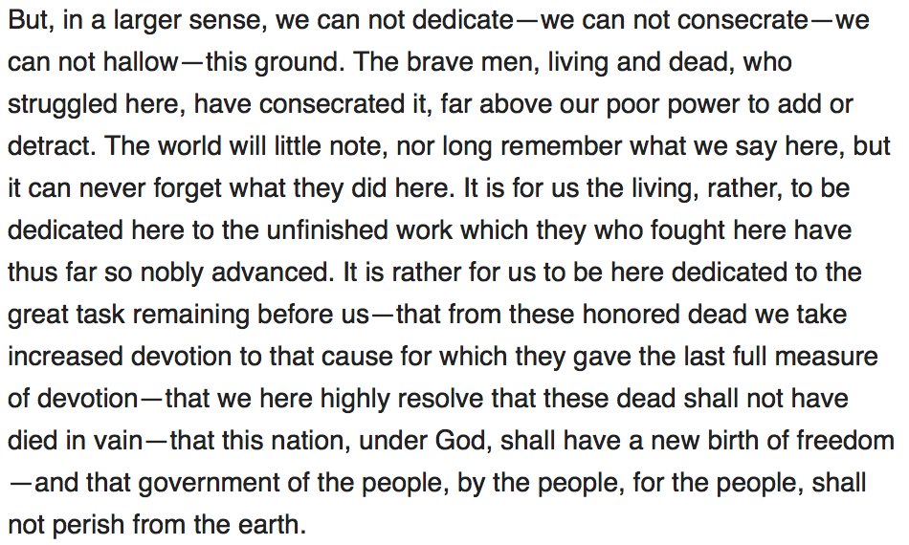
Gettysburg Address

Slide 14
Now Consider a Powerpoint…

Slide 15
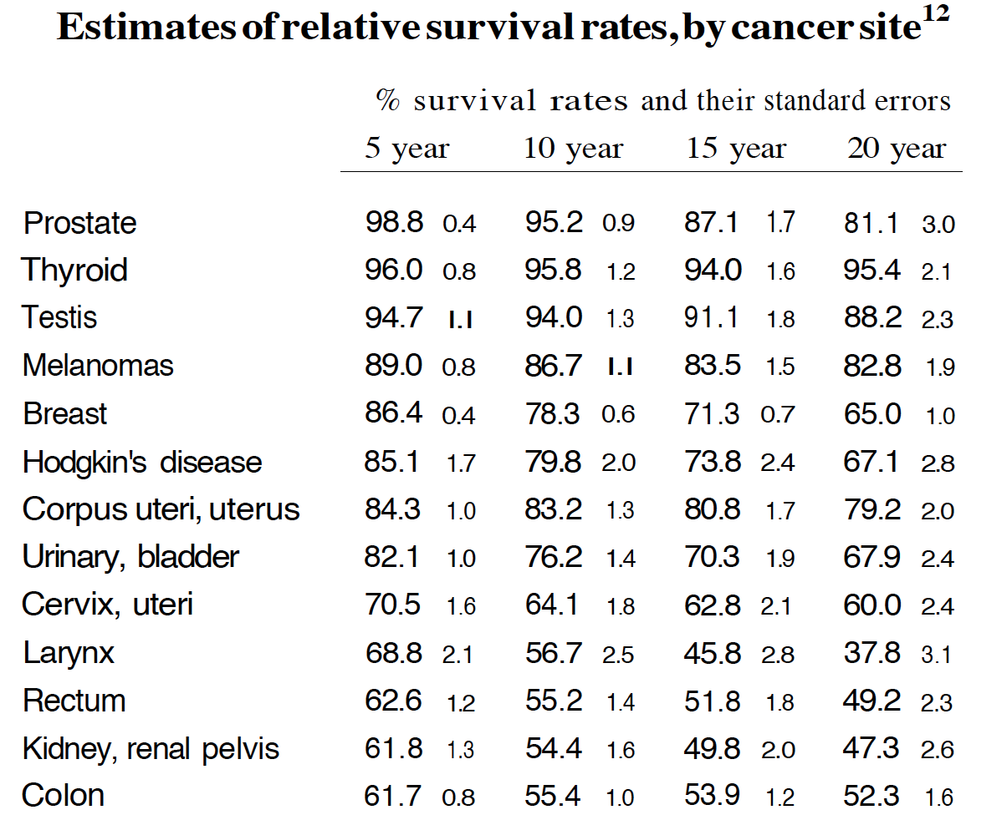
Data is often Dense

Slide 16
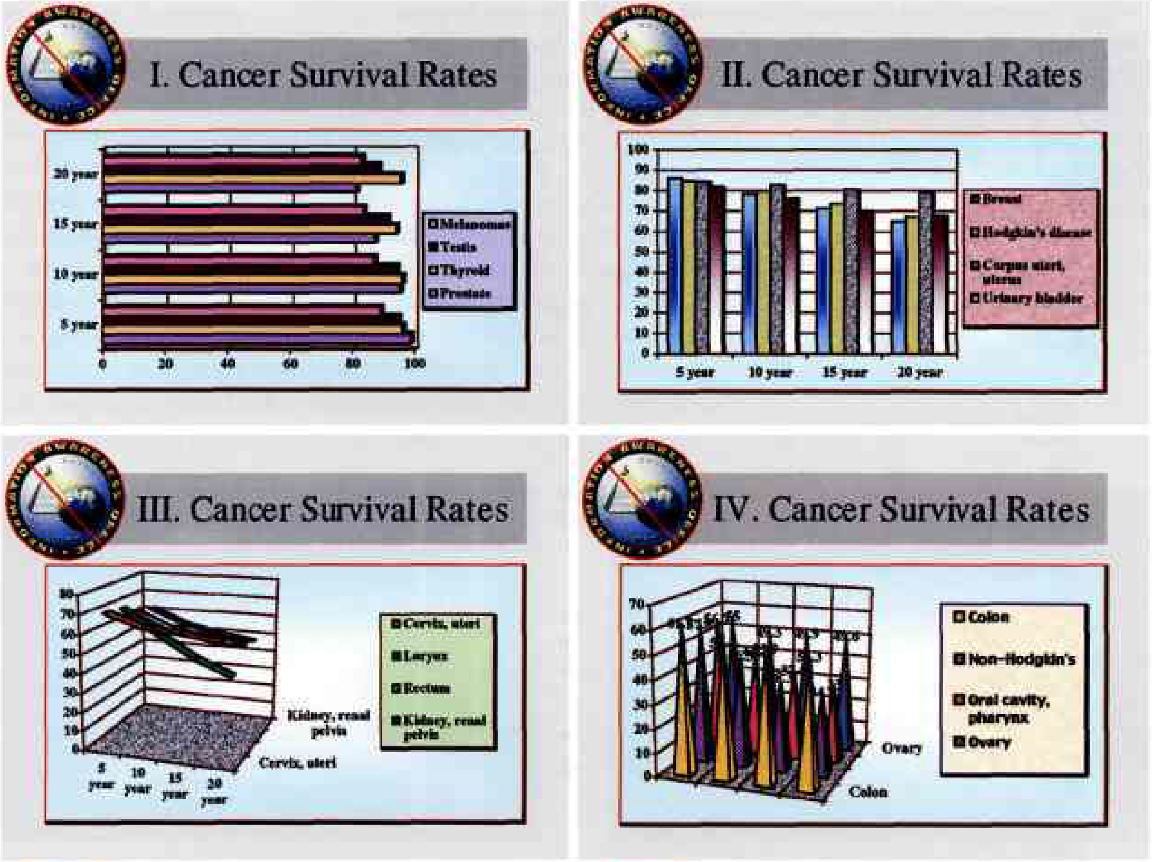

Slide 17
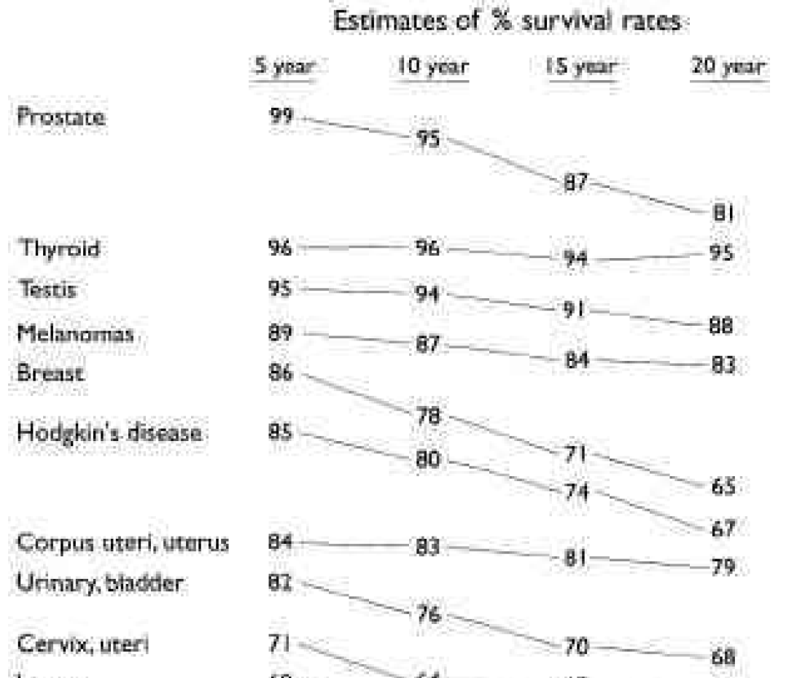
More thought, less fluff

Slide 18
What other questions arise?
Talk to your partner and develop two or three questions you’d like to ask about the cancer stats…

Slide 19
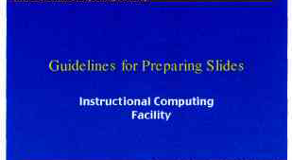

Slide 20
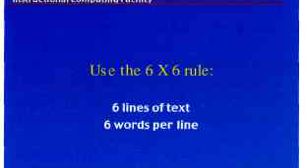

Slide 21
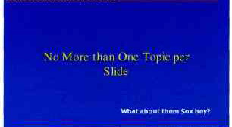

Slide 22
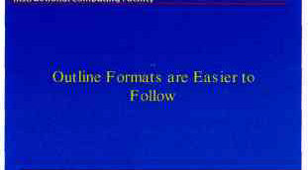

Slide 23
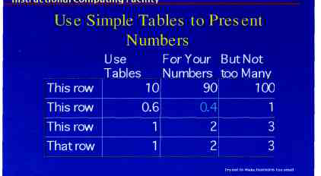

Slide 24
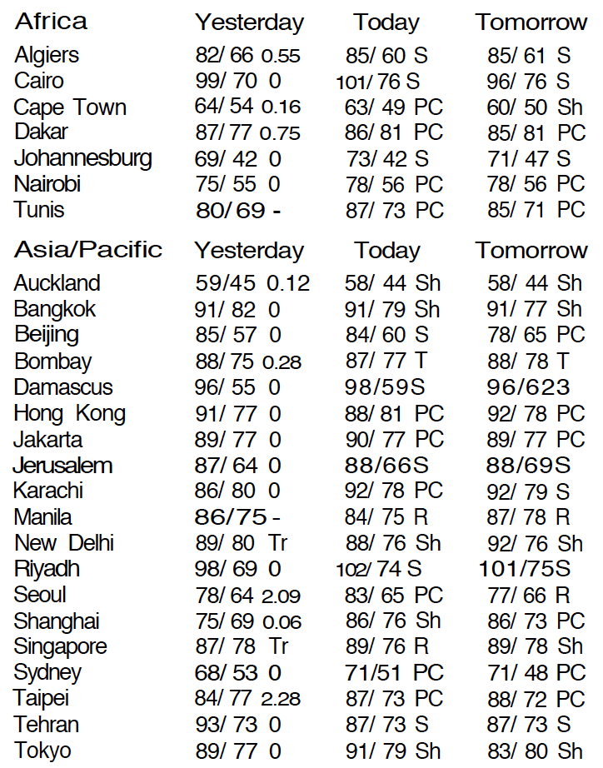
But look at Weather Data

Slide 25
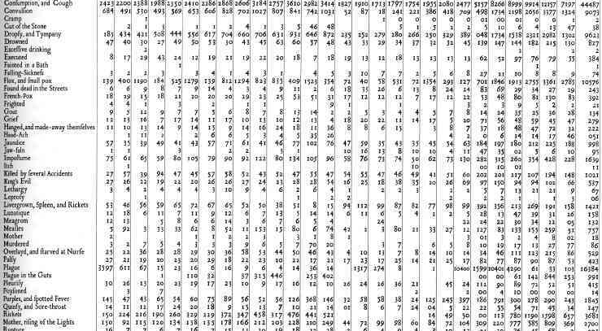
Table of Casualties 1647

Slide 26
Further Issues
Pushing a decline in the density of text more widely.
Highly sequential presentations.
Loss of context because it can’t be held for long.
Sometimes line by line…

Slide 27
Better Presentations
Make content relevant, high quality and with high standards of integrity.
Weak presentations will bore the audience no matter how good the design is.
Be sensitive to when the presentation medium is distorting the content.
PowerPoint is a competent slide manager and projector for low-resolution materials. And that's about it.
Never use PP templates to format paper reports or web screens.
Use PP as a projector for showing low-resolution color images, graphics, and videos that cannot be reproduced as printedhandouts at a presentation.

Slide 28
