Slide 1
Data Governance, Ethics and the law

Slide 2
Ethics and law: why does it matter to computer scientists?

Slide 3

Costs: fines and reputation

Slide 4
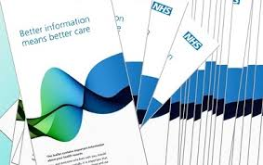
No Buy-in by needed users

Slide 5
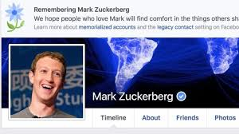
Loss of trust

Slide 6


Slide 7
Fines (under GDPR: a fine up to 10,000,000 EUR or up to 2% of the annual worldwide turnover of the preceding financial year in case of an enterprise, whichever is greater (Article 83, Paragraph 4 [14]))
a fine up to 20,000,000 EUR, or in the case of an undertaking, up to 4% of the total worldwide annual turnover of the preceding financial year, whichever is higher (Article 83, Paragraph 5 &

Slide 8
Damages: potentially unlimited

Slide 9
Data breach notification duty:here goes your reputation

Slide 11
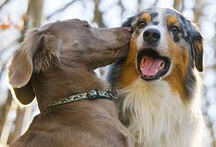
Ethics and Data science
A bit like kissing in the school yard:
Lots of people seem to be talking about it
Much fewer actually do it
Even fewer do it well

Slide 12
What does „data ethics“ mean?
Don‘t break the law?
Don‘t break the spirit of the law?
Don‘t do harm (non-malevolence)?
Do good (benevolence)
Respect autonomy?
Be just?
Be a „good X“ (scientists, doctor, politician etc)
      Noe be bad

Slide 13
What does professional ethics mean
Being a „good X“ (scientists, administartor, judge...)
Not violating the professional rules
Being perceived by others as exemplary
Being a „virtuous“ X

Slide 14
The knowledge trifeca
Known risks („known kowns“)
Known possible risks („known unkown“)
Unknown but real risks (unkonwn unkowns“)

Slide 15
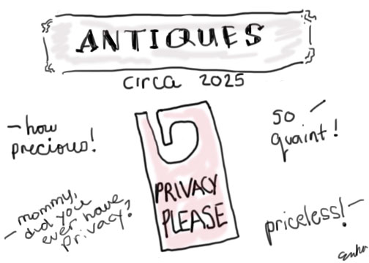

Slide 16
Known risks and the law
Privacy
Property (IP)
  Commercialisation and independence
  Benefit sharing
Openness
  FOI
  Funding council guidelines: open access, replicability

Slide 17
Risk Management and planning tools I
SWOT
  strengths, weaknesses, opportunities, threats
PEST
  political, economic, social and technological
PESTLE
  political, economic, social, tech; legal; ethical
STEEPLE (D)
  Environemntal and demographic
SPELIT,
  legal and intercultural factors

Slide 18
Risk management and planning tools II
Privacy Impact Assessment
Cabinett Office Big Data Analysis Tool

Slide 19
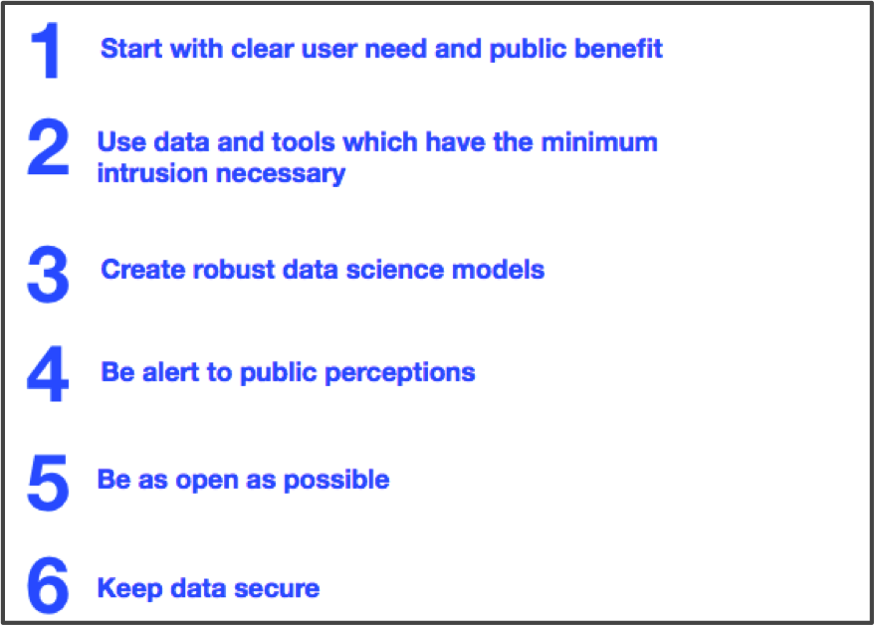
Cabinett Office Data Ethics Tool

Slide 20
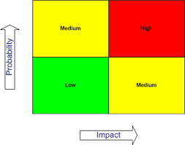

Slide 21

Case studies

Slide 22
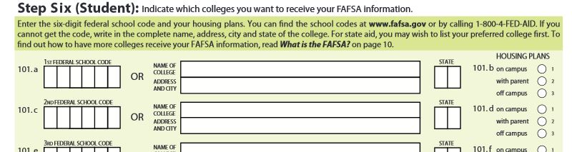
The bad
US university applicants apply for federal grants
One section of the application form asks them to rank their universities by preferenes

Slide 23
Form is then shared with universities
...which in some cases use this to reject candidates that did not list them first
Maybe worse, offered less financial suport to candidates who listed them second
Combined with browsing data from ranking websites

Slide 24
Data minimisation?
Data sharing?
Consent, secondary use/purpose binding principle
Harming your clients?
Non-sustainable/harming your future data access

Slide 25
Privacy
Harm to the person who supplies the data

Slide 26
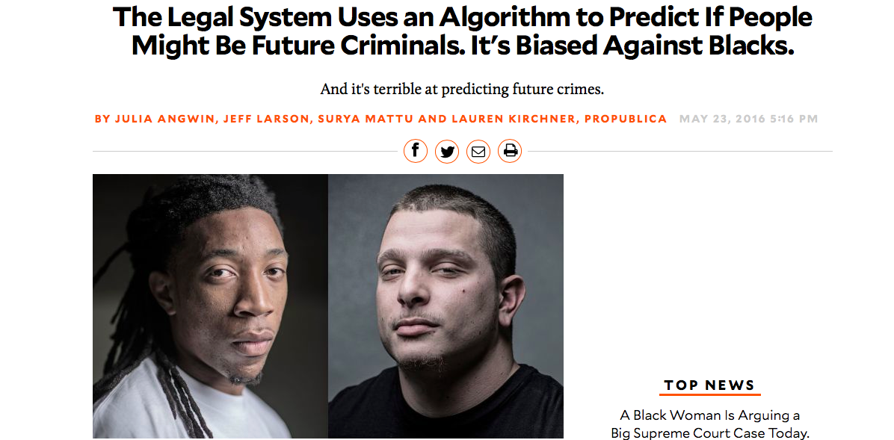
The racist sentencing support system

Slide 27
Discrimination
Violation of laws
Hidden biases
Wider social harm

Slide 28
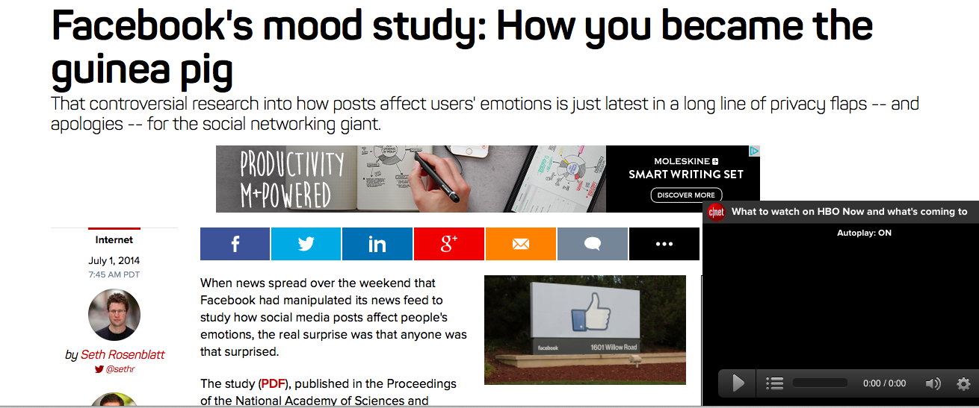
The ugly

Slide 29
Privacy
Autonomy
Benefits? Justice?

Slide 30
The good?

Slide 31
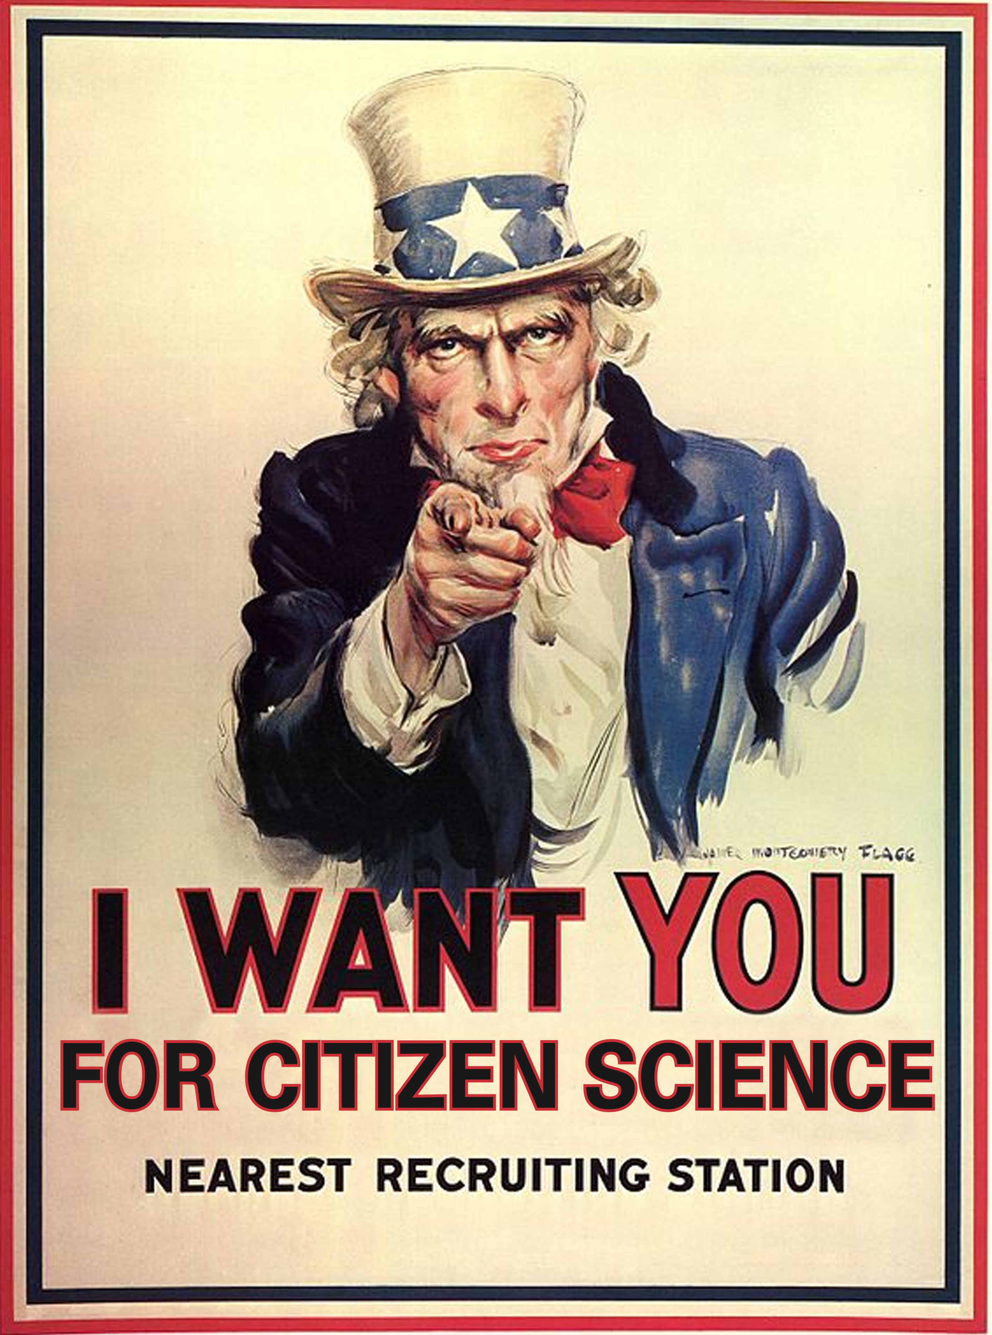
Citizen science – where could be the harm in that?
Citizens record noise levels on mobile phones
City makes planning decisions on that basis
  (traffic calming/redirection measures)

Slide 32
Who is heard and who is not heard?
Who suffers from the decision taken?

Slide 33
The good?

Slide 34
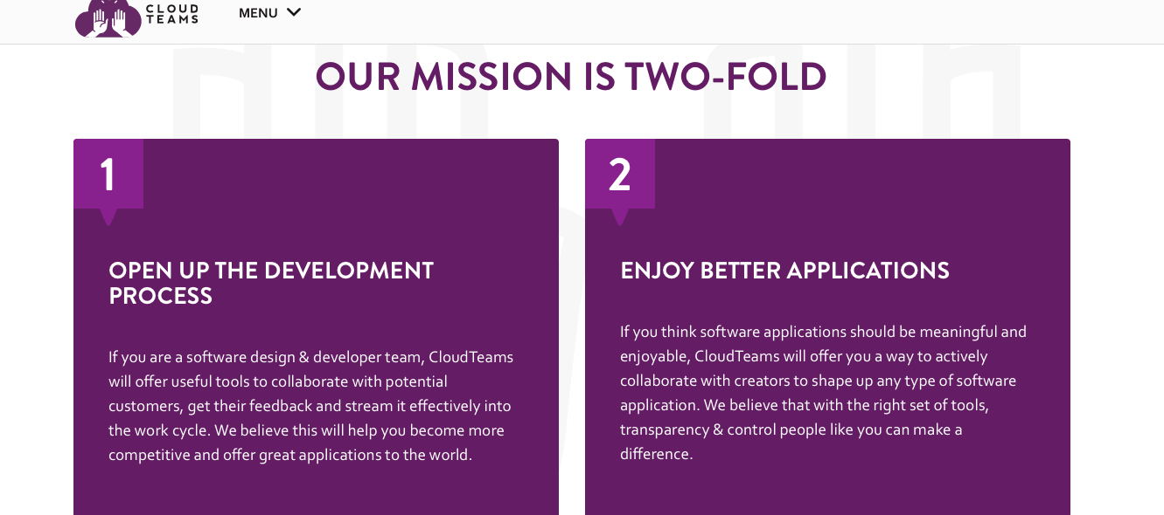
Cloudteams

Slide 35
Earn points while you share
Get earlier/cheaper/free access to the apps that are developed
Make the most of your Facebook account by combining it with CT data

Slide 36
Possible issues
Is gameification appropriate for health data?
Risk through cumulative participation with same development team
Risk of inducing you to violate your obligations

