Slide 1
Professions and Professionals
Professional Issues Professions and Professionals

Slide 2
Professionals
What is a profession
Professional Conduct
Professional bodies in Computing
Computer Misuse

Slide 3
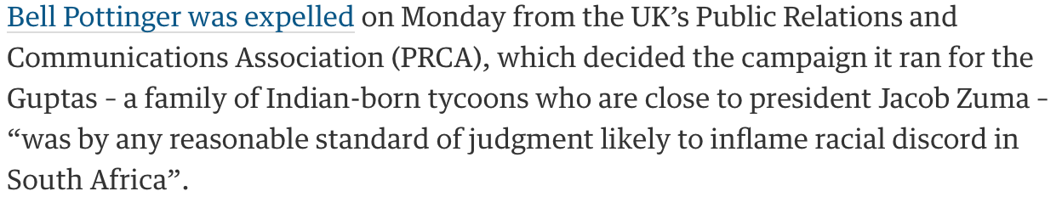
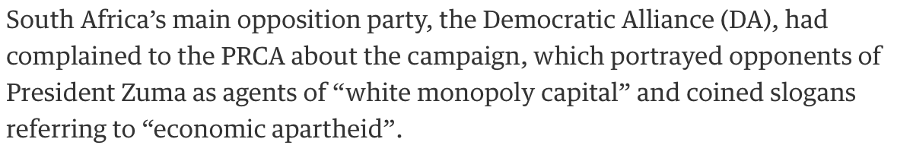
The Bell Pottinger Case

Slide 4
PCRA Code of Conduct
2 Conduct towards the Public, the Media and other Professionals
A member shall:
2.1 Conduct their professional activities with proper regard to the public interest.
2.2 Have a positive duty at all times to respect the truth and shall not disseminate false or misleading information knowingly or recklessly, and to use proper care to avoid doing so inadvertently.
2.3 Have a duty to ensure that the actual interest of any organisation with which they may be professionally concerned is adequately declared.

Slide 5
PCRA Code of Conduct Continued
2.4 When working in association with other professionals, identify and respect the codes of these professions and shall not knowingly be party to any breach of such codes.
2.5 If a member of either House of Parliament, member of a Local Authority or of any statutory organisation or body, record that material in the relevant section of the PRCA Public Affairs and Lobbying Register.
2.6 Honour confidences received or given in the course of professional activity.
2.7 Neither propose nor undertake any action which would constitute an improper influence on organs of government, or on legislation, or on the media of communication.
2.8 Neither offer nor give any inducement to persons holding public office or members of any statutory body or organisation who are not directors, executives or retained consultants, with intent to further the interests of the organisation if such action is inconsistent with the public interest.

Slide 6
Breakout Session
On your own: write a definition of the meaning of “profession” (2 or three lines max).
In a pair:
  compare and discuss your definitions – do they capture what you want to capture?
  If they differ significantly keep both and refine them, otherwise produce a single refined definition
In fours: combine your definitions into at most two definitions: main and alternate.

Slide 7
Pause – While we do the task in hand

Slide 8
Profession
Wikipedia: "A profession is a vocation founded upon specialised educational training, the purpose of which is to supply disinterested counsel and service to others, for a direct and definite compensation, wholly apart from expectation of other business gain" (New Statesman, 21 April 1917)
Have a look at the Wikipedia page because it is contested precisely on the distinction between the vernacular and technical meanings.

Slide 9
What Makes a Profession?
“To me, the essence of professionalism is a commitment to develop one's skills to the fullest and to apply [them] responsibly to the problems at hand. Professionalism requires adherence to the highest ethical standards of conduct and a willingness to subordinate narrow self-interest in pursuit of the more fundamental goal of public service”
Justice Sandra Day O'Connor - US Supreme Court

Slide 10
Some other definitions…
“Doing things right and doing the right thing” (Chambers 20th Century Dictionary)
“an employment not mechanical and requiring some degree of learning; habitual employment; the collective body of persons engaged in any profession …”
(lawyers, doctors, architects, surveyors, accountants, engineers,etc )

Slide 11
The Collective Body
the collective body controls entry to the profession;
the collective body is self governing and self regulatory, in the sense that it establishes and enforces a code of conduct on its members;
the collective body is established either by a Royal Charter or an Act of Parliament which defines the extent of its authority and requires it to undertake certain duties and responsibilities.

Slide 12
Professional Bodies
Promote and set standards in education
  Accredit courses
Promote continuing personal development
Promote advancement of the subject
Promote exchange of knowledge
Give official advice

Slide 13
USA: Engineer
Term “engineer” much more strictly applied than here
State licensing boards
Applying strict regulation to software engineers would cripple the sector

Slide 14
BCS Codes
of Conduct
  Sets out the professional standards required by the Society as a condition of membership
  Covers public interest, duty to relevant authority, duty to the profession, professional competence and integrity
of Good Practice
  “describes standards of practice relating to contemporary demands found in IT”
  Covers practices common to all disciplines plus some specific to IT, business, education .. Such as:

Slide 15
Code of Conduct
1. Public Interest
You shall:
have due regard for public health, privacy, security and wellbeing of others and the environment.
have due regard for the legitimate rights of Third Parties*.
conduct your professional activities without discrimination on the grounds of sex, sexual orientation, marital status, nationality, colour, race, ethnic origin, religion, age or disability, or of any other condition or requirement
promote equal access to the benefits of IT and seek to promote the inclusion of all sectors in society wherever opportunities arise.

Slide 16
Code of Conduct
2. Professional Competence and Integrity
You shall:
only undertake to do work or provide a service that is within your professional competence.
NOT claim any level of competence that you do not possess.
develop your professional knowledge, skills and competence on a continuing basis, maintaining awareness of technological developments, procedures, and standards that are relevant to your field.
ensure that you have the knowledge and understanding of Legislation* and that you comply with such Legislation, in carrying out your professional responsibilities.
respect and value alternative viewpoints and, seek, accept and offer honest criticisms of work.
avoid injuring others, their property, reputation, or employment by false or malicious or negligent action or inaction.
reject and will not make any offer of bribery or unethical inducement.

Slide 17
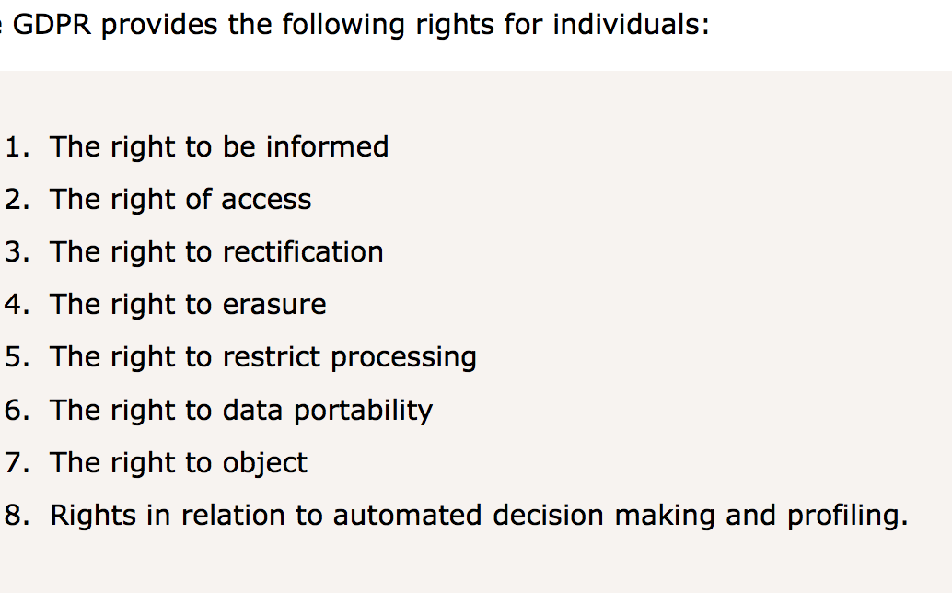
The General Data Protection Regulation

Slide 18
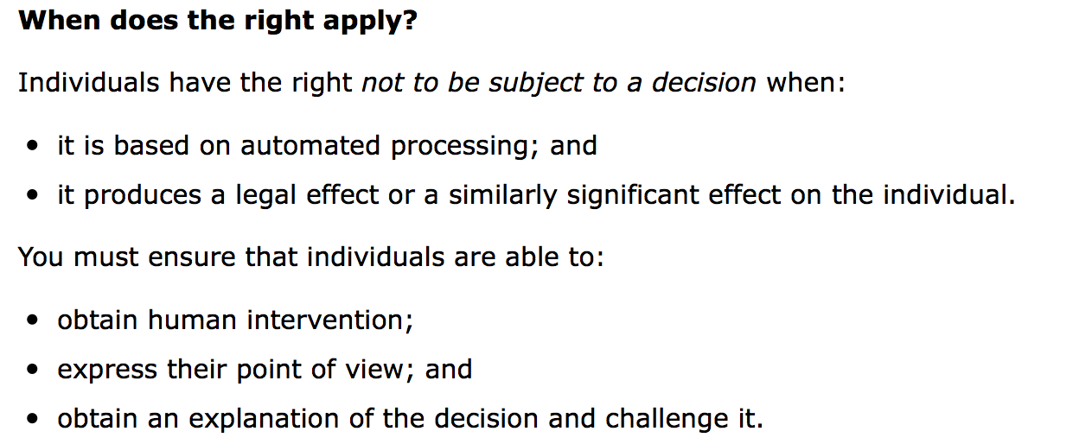
Rights Related to Automated Decision Making

Slide 19
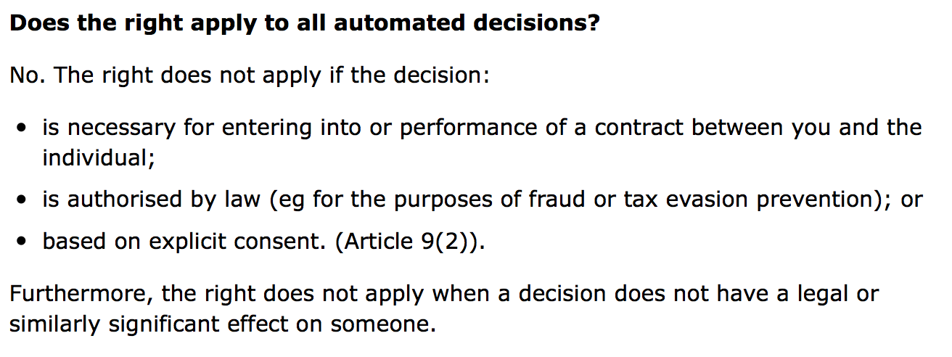
Rights Related to Automated Decision Making

Slide 20
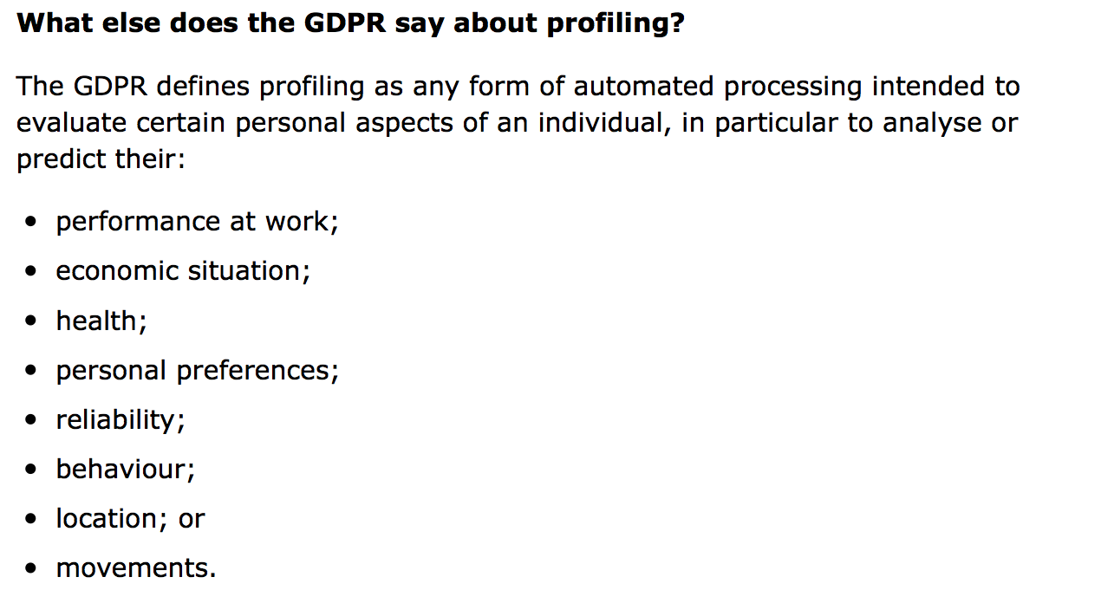
Rights Related to Automated Decision Making

Slide 21
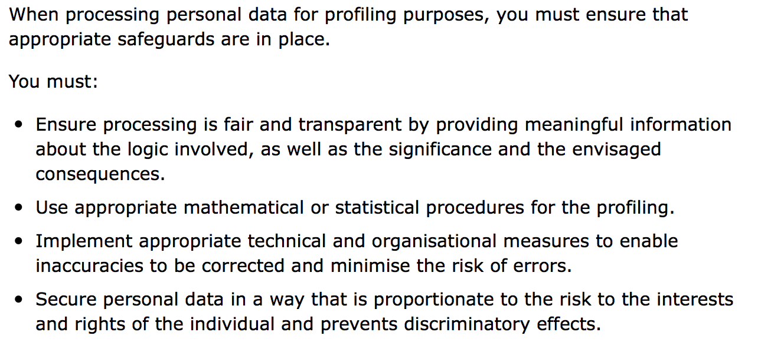
Rights Related to Automated Decision Making

Slide 22
Breakout Session
Individually, do you know any systems that you use that apparently break the GDPR rules on decision making?
In pairs, which part of the code of conduct do you think this causes most problem with?

Slide 23
Pause while we do the exercise

Slide 24
IFIP
International Federation for Information Processing
“the leading multinational, apolitical organization in Information & Communications Technologies and Sciences
recognized by United Nations and other world bodies
represents IT Societies from 56 countries or regions, covering all 5 continents with a total membership of over half a million
links more than 3500 scientists from Academia and Industry, organized in more than 101 Working Groups reporting to 13 Technical Committees
sponsors 100 conferences yearly providing unparalleled coverage from theoretical informatics to the relationship between informatics and society including hardware and software technologies, and networked information systems”

Slide 25
IFIP: no Code of Conduct
Why might that be?

Slide 26
IFIP: no Code of Conduct
Attempts were criticised as being from the perspective of white well-off males.
Instead it issued guidelines but left this to member organisations
E.g. on viruses: IFIP urges:
  Computer professionals to recognise the disastrous potential of viruses and not to distribute viruses knowingly
  Educators to impress upon students the dangers of viruses
  Publishers to refrain from publishing details of virus programs
  Developers of virus detectors not to distribute viruses as tests
  Resources to be devoted to R & D of protection mechanisms
  Governments to make distribution an offence

Slide 27
ACM: General Moral Imperatives
As an ACM member I will:
  Contribute to society and human wellbeing
  Avoid harm to others
  Be honest and trustworthy
  …

Slide 28
EU – FEANI
Mobility directives
  Allow movement and professional recognition between countries
  Fédération Européene d’Associations Nationales d’Ingénieurs
  Members can use prefix Eur.Ing.

Slide 29
Practices Common to all Engineering Disciplines
Maintain your technical competence
Adhere to regulations
Act professionally as a specialist
Use appropriate methods and tools
Manage your workload efficiently
Participate maturely
Respect the interests of your customers
Promote good practices within the organisation
Represent the profession to the public

Slide 30
Practices covered by the BCS
Information Technology
Programme/Project Management
Relationship Management
Security and Safety
Change Management
Quality
Business Processes
Research & Development
We’ll Look at these in more detail later

Slide 31
Summary
Members of the Computing Profession are expected:
  to work within the relevant legal framework
  to act within a framework of rules of conduct
  to be familiar with best practice and to exercise judgement in applying it
Important documents to read are
  Bott et al. Chapter 1-3
  BCS Code of Conduct
  BCS Code of Good Practice
Homework for next time:
  Write a paragraph contrasting the Code of Conduct with the Code of Practice. In particular invent two example contexts – one where the CoC is more useful than the CoP and vice versa.

