Slide 1
Organizations, Structure, Management
Bott Chapter 4

Slide 2
Organizational Models

Slide 3
Organizational Models
Organizational Theory (founded by Max Weber on the theory side) developed the bureaucratic model:
Tasks are split into specialist roles and people become expert in these
Each rule is precisely specified so one expers can be substituted for another
Each individual is accountable to one manager who directs their work
Employees are required to relate to each other and customers in a formal and impersonal way.
Recruitment is based on qualification, employees are protected from arbitrary sacking, promotion is based on seniority and achievement
Organic Model (Likert): “… ensure a maximum probability that in all interactions and in relationships within the organisation, each member, in the light of their background, values, desires and expectations, will view the experience as supportive and one which builds a sense of personal worth and importance” – small professional companies.

Slide 4
Matrix Model
Accepts that bureaucratic model is too restrictive
Work may be project-based
Employees may be working on several projects simultaneously
Employees may answer to several managers at once

Slide 5
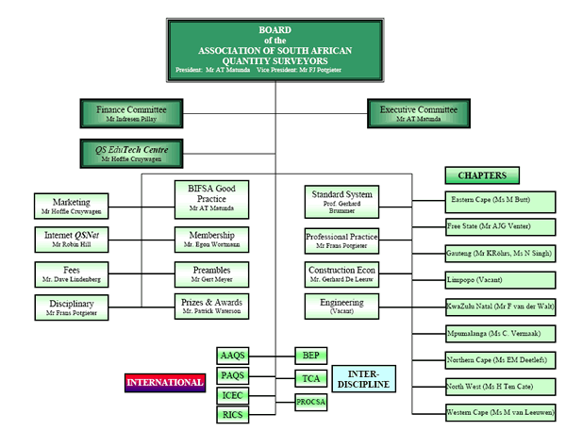
Organogram

Slide 6
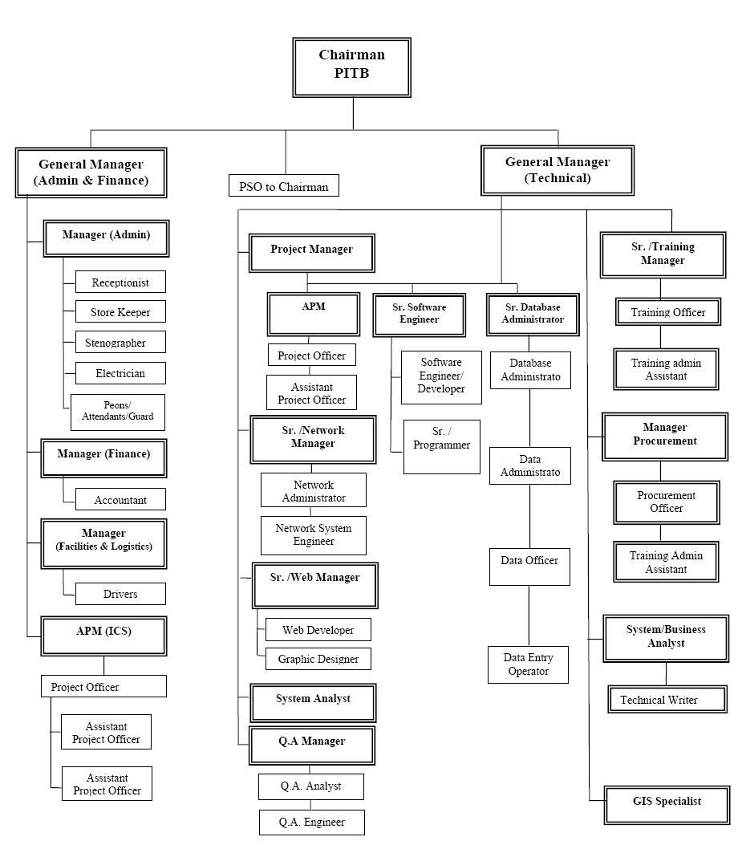
Organogram

Slide 7
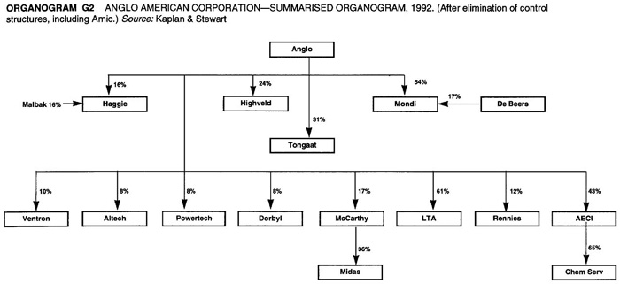
Organogram

Slide 8
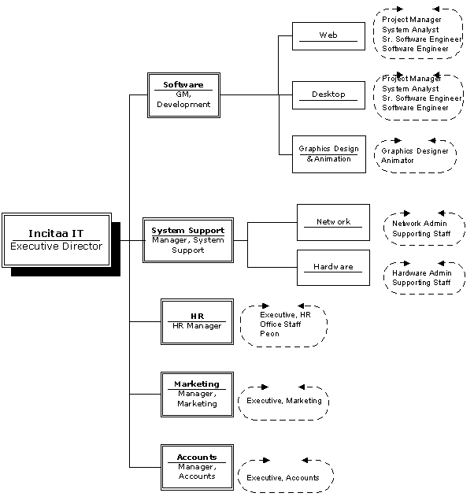
Organogram

Slide 9
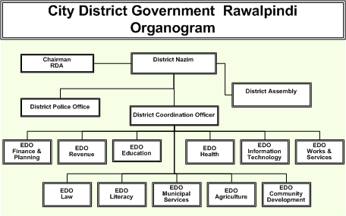
Organogram

Slide 10
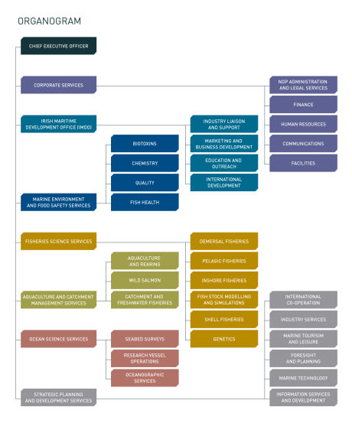
Organogram

Slide 11
Activity
On your own: draw up a list of potential organisational structuring principles.
In a pair, refine your list with your partner and:
Identify two structuring principles that could be used together
Identify two structuring principles that do not combine well
In a group of 4 refine the list further and come up with your best pair of principles that work together and the pair that do not work together. Try to think of a company that could use the pair you suggest in each case.

Slide 12
Some Structuring Principles
Function
Geography
Ownership
Product Line
Technology
Operational Structure
Depth of Hierarchy
Centralised versus decentralised
What structure is appropriate to the size of company?

Slide 13
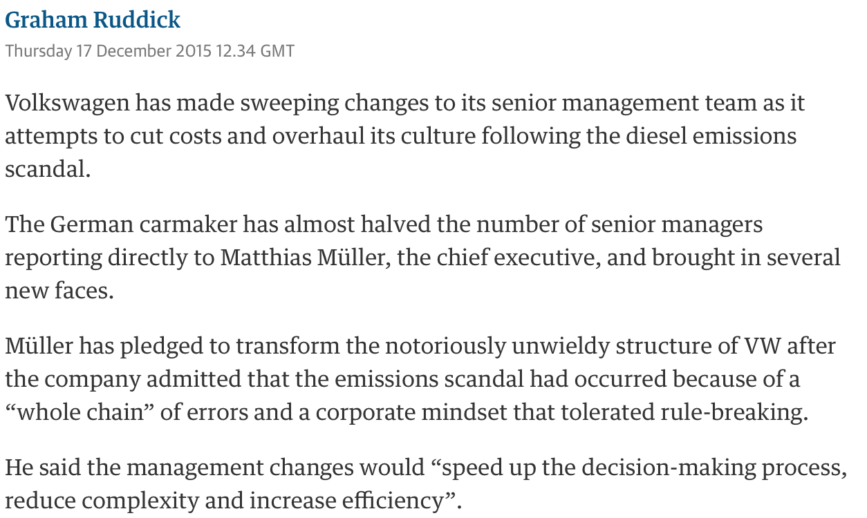
Guardian on VW Dieselgate

Slide 14
VW Response to Dieselgate
Key elements of the process optimization are:
Early documentation and interpretation of legislation around the world and alignment of the product portfolio with the legal requirements
Guidelines for the development of software for drive control units with documentation of the features with relevance for registration
Introduction of multiple controls for approvals in the product development process
Reorganization within Development for the purpose of separating the responsibility for the development of drives from official approvals
Formation of new bodies for cross-brand management and clarification of compliance issues
Uniform process standards and work instructions that give those involved legal certainty in the work process
Training programs in which everyone involved in the process is required to participate
Regular reporting to the Group Board of Management in order to create transparency in relation to the implementation status of this process optimization

Slide 15
Summary
Organisational structure is essential for larger organisations
Structure according to business priorities
All business structures make it difficult for the organisation to respond to some risks.
Structure to facilitate business and make it easy to respond to the most likely serious risks

Slide 16
Managers and Leaders

Slide 17
Managers and Leaders
One day you might want to be a manager or a director
What does that mean exactly?
What issues should you be sensitive to?
Depends on your seniority

Slide 18
Pause for Thought
Managers and Leaders
In pairs, what would you expect of:
A manager
A leader
In terms of:
The activity they carry out.
Their personal characteristics and skills.

Slide 19
The Manager
Develops plans and timetables
Organises
Delegates and monitors
Exercises control, applies corrective action
Communicates
Motivates
Delivers (predictable)
Looks inwards

Slide 20
Leader can emerge …
Perceived by group as most competent in leadership functions -
Task-orientated: coordinating, initiating contributions, evaluating, information seeking and giving, opinion seeking and giving, motivating
Socio-emotional: reconciling differences, arbitrating, encouraging participation, increasing cohesion

Slide 21
The Leader
Establishes direction
Develops vision
Communicates and inspires vision
Energises others
Innovates
Figurehead, Spokesman
Looks outwards

Slide 22
Summary
Managers manage, leaders lead
Managers have a specific role within the organisational structure:
Replaceable
Trainable
Leaders provide direction, may arise from anywhere:
Not easily replaceable
Not trainable

Slide 23
Controlling organizations

Slide 24
Organisation
A company is an instrument for maximising value for the shareholders
Driven by markets – lack of understanding of market = no customers = no business
Driven by resources – lack of understanding = lack of control
The more senior you become the more these will be concerns

Slide 25
Performance areas (Drucker)
Market standing
Innovation
Productivity
Physical and financial resources
Profitability
Worker performance and attitudes
Manager performance and development
Public responsibility

Slide 26
Markets and Marketing
Marketing is not stuff through your letter-box or people cold-calling you at 6pm.
Marketing is the business of understanding the market, your place in it, your opportunities, threats, competition and your customers
There exist many tools and models to help understand them

Slide 27
Porter’s 5 forces
New Entrants
Barriers to entry
Suppliers
Competitors
Buyers
Substitutes

Slide 28
Examples
New Entrant: Ford - Tesla
Substitute: Vinyl record – CD – iTunes - Spotify
Control of suppliers – Tesco
Control of buyers – monopoly
Control by buyers – perfect market; eBay?
Barriers to entry – Semiconductor industry – mobile phones…

Slide 29
P.E.S.T. / S.W.O.T.
Political
Economic
Social
Technological
Strengths
Weaknesses
Opportunities
Threats
(internal)
(external)

Slide 30
P.E.S.T. – car market
Political – emissions reduction targets
Works against internal combustion engines
Economic – control of rare earth production
Raises concerns over electric vehicles
Social – family size, behaviour
1-parent families – hatchbacks?
Millenials: Transport as a service
Technological – new products
Hydrogen, hybrids, recyclable materials

Slide 31
Marketing Mix – the 4 * Ps
Product
Quality, features, name, packaging, services, guarantee
Price
List price, discounts, credit
Promotion
Advertising, personal selling
Place
Distributors, retailers, locations, transport

Slide 32
Competition
Can compete on cost or differentiation:
Cost: make the same thing cheaper
Differentiation: make it different / better / here
Competitiveness based on core competencies
Anyone can make Coca-Cola
Only they have the network of licensed manufacturers and distributors (and the brand name)
Anyone can put an aircraft in the sky
Only the profitable airlines can fill it every time
Each survivor is uniquely superior to all others in some way and thus occupies a niche

Slide 33
Breakout
You are a horse-buggy whip manufacturer ca. 1910
Consider the market you are in, perform a PEST and SWOT analysis and indicate what market repositioning might be advantageous

Slide 34
S.W.O.T.
Horse-buggy whip manufacturer, 1910 sees horses making way for cars
Strength: has supply chain to reach buggy owners / future car owners
Weakness: product is horse-dependent
Threat: cars make product obsolete
Opportunity: reposition as supplier of driver accessories
Actually they didn’t and went out of business

Slide 35
Market repositioning
McDonalds
Royal Bank of Scotland
Burberry
Apple

Slide 36
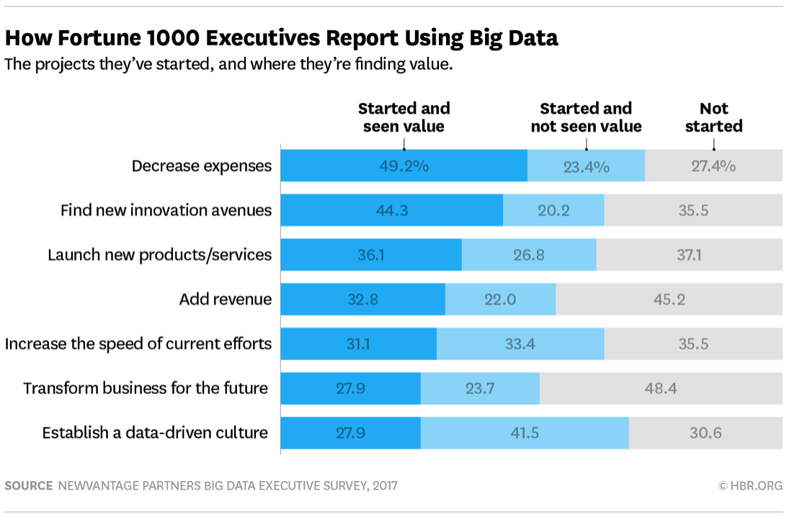
Data…

Slide 37
Summary
Successful organizations know their markets
Successful organizations are sensitive to changes in markets
Successful organisations measure what is going on in markets
Companies use data to support strategic decisions (and this is changing rapidly).

