Slide 1
Human Resources
Bott Chapter 9

Slide 2
What are Human Resources?
Hiring the right people
Keeping the balance of skills and expertise right for the work of the organisations.
Administration relating to employment
Complying with the law

Slide 3
Legal Context: HR Responsibilities
ensuring that recruitment, selection and promotion procedures comply with anti-discrimination legislation;
staff training and development;
setting up and monitoring remuneration policy;
setting up and monitoring appraisal procedures;
administering dismissal and redundancy procedures;
contracts of employment;
workforce planning;
designing and administering grievance procedures;
being aware of new legislation affecting employment rights and advising management of what the organisation must do to comply with it;
health and safety;
administering consultative committees.

Slide 4
Recruitment and Selection
Preparing a job description and further particulars
Disseminating the description
Selecting:
  Individual Interviews
  Panel Interview
  References
  Psychometric tests
  Situational assessment
  Task assessment
Drive is to more” evidence-based” approaches that avoid bias (unconscious or otherwise)

Slide 5
Edinburgh University JD Template
1. Job Details: Job title; School/Support Department; Unit (if applicable): Line manager:
2. Job Purpose (Normally no more than 2 or 3 sentences)
3. Main Responsibilities (Normally between 4 and 10. Percentages should total at least 95% (and no more than 100%))
4. Planning and Organising
5. Problem Solving
6. Decision Making
7. Key Contacts/Relationships
8. Knowledge, Skills and Experience Needed for the Job
9. Dimensions
10. Job Context and any other relevant information
Verification (JDs should be agreed by the relevant manager and individual job-holder or representative. Further verification may also be specified in some cases.)

Slide 6
Staff Training and Development
Job descriptions often are derived from role descriptions.
Role descriptions relate to a bureaucratic structure and identify the skills necessary to fulfill a particular role
Training and development in part are oriented to fit people to more senior roles so they are eligible for promotion.
Training can also be linked to development plans for the organisation to take account of the changing environment.

Slide 7
Administrative Role Profiles at Edinburgh University
Grade 5: Roles at this grade will be responsible for providing or contributing to the provision of support services to an agreed quality standard or specification, within clear procedures or practices. There will be minimal day to day supervision, but clear guidance. The roles require an understanding of the allocated workload but also to react to changing priorities. Initiative is needed to handle processes and resolve problems and queries based on procedures plus experience and judgment, mainly without reference to others. May involve supervision of other staff.

Slide 8
Administrative Role Profiles at Edinburgh University
Grade 6: Roles at this grade will be providing advice and support based on a detailed understanding of methods, systems and procedures gained through significant practical experience and/or formal training. They will exercise initiative and judgement to resolve daily problems within a range of established policies/procedures, seeking advice on more complex issues. There is discretion to determine short-term priorities and if applicable the priorities of a team of people involved in the same type of work. Contributions include proposing and implementing improvements to current working methods

Slide 9
Administrative Role Profiles at Edinburgh University
Grade 7: Roles at this grade will be providing advice and support to schools/departments/work units based upon a full understanding of a technical, professional or specialised field. They will plan and ensure progress within established professional procedures and university policy. They will be expected to identify
gaps in information, and conduct analyses to solve/resolve problems and issues with short-term consequences. They will put forward recommendations on managing more complex situations. Individuals will be responsible for planning and organising their own work or that of a team of colleagues who may be involved in different types of work and will encounter changing priorities. There will be a need for liaison and the co-ordination of activities, across a number of subsections of a school/department/university.

Slide 10
Remuneration Policies and Job Evaluation
Designing pay structures that reward individuals for work.
Critical to the retention of key staff.
Anti-discrimination legislations has led to an emphasis on equal pay for equal value
Scales provide overall structure
Job evaluation attempts to position roles/jobs in the structure:
  Non analytical – looks at the value of the role in the company.
  Analytical: attempts to decompose jobs into component skills.

Slide 11
Appraisal Schemes
Often an annual process
Provides a means to give feedback to employees and to encourage a forward look in terms of skills development, aspirations, …
Oriented towards objectives (Peter Drucker, Management by Objectives).
Review against objectives and performance measures.
Sometimes it is difficult to fit some activities into the framework

Slide 12
Redundancy, dismissal and grievance procedure
Fair dismissal:
  Lack of capability to do the job
  Misconduct
  It is illegal for the employer to employ the employee
  Redundancy
  “Other reasons” – but many are “unfair” e.g. on grounds of discrimination, because the employee is taking legal action to enforce their rights at work, ….

Slide 13
Redundancy and dismissal
Dismissal Process:
  Written statement of why dismissal is being considered
  Arrange a meeting where both sides can state their case
  Following the meeting the employee is informaed of the decision.
  Right of appeal to more senior manager
Other issues: constructive dismissal, takeovers and outsourcing, whistleblowing

Slide 14
Redundancy
Redundancy
  Employer no longer requires people to do a particular category of job (or fewer people)
  Employees entitled to compensation (subject to a legal minimum)
  Often employer seeks to reduce the number of employees in a particular category
    Traditionally selection was last-in, first-out (is this reasonable?)
    Often voluntary redundancy is offered (do you see any issues with this?)

Slide 15
UK Statutory Redundancy Pay
3. Redundancy pay
You’ll normally be entitled to statutory redundancy pay if you’re an employee and you’ve been working for your current employer for 2 years or more.
You’ll get:
half a week’s pay for each full year you were under 22
one week’s pay for each full year you were 22 or older, but under 41
one and half week’s pay for each full year you were 41 or older
Length of service is capped at 20 years.
If you were made redundant on or after 6 April 2017, your weekly pay is capped at £489 and the maximum statutory redundancy pay you can get is £14,670. If you were made redundant before 6 April 2017, these amounts will be lower.
Redundancy pay (including any severance pay) under £30,000 isn’t taxable.

Slide 16
Contracts of Employment
In most modern economies employees are required to have contracts (whether or not they are written)
Employees should understand their conditions of employment.
HR staff oversee the signing and record keeping around contracts.

Slide 17
Human Resource Planning
HR departments often get involved in resource planning:
  Characterizing the skills of the current workforce
  Characterizing the current workload and how effectively the workforce meets that workload
  Forecasting likely increases in workload and the pattern of workload
  Forecasting staff losses and gains
  Predicting the effects of takeovers etc on HR.

Slide 18
Summary
Human resources consider all aspects of getting the right people to do the work of the organisation.
This includes:
  Good processes for finding and hiring the right people
  Good processes to handle issues for individuals during employment
  Good processes to manage the balance of human resource against the organizational workload.

Slide 19

Edinburgh University Mission

Slide 20
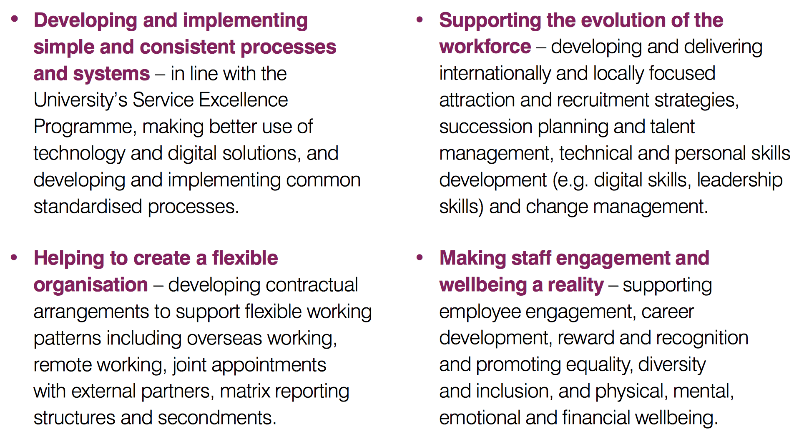
Edinburgh University HR Work Themes

Slide 21
Edinburgh University HR Work Practice
Simplification – ensuring that policies and processes are easy to access, easy to use and easy to understand
Facilitation – providing HR support that is focused on understanding business problems and providing practical solutions
Anticipation – adopting a planned approach to managing projects, anticipating and responding to the changing needs of customers and providing solutions that are fit for the future.

Slide 22
Edinburgh University HR Activities
provide advice and guidance to managers to help them carry out their management roles effectively
provide advice and guidance to staff on employment policies and processes
work in partnership with our recognised Trade Unions
maintain and manage systems and processes that support the employee lifecycle
ensure compliance with employment legislation and statutory reporting obligations

Slide 23
Working in Teams (may be SDP relevant)
(Adapted from Management School Talk)

Slide 24

Belbin Team Roles

Slide 25
Session Guide
Belbin team types
Implications / issues
Action planning

Slide 26
Context
Research by Meredith Belbin
Effective Teams
Key Roles for Success
Situation Dependent

Slide 27
Roles
Contribution to Team
Allowable Weaknesses
All of equal value
Dropped Points

Slide 28
Leadership Roles
Shaper
Co-ordinator

Slide 29
Creative Roles
Plant
Resource Investigator

Slide 30
……the other Roles
Monitor Evaluator
Implementer
Completer Finisher
Team Worker
Specialist

Slide 31
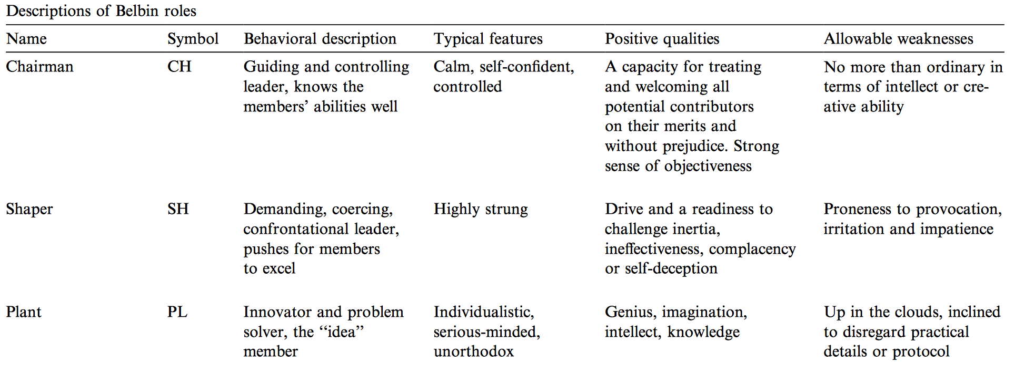
Belbin Roles
Sallie M. Henry, K. Todd Stevens,
Using Belbin's leadership role to improve team effectiveness: An empirical investigation,
In Journal of Systems and Software, Volume 44, Issue 3, 1999, Pages 241-250, ISSN 0164-1212

Slide 32
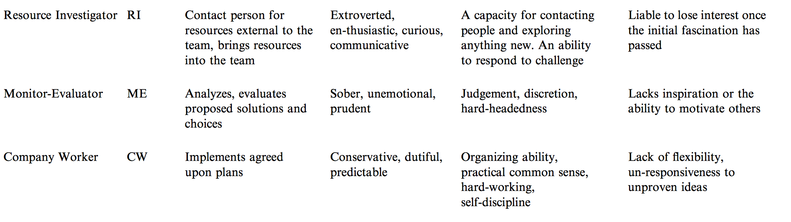
Belbin Roles

Slide 33
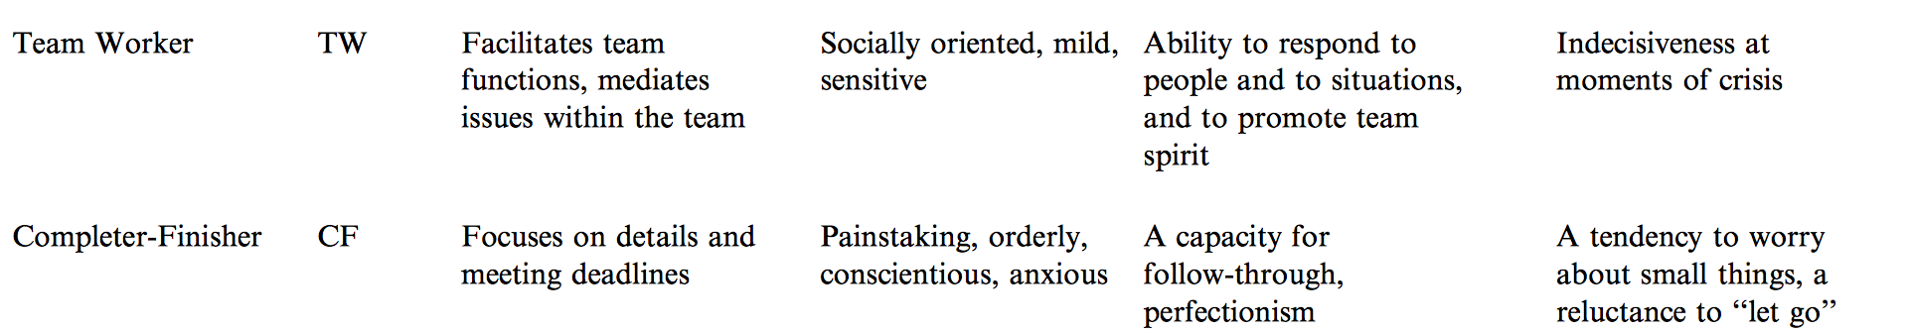
Belbin Roles

Slide 34
Belbin research findings
Roles can equally be applied to non-managers
Fisher, Hunter & Macrosson
Journal of Managerial Psychology, Vol.17 No.1, (2002)
Balanced teams perform better than biased teams
Shapers vs. Balanced
Pritchard & Stanton
Journal of Management Development, Vol 18, No.8, (1999)
No correlation between salary/status and team role
Dulewicz
Journal of Occupational & Organisational Psychology
Vol 68, Issue 2 (1995)

Slide 35
Belbin in UK Managers
1441 male / 355 female
Predicting team roles from established personality profiles
High validity suggested
Findings:
Suggested surplus of co-coordinators and resource investigators
Suggested dearth of Completers, Monitor Evaluators , Plants and Shapers……relatively few who have this as a primary or secondary role.
Lack of the balanced teams in UK industry
Fisher, Hunter & Macrosson
Personnel Review, Vol.29 No.2, (2000)

Slide 36
Belbin Team Types
Resource
Investigator
Ideas
Plant
Co-ordinator
Monitor
Evaluator
Optimal
Solution
Shaper
Clear goals,
objectives
Specialist
Completer
finisher
Implementer
Work
Success
Team
Worker

Slide 37
Career
Planning
Job Search
Written Application
Selection
Processes
Pro-active Follow-up
Plant
Strong on ideas
May lack focus
Research strong
Networking weak
Potentially unorthodox
Insensitive to company needs
May lack focus
May compete with others
Insensitive to company needs
Feedback seen as irrelevant
Learning minimised
Strong on ideas
Networking strong
May become disillusioned
Uncomfortable with medium
Thrives on group activities
OK
OK
OK
Finds self-marketing difficult
Prefers group activities
May undersell self
Strength
Career Planning
Job Search
Written
Application
Selection
Process
Pro-active
Follow-up
Action focus – less emphasis on planning
May set unrealistic goals
High expectations and self belief
May oversell achievements
May oversell self
May compete with others
Feedback seen as irrelevant
Learning minimised
Plant
Strong on ideas
May lack focus
Research strong
Co-ordinator
Belbin and Career Management
Co-ordinator
Shaper

Slide 38
Belbin and Career Management

Slide 39
Belbin and Career Management

Slide 40
Summary
Insight into our own team role allows us to work on our strengths and weaknesses
A knowledge of team roles helps us build balanced teams
A knowledge of team roles helps us develop more effective teams
"When he took time to help the man up the mountain,
lo, he scaled it himself.“
Tibetan Proverb

