Slide 1
The GDPR and Its Implications On Cloud Services
September 2017
Norm Barber, Managing Director
(normb@unifycloud.com)

Slide 2




UnifyCloud LLC – General Background
A rapidly growing and successful Redmond, WA-based solutions developer with significant technical resources located in the US and India. Our global focus is on Cloud, Cybersecurity, Compliance (regulatory) and Cost.
Effectively migrating from a traditional, on-premises IT environment to a Hybrid IT environment that may include elements of SaaS, IaaS, and PaaS requires a logical set of steps.
As Gartner has noted, “An organization cannot simply ‘jump’ to the Cloud. There need to be activities that are part of a phased evaluation and plan to move to the Cloud.”
Discover
Assess
Target
Migrate
Monitor
The General Data Protection Regulation (GDPR) impacts the entire Cloud (SaaS, IaaS, PaaS) journey

Slide 3
Disclaimer
This presentation is a commentary on the GDPR, as UnifyCloud LLC interprets it, as of the date of publication. We’ve spent a lot of time with GDPR and like to think we’ve been thoughtful about its intent and meaning. But the application of GDPR is highly fact-specific, and not all aspects and interpretations of GDPR are well-settled.
As a result, this presentation is provided for informational purposes only and should not be relied upon as legal advice or to determine how GDPR might apply to you and your organization. We encourage you to work with a legally qualified professional to discuss GDPR, how it applies specifically to your organization, and how best to ensure compliance.
UNIFYCLOUD LLC MAKES NO WARRANTIES, EXPRESS, IMPLIED, OR STATUTORY, AS TO THE INFORMATION IN THIS WHITE PAPER. This presentation is provided “as-is.” information and views expressed in this presentation, including URL and other Internet website references, may change without notice.

Slide 4
Today’s GDPR briefing topics
What is the GDPR
How to interpret the GDPR
Addressing GDPR compliance in the Cloud
GDPR Baseline approach
Case Study: Managing GDPR in Azure

Slide 5


Audience poll: GDPR key roles that will impact you
Controller (from GDPR)
“…the natural or legal person, public authority, agency or other body which, alone or jointly with others, determines the purposes and means of the processing of personal data; where the purposes and means of such processing are determined by Union or Member State law, the controller or the specific criteria for its nomination may be provided for by Union or Member State law.”
Processer (from GDPR)
“… a natural or legal person, public authority, agency or other body which processes personal data on behalf of the controller.”
Solution Purveyor
CSV
ISV
Consultant

Slide 6
Poll:
How ready are you?

Slide 7
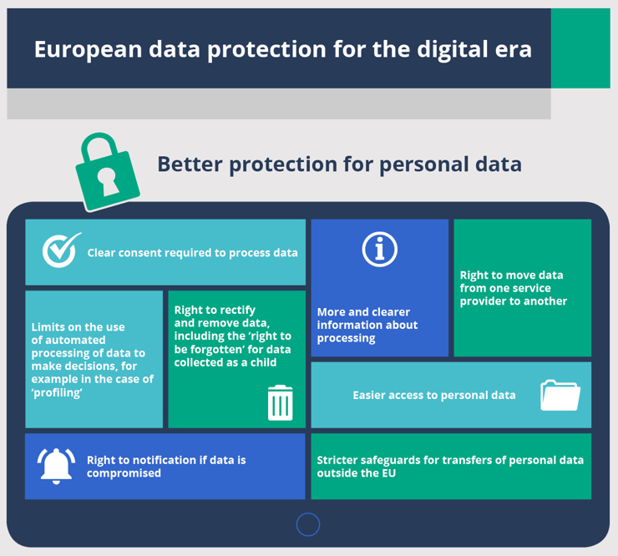
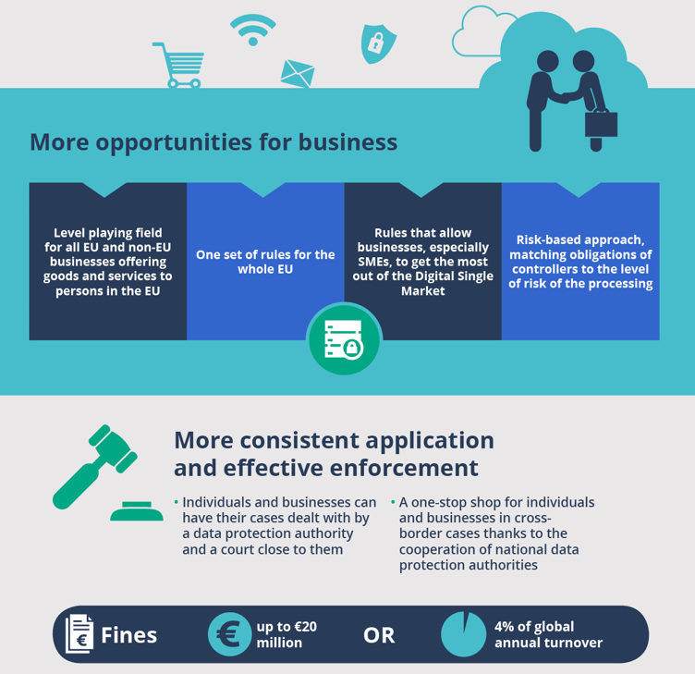

GDPR key drivers for May 25, 2018 enforcement (in effect as of 5/4/16)
Updates and modernizes the principles of the 1995 Data Protection Directive
Sets out the rights of the individual and establishes the obligations of those processing and those responsible for the processing of the data.
Establishes the methods for ensuring compliance as well as the scope of sanctions for those in breach of the rules.
Applies to all organizations doing business in the EU regardless of location.
Source:

Slide 8

GDPR data definitions regardless of nationality or EU residence
Personal Data (from GDPR)
“…means any information relating to an identified or identifiable natural person ('data subject'); an identifiable natural person is one who can be identified, directly or indirectly, in particular by reference to an identifier such as a name, an identification number, location data, an online identifier or to one or more factors specific to the physical, physiological, genetic, mental, economic, cultural or social identity of that natural person.”
Examples:
Name
Identification number (e.g., SSN)
Location data (e.g., home address)
Online identifier (e.g., e-mail address, screen names, IP address, device IDs)
Genetic data (e.g., biological samples from an individual)
Biometric data (e.g., fingerprints, facial recognition)
“The GDPR also requires compliance from non-EU organizations that offer goods or services to EU residents or monitor the behavior of EU residents.”
Source: Brief: You Need An Action Plan For The GDPR; Forrester Research; October 2016

Slide 9
GDPR compliance is a challenge for both controllers and processors
“By the end of 2018, over 50% of companies affected by the GDPR will not be in full compliance with its requirements.”
Gartner - Focus on Five High-Priority Changes to Tackle the EU GDPR; September 30, 2016
Enhanced personal privacy rights
The General Data Protection Regulation (GDPR) imposes new rules on organizations that offer goods and services to people in the European Union (EU), or that collect and analyze data tied to EU residents, no matter where they are located.
Increased duty for protecting data
Mandatory breach reporting
Significant penalties for non-compliance

Slide 10
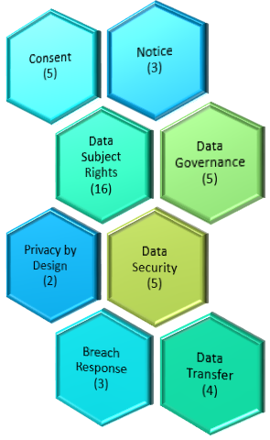
Controller’s (or your customer’s) GDPR compliance model
43 GDPR Requirements*
Provide notification to data subjects, in clear and plain language.
Request and obtain the data subject’s affirmative and granular consent.
Discontinue with processing activities if the data subject denies consent.
Provide a mechanism for data subjects to withdraw consent.
Obtain affirmative consent from a child’s (under age of 16) parent or guardian.
GDPR Regulation (261 pages)
“…organizations must demonstrate that they have implemented appropriate measures to mitigate privacy risks. Even in the absence of a privacy breach or customer complaint, regulators may require firms to exhibit evidence of their compliance and risk management strategies, including a privacy impact assessment (PIA) when appropriate.”
Source: Brief: You Need An Action Plan For The GDPR; Forrester Research; October 2016
* UnifyCloud LLC GDPR interpretation. You are encouraged to complete your own GDPR interpretation

Slide 11
Controller’s (or your customer’s) GDPR compliance model
43 GDPR Requirements*
Provide notice of processing activities at the time personal data is obtained.
Provide notice of processing activities if personal data has not been obtained directly.
Provide the data privacy notice at all points where personal data is collected.
GDPR Regulation (261 pages)
* UnifyCloud LLC GDPR interpretation. You are encouraged to complete your own GDPR interpretation

Slide 12
Controller’s (or your customer’s) GDPR compliance model
43 GDPR Requirements*
Provide mechanism for validating identity of the requesting data subject.
Provide mechanism for to request access to their personal data.
Provide a mechanism to respond to requests on personal data access.
Maintain the technological ability to trace and search personal data.
Provide mechanism to request rectification and rectify personal data.
Provide a mechanism to request the erasure of personal data.
Maintain the technological ability to locate and erase personal data.
Track to which additional controllers personal data has been transferred.
GDPR Regulation (261 pages)
* UnifyCloud LLC GDPR interpretation. You are encouraged to complete your own GDPR interpretation

Slide 13
Controller’s (or your customer’s) GDPR compliance model
43 GDPR Requirements*
When personal data is made public, contact those entities for data erasure.
Provide mechanism to request the restriction of data processing.
Maintain the technological ability to restrict processing of personal data.
Provide mechanism to request copies and transmit personal.
Provide mechanism to respond to data portability requests.
Locate personal data and export in structured, machine-readable formats.
If processing for direct marketing, provide mechanism to object.
Maintain the technological ability to discontinue the data processing.
GDPR Regulation (261 pages)
* UnifyCloud LLC GDPR interpretation. You are encouraged to complete your own GDPR interpretation

Slide 14
Controller’s (or your customer’s) GDPR compliance model
43 GDPR Requirements*
Maintain audit trails to demonstrate accountability and compliance.
Maintain inventory of data detailing categories of data subjects.
Maintain auditable trails of processing activities.
Carry out data protection impact assessments of processing operations.
Provide the de-identification of personal data for archiving purposes.
GDPR Regulation (261 pages)
* UnifyCloud LLC GDPR interpretation. You are encouraged to complete your own GDPR interpretation

Slide 15
Controller’s (or your customer’s) GDPR compliance model
43 GDPR Requirements*
Embed privacy controls (in service and development lifecycle).
Embed privacy designed to minimize the amount of personal data collected.
GDPR Regulation (261 pages)
* UnifyCloud LLC GDPR interpretation. You are encouraged to complete your own GDPR interpretation

Slide 16
Controller’s (or your customer’s) GDPR compliance model
43 GDPR Requirements*
Provide mechanism to pseudonymize, encrypt, or otherwise secure personal data.
Implement security measures in the service.
Confirm ongoing confidentiality, integrity, and availability of personal data.
Provide mechanism to restore the availability and access to personal data.
Facilitate regular testing of security measures.
GDPR Regulation (261 pages)
* UnifyCloud LLC GDPR interpretation. You are encouraged to complete your own GDPR interpretation

Slide 17
Controller’s (or your customer’s) GDPR compliance model
43 GDPR Requirements*
Controllers notify DPA within 72 hours in the event of a data breach incident.
Controllers notify affected data subjects of a high-risk data breach incident.
Processors notify controllers without undue delay of a data breach incident.
GDPR Regulation (261 pages)
* UnifyCloud LLC GDPR interpretation. You are encouraged to complete your own GDPR interpretation

Slide 18
Controller’s (or your customer’s) GDPR compliance model
43 GDPR Requirements*
Track and record personal data that is forwarded to third-parties.
Provide mechanism for tracking and recording data transfers in and out of the EU.
Maintain inventory of data transfer contracts with third-parties.
Provide appropriate safeguards (e.g., Privacy Shield) for effective legal remedies.
GDPR Regulation (261 pages)
* UnifyCloud LLC GDPR interpretation. You are encouraged to complete your own GDPR interpretation

Slide 19

Controller’s (or your customer’s) GDPR compliance model
On Premises Compliance
GDPR Regulation (261 pages)
Business Processes & User Controls
Applications & Workload Features
Internal Audit
IT Infrastructure Controls

Slide 20






Controller’s (or your customer’s) GDPR compliance model
Cloud Compliance Model
GDPR Regulation (261 pages)
Business Processes & User Controls
Internal Audit
SaaS Applications & Workload Features
Cloud IT Infrastructure Controls

Slide 21

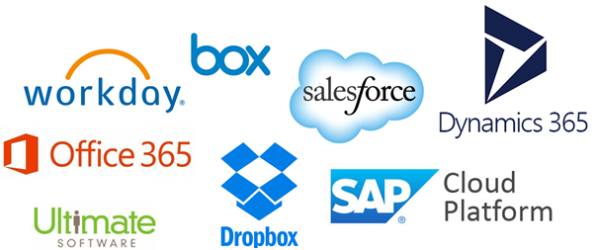
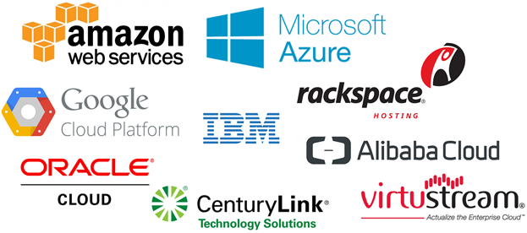
Controller’s (or your customer’s) GDPR compliance model
Cloud Compliance Model
GDPR Regulation (261 pages)
Business Processes & User Controls
Internal Audit
“So a dashboard through which your team can easily track that (capabilities) will come in handy.”
Source: Brief: You Need An Action Plan For The GDPR; Forrester Research; October 2016
SaaS Applications & Workload Features

Slide 22
Poll:
How many cloud services providers do you have?

Slide 23
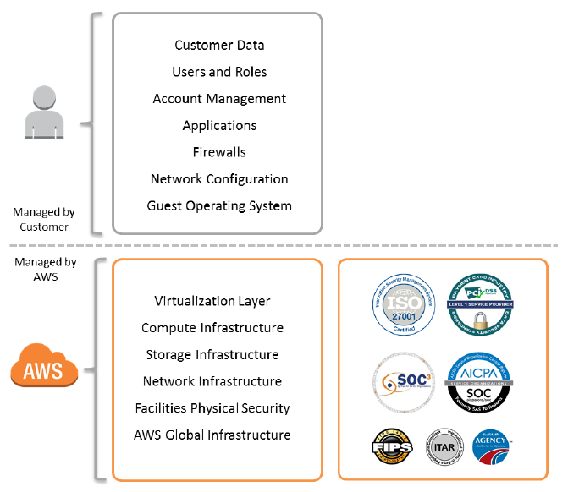
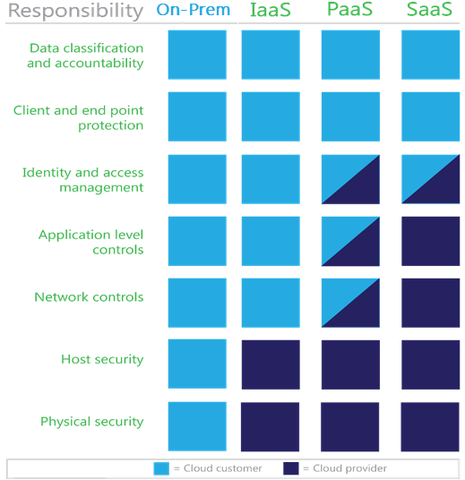

Understanding a Cloud shared responsibility model for GDPR
Source: Amazon Web Services
Source: Microsoft

Slide 24
What “managed by customer” means (from a typical SOC* report)…
Controls and reporting as well as configuration oversight excluded from a CSV platform SOC report
Controls over account / subscription IDs and passwords and access to applications.
Compliance with applicable laws/regulations.
Determining and implementing encryption for data.
Securing certificates used to access applications.
Selection of access mechanism for data.
Determining the Services configurations.
Backup of data to local / Cloud storage.
Protection of the secrets associated with accounts.
Implementing interconnectivity between Cloud and on-premises resources.
Security Development Lifecycle for applications.
Application QA prior to moving to Cloud production.
Monitoring the security of applications.
Reviewing and applying public security and patch updates (IaaS).
Reporting the incidents and alerts specific to systems and subscriptions.
Support timely responses with Cloud platform.
Implementing redundant systems for hot-failover.
* AICPA Service Organization Control (SOC) Reports (Type I and Type II) formerly Statement on Auditing Standards No. 70: Service Organizations (SAS 70)

Slide 25
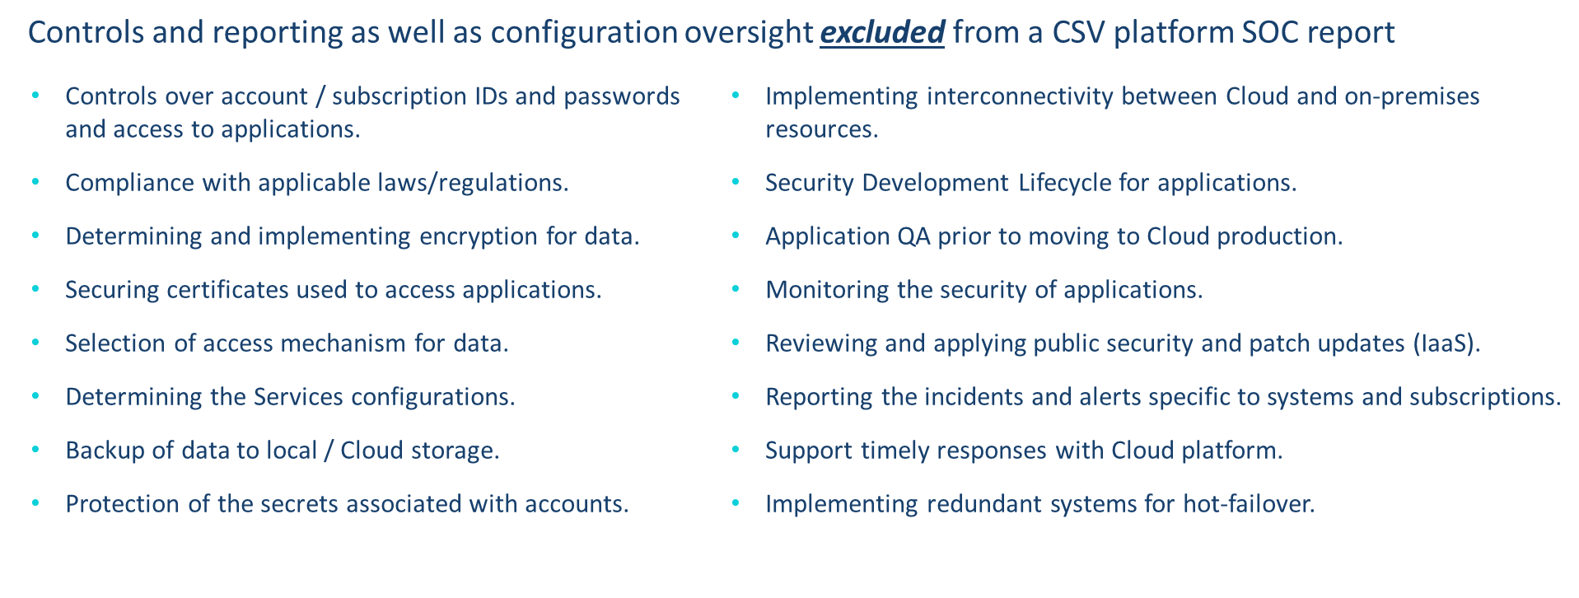
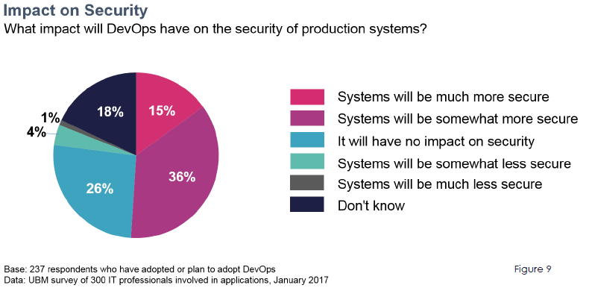
Using a GDPR baseline approach
An Cloud Service GDPR Baseline should include:
Cloud Services Compliance Validation (ISO, SOC)
Services Setting Values
DevOps Rules for Cloud Services
“However, in terms of security, while few respondents reported a decrease in production security, this is an area where DevOps has not yet contributed significant improvement. (See Figure 9) This may not be the fault of DevOps practices themselves–increasing security requires a deliberate effort–but it could point to an opportunity for tools vendors.”

Slide 26
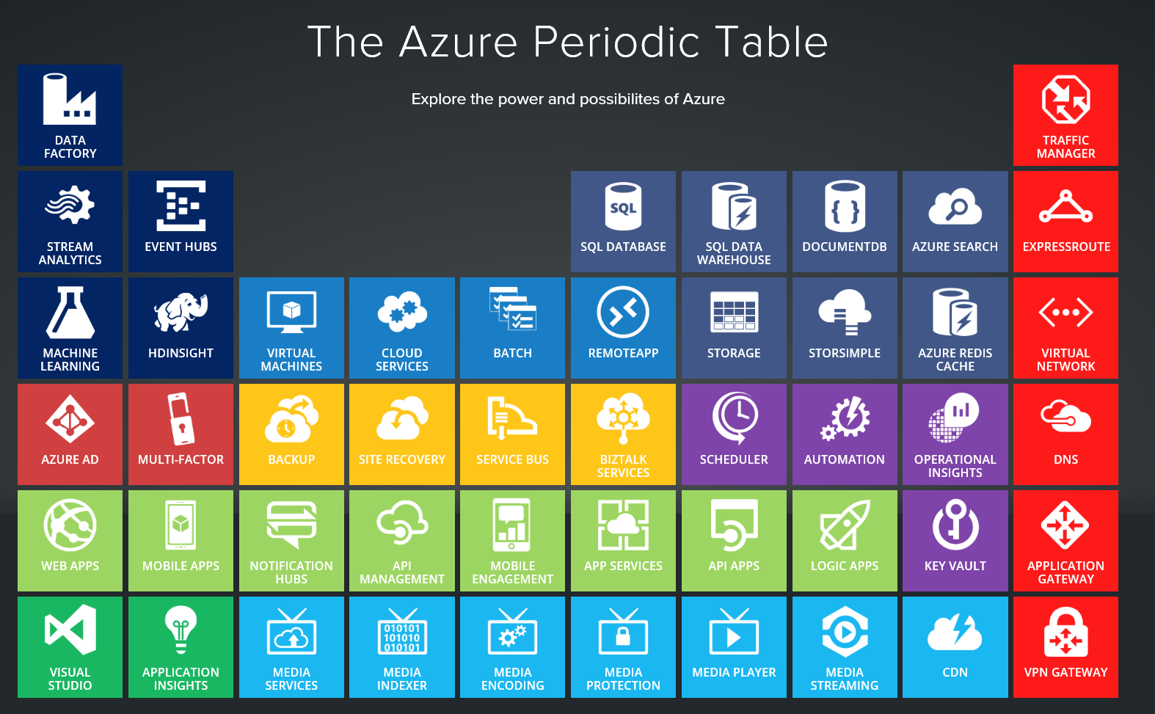
Case Study: GDPR Baseline Dashboard for Azure
130 deployable Azure Services (last count)
Some Services are candidates for GDPR defined “personal & sensitive data””
  Blob Storage
  Data Factory
  Data lake Store
  SQL Database
  SQL Data Warehouse
  StorSimple
Some Services are capabilities to help meet GDPR requirements:
  Azure AD
  Azure Information Protection
  Key Vault
  Multi-factor Authentication

Slide 27
Azure Services and GDPR compliance roles

Slide 28
GDPR baseline setting guidance for Azure Services

Slide 29
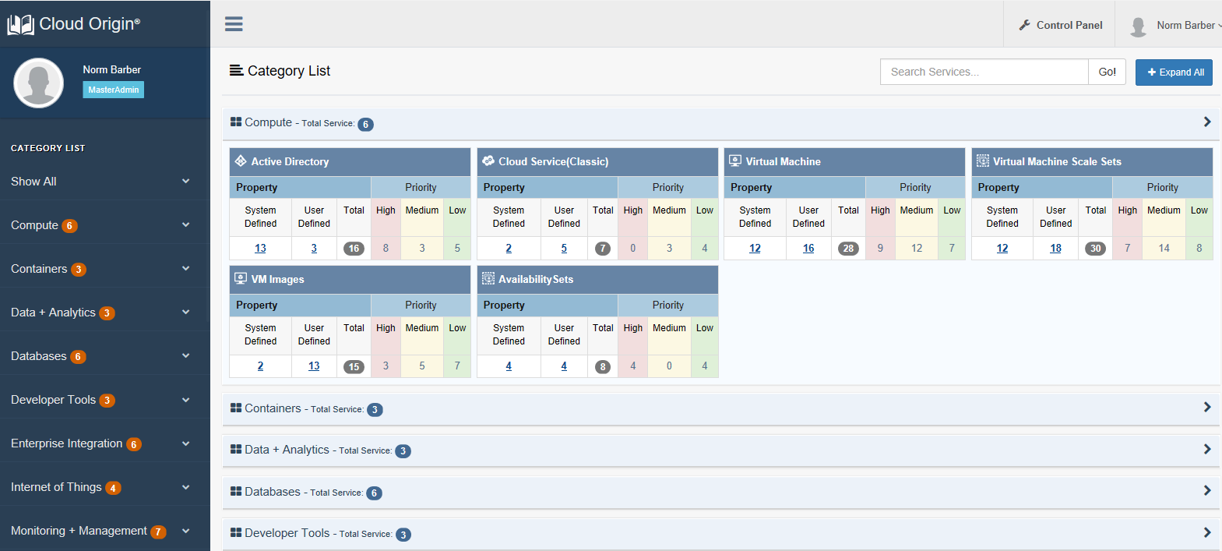
Creating a GDPR baseline

Slide 30
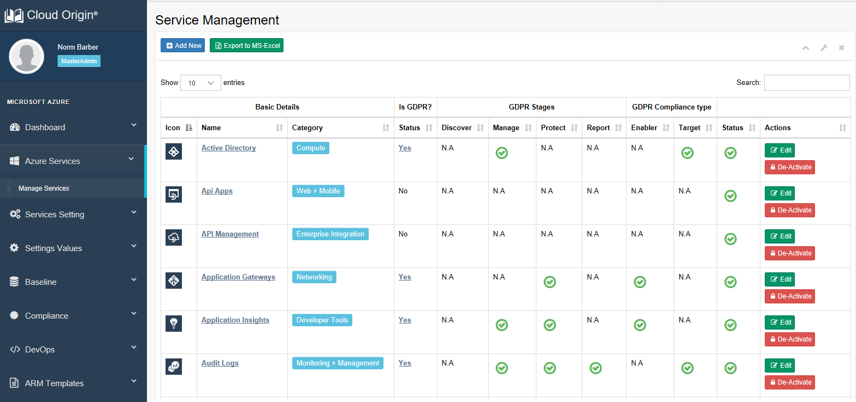
Creating a GDPR baseline

Slide 31
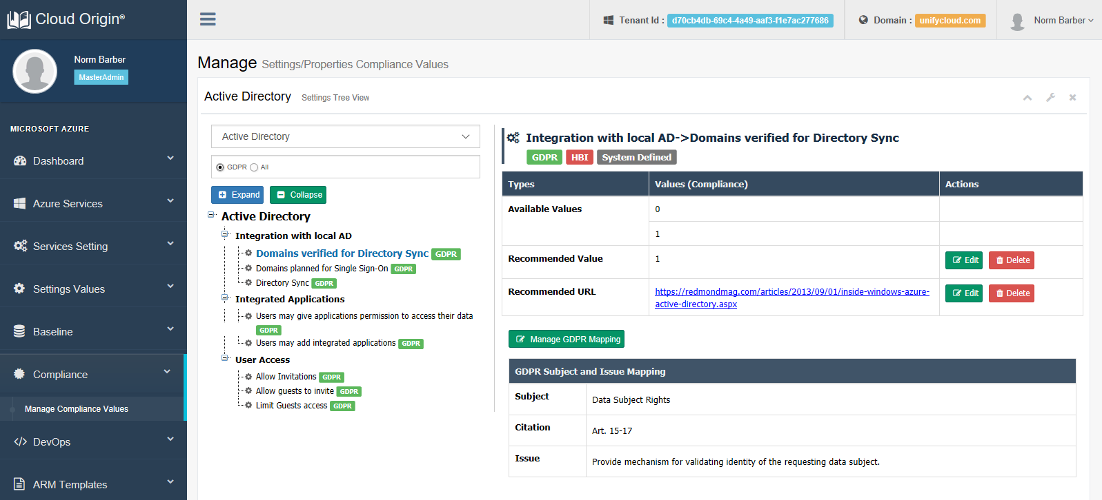
Creating a GDPR baseline

Slide 32
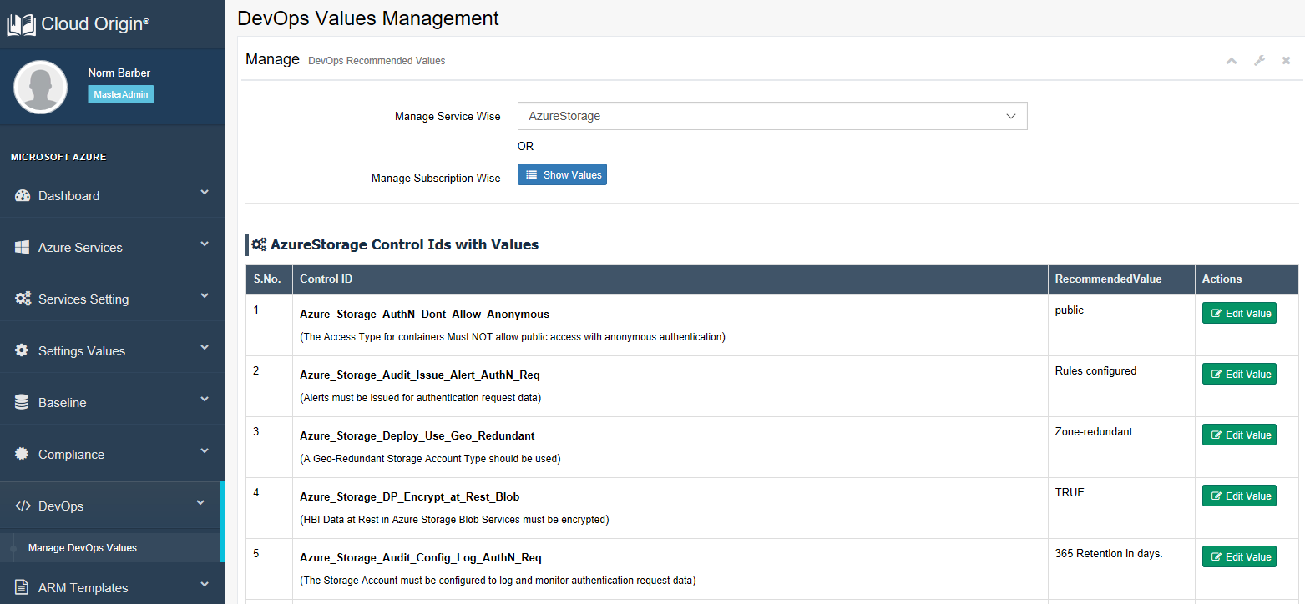
Creating a GDPR baseline

Slide 33
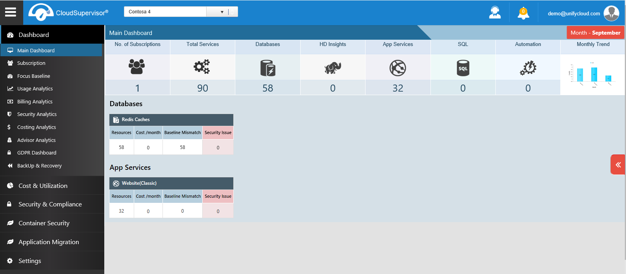
Monitoring a GDPR baseline

Slide 34
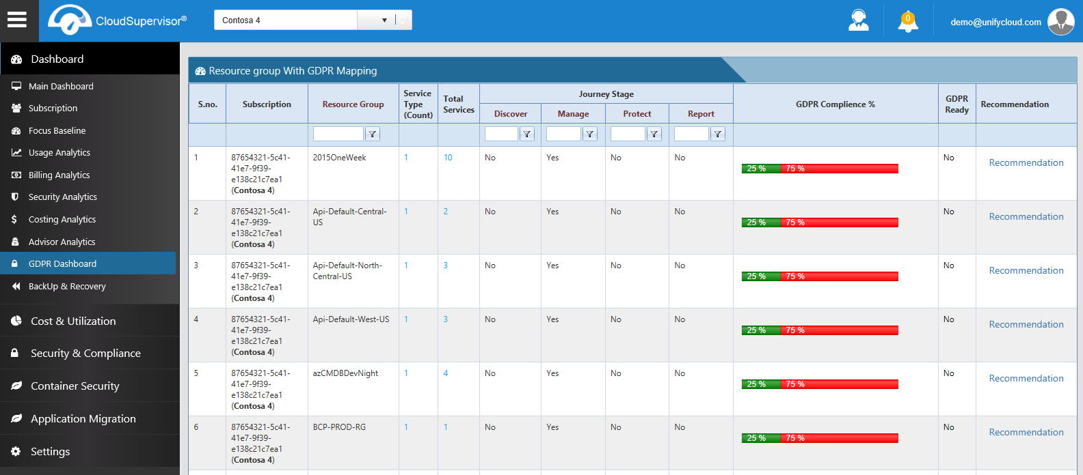
Monitoring a GDPR baseline

Slide 35
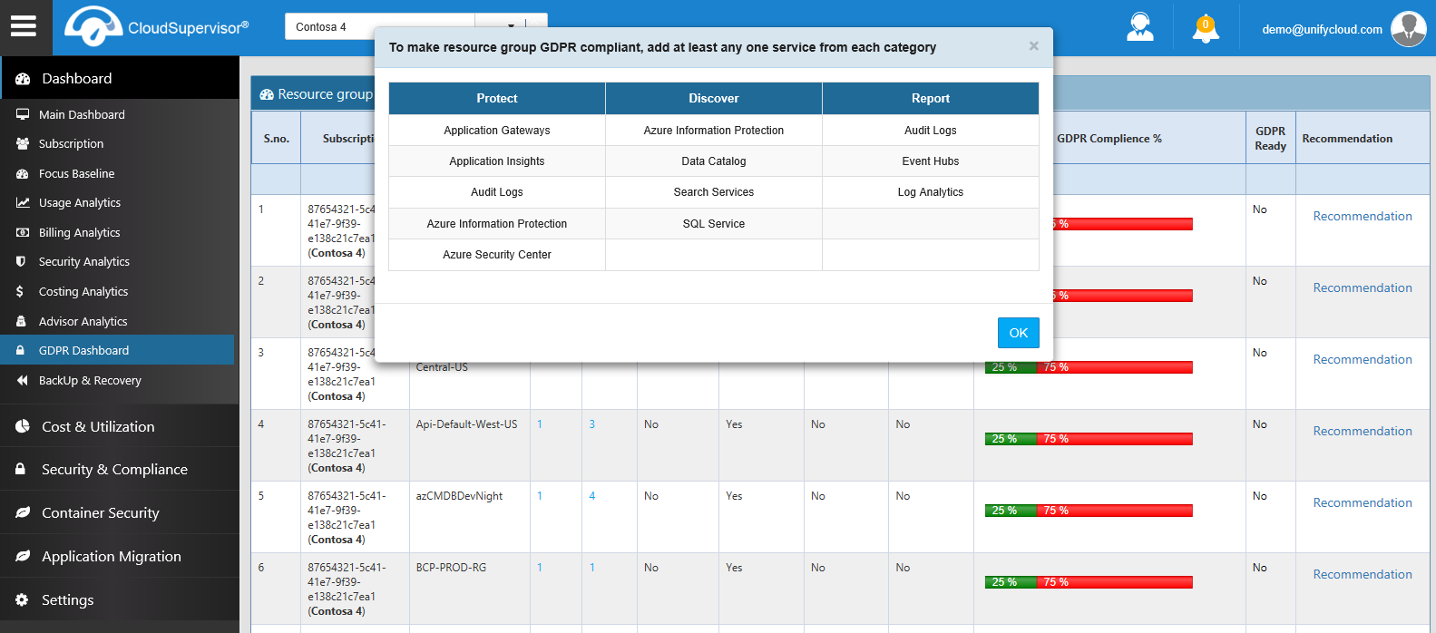
Monitoring a GDPR baseline

Slide 36
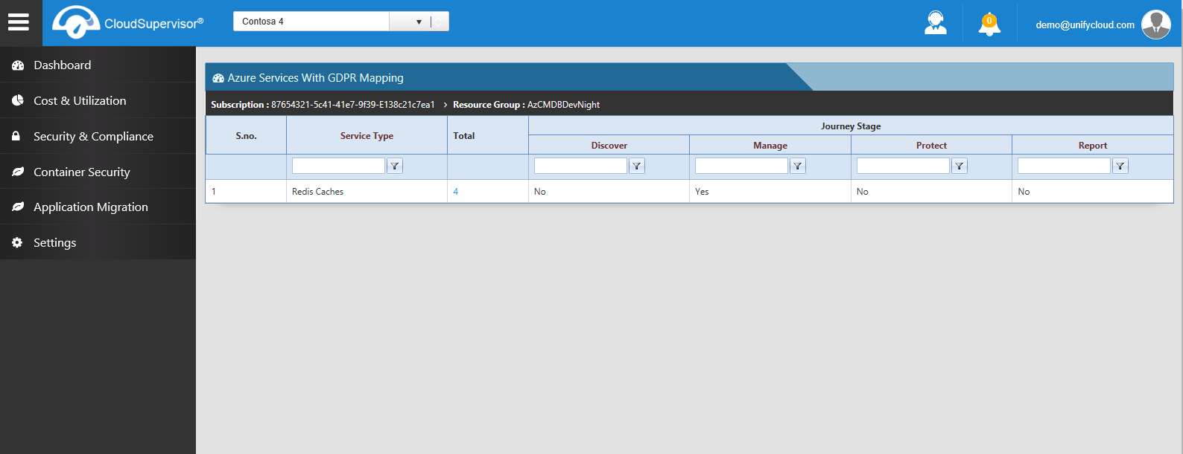
Monitoring a GDPR baseline

Slide 37
Summary
GDPR is in effect now and will be enforced starting on May 25, 2018
Cloud solutions (IaaS/PaaS and SaaS) will be part of a controller’s compliance model
Understand / interpret the GDPR requirements and map to processor features / controls
Consider using a GDPR baseline approach for areas where certifications do not apply
For vendors…do NOT imply using your solution will directly guarantee GDPR compliance
Thank you! Any final questions?

Slide 38
The GDPR and Its Implications On Cloud Services
September 2017
Norm Barber, Managing Director
(normb@unifycloud.com)
A copy of this presentation will be made available to you after the session ends. Visit www.cloudatlasinc.com for additional information about our solutions.

