Slide 1
Evolutionary Algorithms for Hyperparameter Optimization
MLP Project 2017-18
Group 52 – AID
Antonios Valais
Ian Mauldin
Dinesh Saravana Sundaram

Slide 2
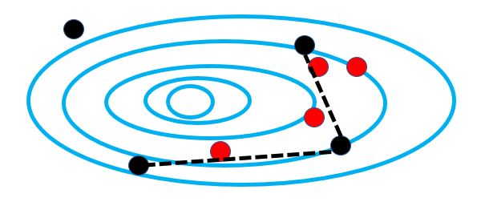
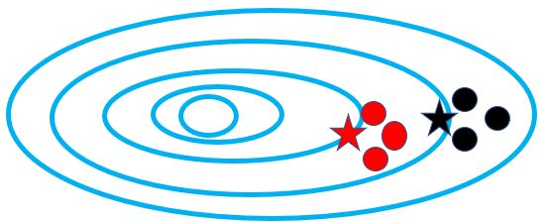
Evolutionary Algorithms:
Smarter nature-inspired search process
Uses fitness landscape
Genetic Algorithm (GA)
Evolutionary Strategies (ES)

Slide 3
Applying ES and GA to neural networks
EMNIST and OMNIGLOT classification with fully-connected networks
Hyperparameters
  Number of hidden layers
  Number of neurons
  Activation functions
  Learning rules
Encode hyperparameters in chromosome
Train each chromosome as a different neural network architecture
Fitness is performance on validation set
GA
Optimal Fitness (Classification Performance)

Slide 4
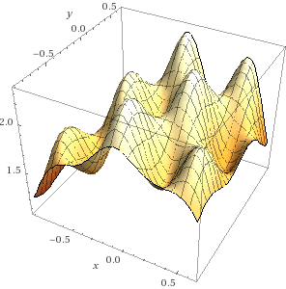
Conclusions
GA
  “Global” search process
    Have to define the initial bounds
    on hyperparameters
  Works on schemas
ES – Gradient based search
  “Local” search process
    Performance dependent on starting point
  Follows a gradient
    Can be trapped in local optima
GA + ES
  Combines advantages and mitigates of disadvantages of both search processes
  Found our best network architecture for OMNIGLOT

