Slide 1
Computer Graphics
Lecture 7: Path tracing
Kartic Subr

Slide 2


Incident or incoming radiance at x
$$n$$
$$x$$

Slide 3




Differential irradiance at infinitesimal patch
$\text{d}E_{i}$ = $L(x, ω_{i})\text{ (}ω_{i}\text{.}\text{n}\text{) }\text{d}ω_{i}$
$$n$$
radiance
$$L(x, ω_{i})$$
W m⁻²
differential irradiance at x,
due to one incident ray
W m⁻² Sr⁻¹
$$\text{d}ω_{i}$$
$$\text{dA}$$
$$x$$

Slide 4

Outgoing radiance along a direction
radiance
$$L(x, ω_{i})$$
$$L(x, ω_{o})$$
$$\text{d}ω_{i}$$
$$\text{dA}$$
$$x$$

Slide 5

Linear optics: reflected radiance ∝ irradiance
$L\left(x, ω_{o}\right)$ = $ρ(ω_{i},ω_{o})$ $\text{d}E_{i}$

Slide 6
Constant of proportionality is a function!
$L\left(x, ω_{o}\right)$ = $ρ(ω_{i},ω_{o})$ $\text{d}E_{i}$
Constant for a given pair of incident-outgoing directions
Determines appearance of opaque materials
Bidirectional Reflectance Distribution Function (BRDF)-

Slide 7


BRDF slice per incident direction
$$ω_{i}$$
$ρ(ω_{i},:)$
more light along
direction of specular reflection

Slide 8
BRDF slice per incident direction
$$ω_{i}$$
$ρ(ω_{i},:)$
more light along
direction of specular reflection

Slide 9
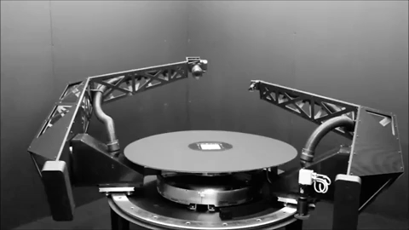
BRDF measurement - gonioreflectometer
tabulate 4D measured values?
[robotae]
http://www.cs.cmu.edu/afs/cs/academic/class/15462-f09/www/lec/lec9.pdf

Slide 10
phase functions
commonly used material models
BSDF
BSSRDF
SvBRDF

Slide 11

Reflection: multiple incident rays
$L\left(x, ω_{o}\right)$ = $\sum_{i}{ ρ(ω_{i},ω_{o}) \text{d}E_{i}}$
contributions for different directions weighted by BRDF

Slide 12

Add emission from surface at x
$L\left(x, ω_{o}\right)$ =$L_{e}\left(x, ω_{o}\right)$ + $\sum_{i}{ ρ(ω_{i},ω_{o}) \text{d}E_{i}}$
contributions for different directions weighted by BRDF

Slide 13

In the limit …
$L(x, ω_{o})$ = $L_{e}\left(x, ω_{o}\right)$. + $\int_{H^{2}}^{ }{ ρ\left(ω_{i},ω_{o}\right) L(x, ω_{i}) \text{(}ω_{i}\text{.}\text{n}\text{) }\text{d}ω_{i}}$
surface emission
hemisphere
BRDF
incident radiance
cosine dependence
… the rendering equation
[Kajiya 86]

Slide 14
The rendering equation
[Kajiya 86] https://dl.acm.org/citation.cfm?id=15902

Slide 15
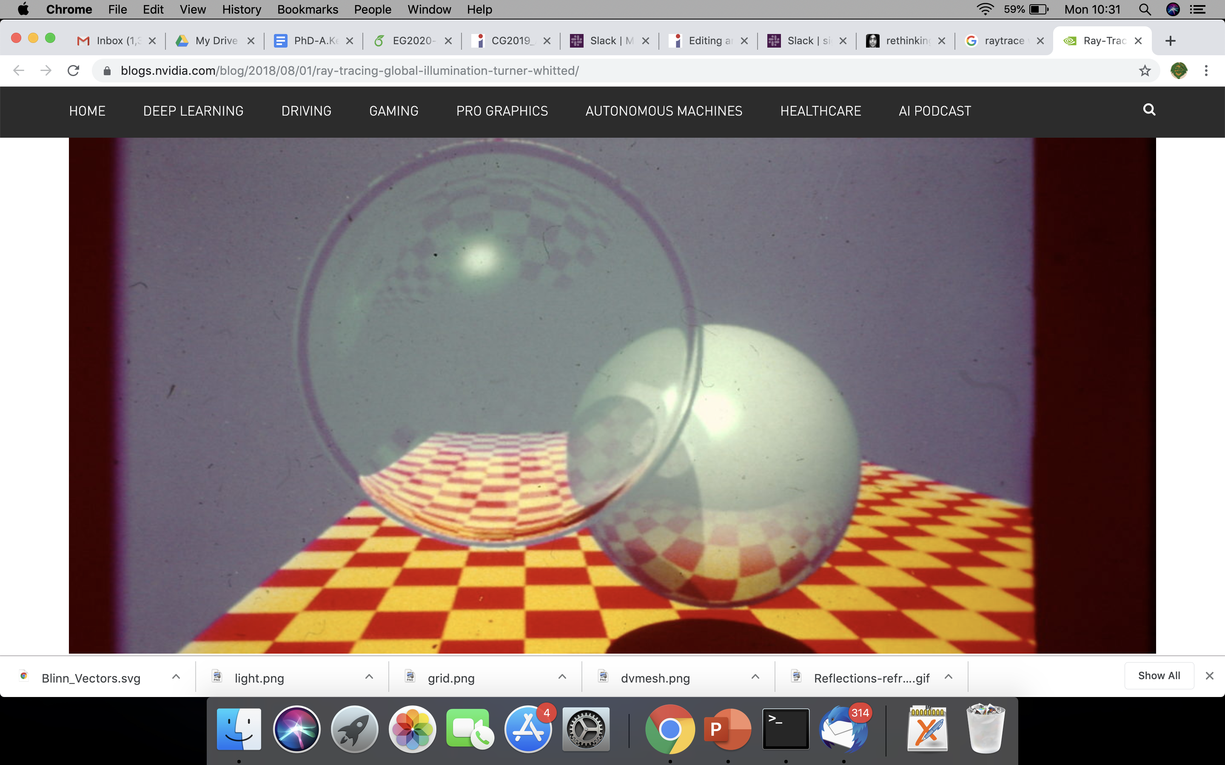
Contrast with Whitted raytracing
How to get ‘soft’ shading and lighting effects?

Slide 16
Solving the rendering equation

Slide 17


Estimate integrals recursively
1) Sample hemisphere at last bounce to camera

Slide 18
Estimate integrals recursively
1) Sample hemisphere at last bounce to camera
2) Trace each sample ray back to intersection

Slide 19
Estimate integrals recursively
1) Sample hemisphere at last bounce to camera
2) Trace each sample ray back to intersection
3) Sample those hemispheres
4) Recurse until k bounces
5) Use recursion results to estimate radiance

Slide 20
Estimate integrals recursively
k bounces with n samples each
= n^k samples per pixel
e.g. 8000 spp if n = 20 and k = 3

Slide 21
Let there be blur!
Numerical integration
aperture
time
materials
penumbra
Distributed ray tracing [Cook et al 1984]

Slide 22
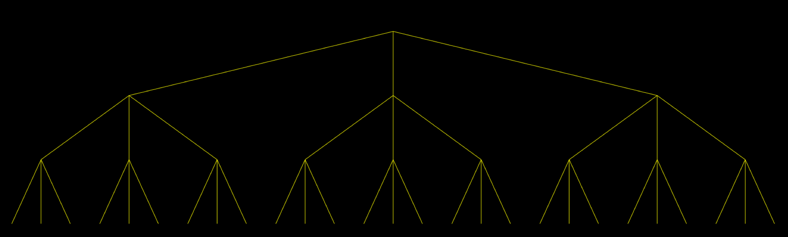
Whitted ray tracing – ray tree
primary ray
1 bounce
reflected ray
refracted ray
light ray
2 bounces
3 bounces : 3^3 = 27 rays

Slide 23
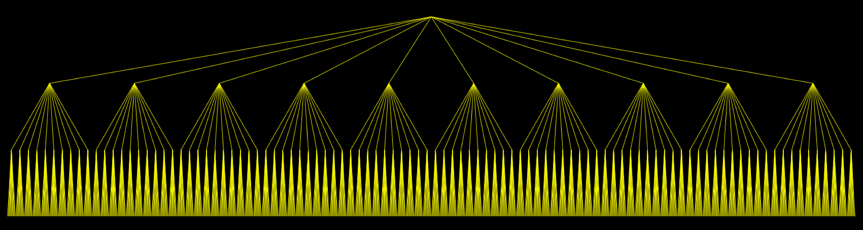
Distributed ray tracing – ray tree
primary ray
estimating integral by averaging
1 bounce
2 bounces
3 bounces : 10^3 = 1000 rays

Slide 24
Helps, but expensive!

Slide 25

Better way to solve the rendering equation?
estimating integral by averaging
path tracing [Veach98]

Slide 26

Random sampling at each level
x₁ drawn randomly in [0,1] x [0,1]

Slide 27
Random sampling at each level
x₂ drawn randomly in [0,1] x [0,1]

Slide 28
When to terminate?
x_{d} drawn randomly in [0,1] x [0,1]
?

Slide 29
When to terminate path?
Fixed depth d
When radiance is low
threshold
randomly
Russian roulette

Slide 30


More bounces? depends on scene
2 bounces
9 bounces
https://twitter.com/DisneyAnimation/status/1146085535057715200

Slide 31
Path tracing each pixel - overview
pixel area
2D
aperture
2D
2d+5 dimensions
N samples
per pixel
exp. time
1D
bounces
d*2D
pixel value = average radiance
(over sampled paths)

Slide 32
Path tracing: mapping samples to paths
pixel area
2D
aperture
2D
2d+5 dimensions
N samples
per pixel
exp. time
1D
map sample to path
& record radiance
randomly sample
the hypercube
bounces
d*2D
pixel value = average radiance
(over sampled paths)

Slide 33
Path tracing: mapping samples to paths
pixel area
2D
aperture
2D
2d+5 dimensions
N samples
per pixel
exp. time
1D
bounces
d*2D
randomly sample
the hypercube
map sample to path
& record radiance
pixel value = average radiance
(over sampled paths)

Slide 34
Path tracing - maths
pixel average radiance
pixel filter weighting
[https://jo.dreggn.org/path-tracing-in-production/2019/index.html

Slide 35
http://madebyevan.com/webgl-path-tracing/

Slide 36
Quiz + feedback
Define radiance
Define irradiance
Define BRDF
How would you obtain 1 from 2 and 2 from 1
Feedback on a scale of 1-10 (1-bad and 10-good)
Lectures are interesting
Lectures are difficult
I feel like I am learning, from this course
I am enjoying this course
Level of difficulty of tutorials
Recommendations for second half of the course (list one or two)
Describe (1-2 sentences) what changes you would recommend for material covered thus far, for the next offering of the course

