Slide 1
Computer Graphics
Lecture 5: Raytracing - continued
Kartic Subr

Slide 2
Recap
for each pixel p
trace ray
shade hit point
image credit
http://studiomaven.org/Context__Overview_of_Ray-Traced_Rendering.html

Slide 3
Intersection - continued

Slide 4
Shading - continued
final shading

Slide 5
Shading
diffuse reflection
ambient light
specular reflection
final shading

Slide 6
Shading
m^{th} light
ambient light
diffuse reflection
ambient light
specular reflection
final shading

Slide 7
Shading
m^{th} light
ambient light
diffuse reflection
ambient light
final shading
specular reflection
shininess coefficient

Slide 8
Phong shading
material property
ambient
diffuse
specular
light property
R is the mirror reflection direction
source:wikipedia

Slide 9
How to deal with texture?

Slide 10
How to deal with texture?
object space
texture space
mapping
texture coordinates

Slide 11
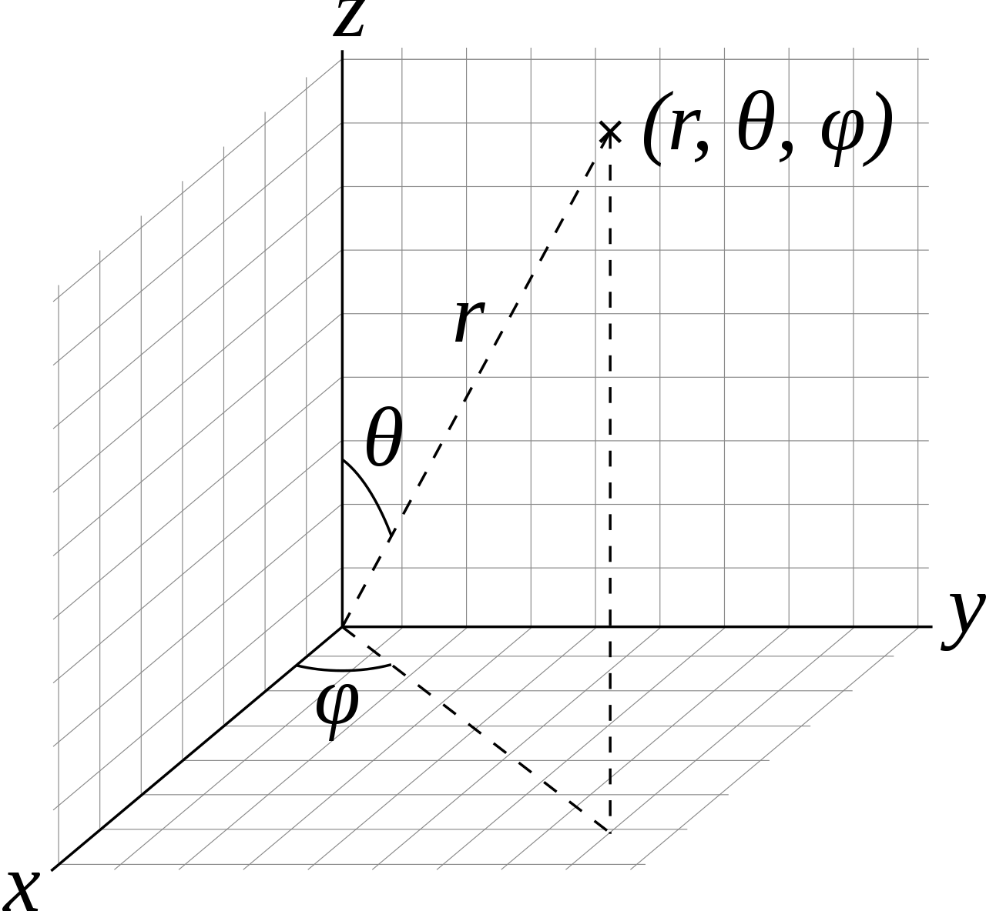
Texture coordinates on a sphere

Slide 13
Problems
How to generate maps?
Finite resolution
Artifacts
More later!
http://www.cemyuksel.com/courses/conferences/siggraph2017-rethinking_texture_mapping/rethinking_texture_mapping_course_notes.pdf

Slide 14
What’s wrong with this image?

Slide 15
Does not have any blur!

Slide 16
What causes blur?

Slide 17
A step function (edge)
pixel value
255
0
image

Slide 18
A blurred step function
pixel value
255
0
image

Slide 19
Fundamental operation?
255
255
?
0
0

Slide 20
Fundamental operation?
255
255
?
0
0

Slide 21
Sums of shifted functions!
f(x)
255
+
f(x-t₁)
0
+
f(x-t₂)
…

Slide 22
Sums of shifted functions!

Slide 23
Can you spot the “shifted sums” in each case?

Slide 24
Example: motion blur
integrate time

Slide 25
quality of numerical integration is key!
integrate time

