Slide 1
Computer Graphics
Lecture 4: Raytracing
Kartic Subr

Slide 2
Albrecht Dürer,
1525
Computer Graphics: Principles and Practice, Third Edition by Kurt Akeley, Steven K. Feiner, James D. Foley, David F. Sklar, Morgan McGuire, Andries van Dam, John F. Hughes

Slide 3
Johannes Vermeer 17th Century

Slide 4
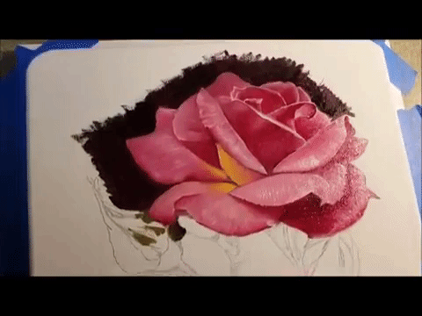
Vermeer’s comparator mirror
https://youtu.be/deAK0oV6Vt8

Slide 5
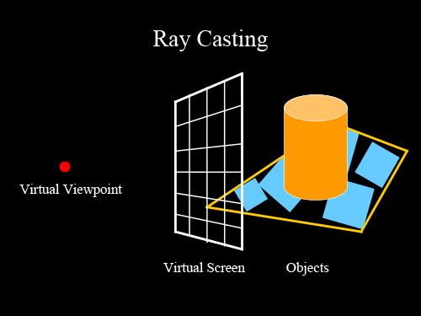
Ray casting
image credit
http://studiomaven.org/Context__Overview_of_Ray-Traced_Rendering.html

Slide 6
Ray casting
for each pixel p
cast ray r through p into the scene
test if r intersects objects in the scene
if yes
find closest intersection point h
shade h
else
return background colour (black)
endif
image credit
http://studiomaven.org/Context__Overview_of_Ray-Traced_Rendering.html

Slide 7
Ray intersection
p
r
intersection point ?

Slide 8
Ray – plane intersection

Slide 9
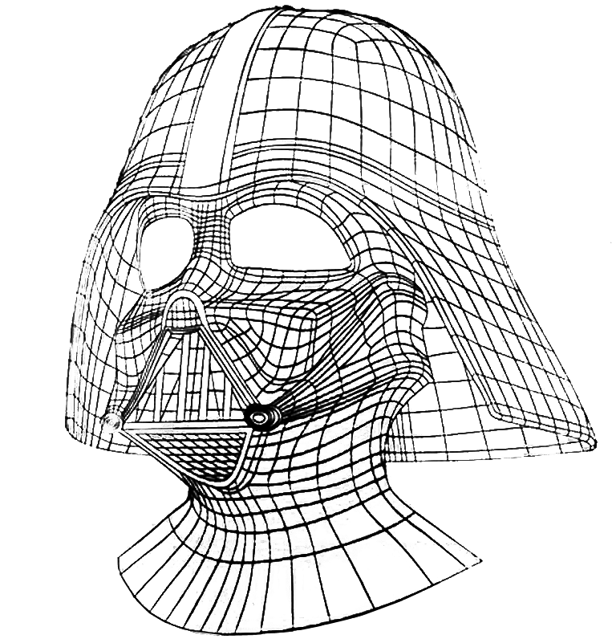
Computation: test many objects
hit!
missed

Slide 10
Acceleration data structures
grids
- uniform
- adaptivce e.g. octree
bounding box
- simple
- concave objects?
arbitrary bounding volume
- ‘tight’ but more tests
- concave objects?

Slide 11
Acceleration: bounding volume hierarchy

Slide 12
Acceleration: bounding volume hierarchy

Slide 13
Acceleration: bounding volume hierarchy
test ray at highest level
- recurse based on intersection result
Interested readers: slides

Slide 14
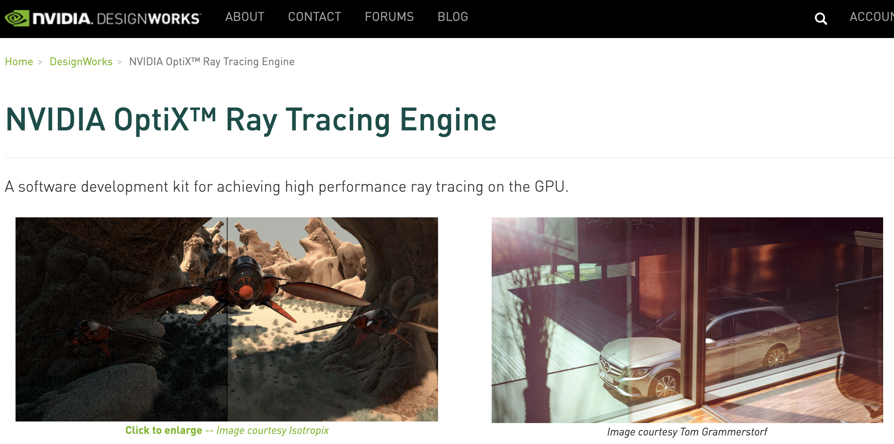
Ray intersection - GPU

Slide 15
Ray intersection - GPU
- Reduce computation time by executing parallel tests
Reduce number of tests via acceleration structures
trade off: building data structures and book-keeping
exploring data structures may not be easy or efficient

Slide 16
Shading
ambient light (constant)
+
diffuse
+
specular reflection of light

Slide 17
Phong shading
material property
ambient
diffuse
specular
light property
R is the mirror reflection direction
source:wikipedia

Slide 18
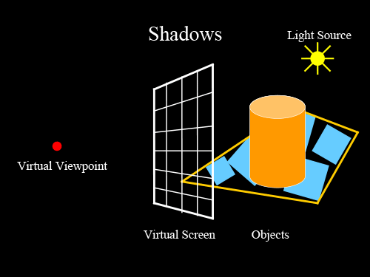
Shadows
image credit
http://studiomaven.org/Context__Overview_of_Ray-Traced_Rendering.html

Slide 19
Mirror (specular) reflection/refraction
image credit
http://studiomaven.org/Context__Overview_of_Ray-Traced_Rendering.html

Slide 20
Reflection

Slide 21
What’s new?

Slide 22
Resources
https://www.cs.utah.edu/~shirley/books/fcg2/rt.pdf
http://www.cs.utah.edu/~shirley/papers/rayedu.pdf
http://www.realtimerendering.com/raytracing/roundup.html
http://rtintro.realtimerendering.com/
https://benedikt-bitterli.me/tantalum/tantalum.html

