Slide 1
Computer Graphics
Lecture 3: Modelling
Kartic Subr

Slide 2
What is a model?

Slide 3
What is a model?
use (a system, procedure, etc.) as an example to follow or imitate.

Slide 4
materials
animation
lighting
geometry
textures

Slide 5
Search videos showing ‘effects breakdown’
https://www.youtube.com/watch?v=pTffQIFFYR8

Slide 6
Approaches to modelling
Artistic creation
maths
measurement

Slide 7
Approaches to modelling
Artistic creation
maths
measurement
Use physics
Repeated procedure
Analytical shapes (sphere)
3D scan
Photograph
Motion capture

Slide 8
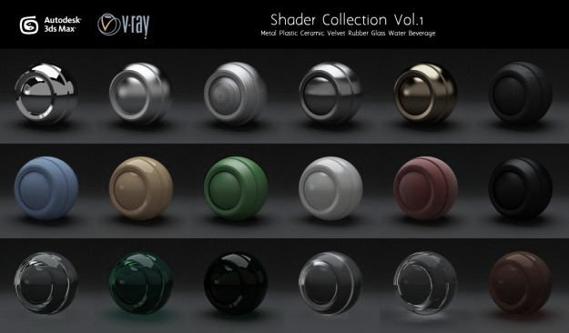
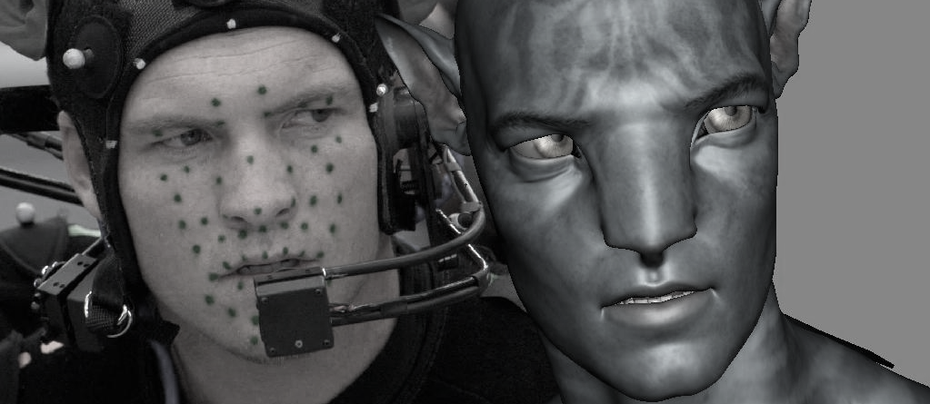

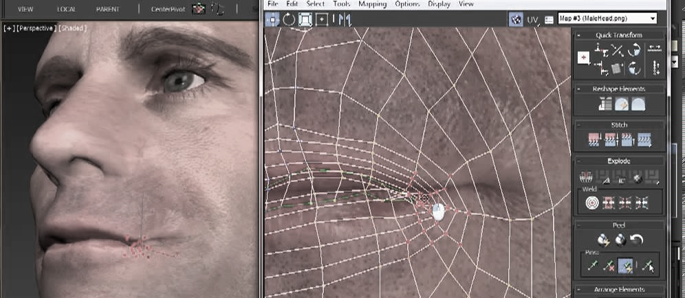
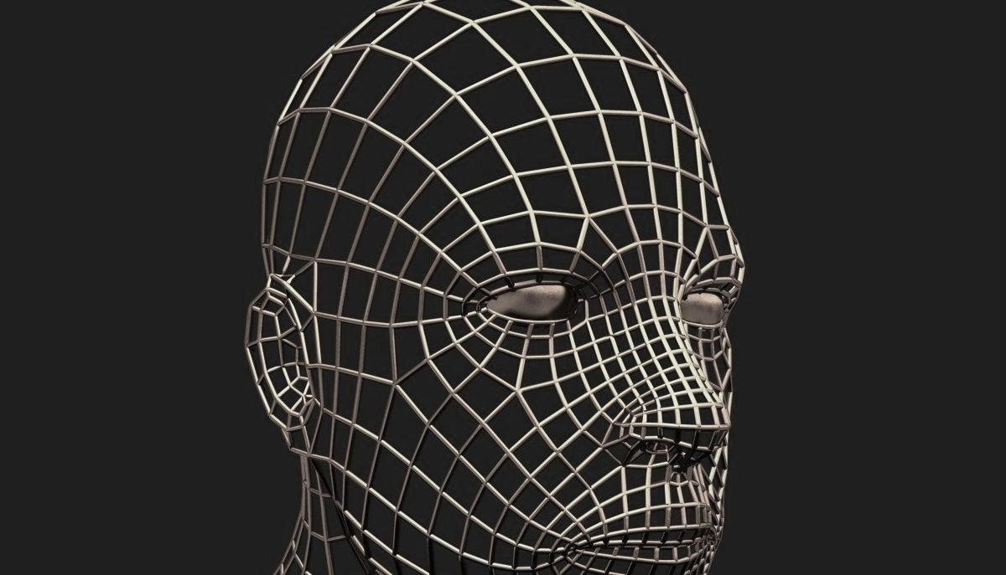
manually created models
artistic expression

Slide 10
measurement

Slide 12
mathematical models

Slide 13
3D shape representations
Implicit representation
Explicit representations
  primitives
  parametric

Slide 14
3D modelling – common approaches
constructive solid geometry
parametric surfaces
procedural modelling
https://www.cs.cmu.edu/~scoros/cs15869-s15/lectures/05-CSG_Procedural.pdf
http://www.inf.ed.ac.uk/teaching/courses/cg/lectures/slides16.pdf
https://www.cs.princeton.edu/courses/archive/spring03/cs426/lectures/16-procedural.pdf

Slide 15
Materials – common approaches
measured
parametric e.g. ggx, bssrdf
procedural modelling
more about this, later in the course …

Slide 16
Lighting

