Slide 1
Computer Graphics
Lecture 2: Imaging, Radiometry, Photometry
Kartic Subr

Slide 2
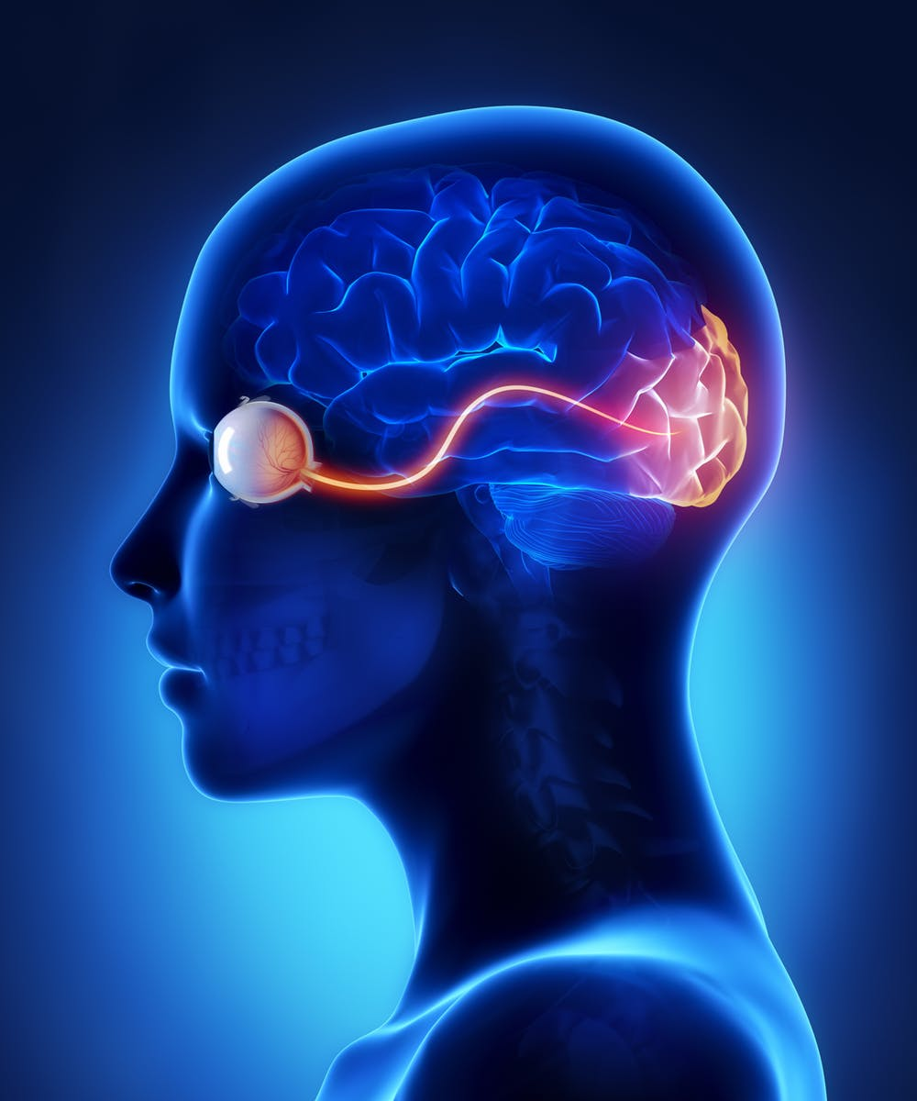
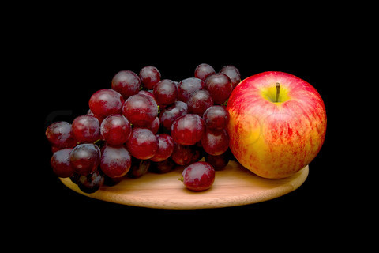
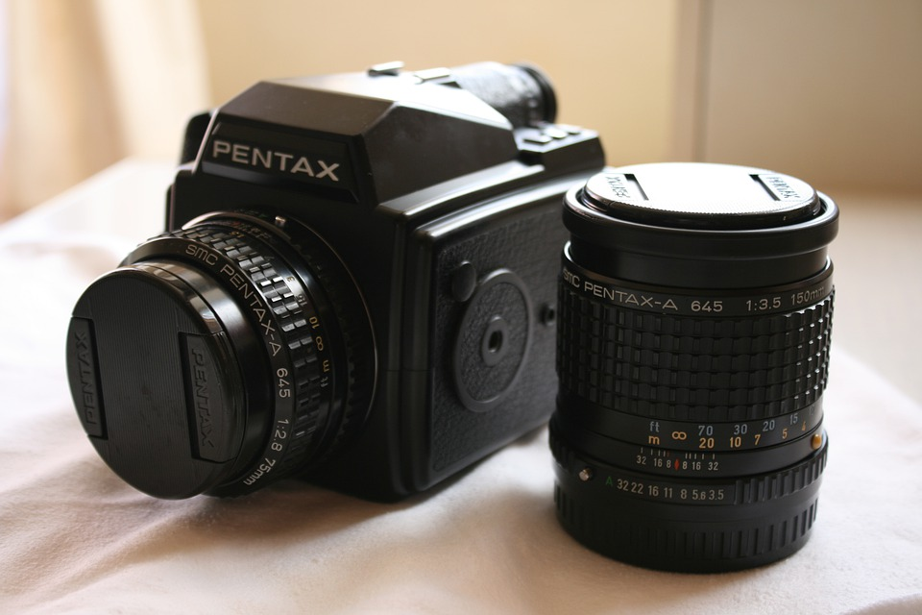
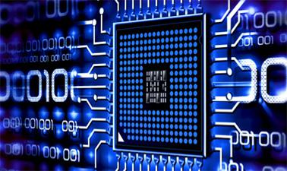
The big picture!
Real
photography
scene
camera
image manipulation
display
Human
visual system
rendering
Virtual

Slide 3
Energy in the scene

Slide 4
Energy in the scene -- Light
flux
irradiance
radiance

Slide 5
Energy in the scene -- Radiometry

Slide 6
Energy in the scene -- colour

Slide 7
The big picture!

Slide 8
Cameras
Notes:
8 bits per channel
Store energy in the scene
View, color, energy mapping

Slide 9
Cameras – thin lens
https://graphics.stanford.edu/courses/cs178-10/applets/thinlens.html
Notes:
8 bits per channel
Store energy in the scene
View, color, energy mapping

Slide 10
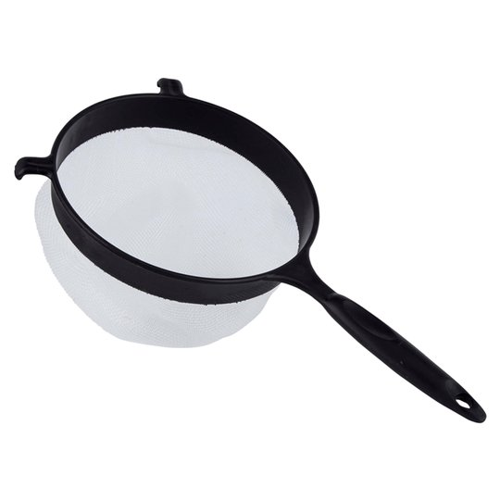
Cameras – sensors
https://www.visiononline.org/userassets/aiauploads/file/cvp_the-fundamentals-of-camera-and-image-sensor-technology_jon-chouinard.pdf
Notes:
8 bits per channel
Store energy in the scene
View, color, energy mapping

Slide 11
The big picture!

Slide 12
Displays

Slide 13
Displays
Radiance

Slide 14
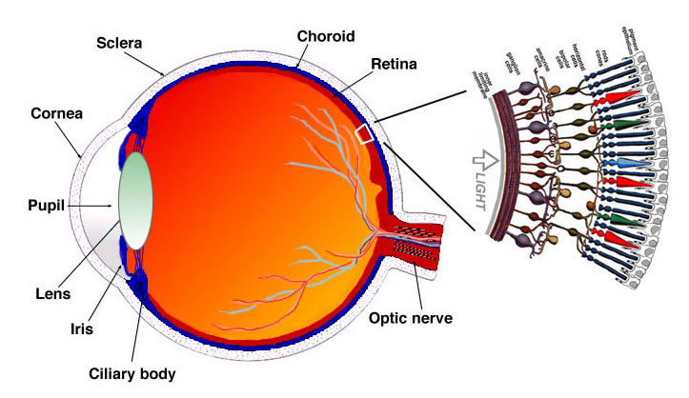
Human vision -- optics

Slide 15
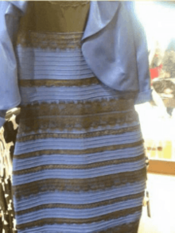
Human vision -- perception
http://persci.mit.edu/people/adelson/checkershadow_proof

Slide 16
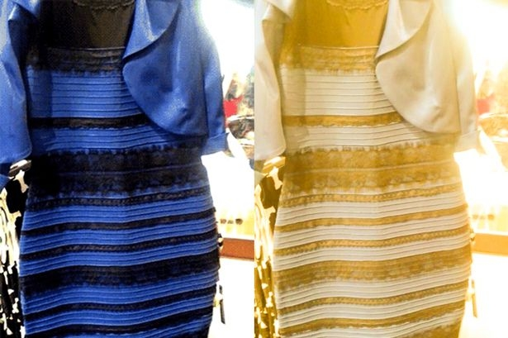
Human vision -- perception
http://persci.mit.edu/people/adelson/checkershadow_proof

Slide 17
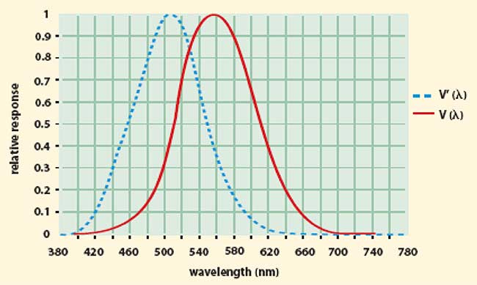
Perceived energy -- photometry
https://www.photonics.com/Articles/Photometry_The_Answer_to_How_Light_Is_Perceived/a25119
https://graphics.stanford.edu/courses/cs178-10/applets/colormatching.html

Slide 18
CG – account for all factors!

