Slide 1
Transform a function into a sum of Sinusoids?

Slide 2
Can we ‘operate on’ a vector?
operator
a
b
u
au + bv
=
c
d
v
cu + dv

Slide 3
Which vector – unaffected by operator?
?
a
b
u
u
=
constant
c
d
v
v

Slide 4
Which vector – unaffected by operator?
a
b
u
u
=
constant
c
d
v
v
Eigenvector of matrix

Slide 5
Continuous - Eigenfunctions
Eigenfunction of differential operator?
$$\frac{d}{dx}$$

Slide 6
Fourier analysis: origin and intuition
Eigenfunction of the differential operator
scaling
Notes:
\frac {\mathrm d} {\mathrm {d}x} e^{\lambda x} = \lambda e^{\lambda x}
f(x) = \sum\limits_{i=1}^N e^{\lambda_i x}, \quad \frac {\mathrm d} {\mathrm {d}x} f(x) = \sum\limits_{i=1}^N \lambda_i e^{\lambda_i x}

Slide 7
$$\frac{d}{dx}$$
$$f\left(x\right)=x$$
$$f\left(x\right)=k$$

Slide 8
Move out of my way. I’m a derivative operator!!
You can’t bully me. Meet your Eigenfunction. You won’t affect me!
$$e^{x}$$

Slide 9
HA! I am
$$\frac{d}{dy}$$
$$e^{x}$$

Slide 10
Use this to solve differential equations
Eigenfunction of the differential operator
differential equations -> algebraic equations
scaling
projection
Notes:
\frac {\mathrm d} {\mathrm {d}x} e^{\lambda x} = \lambda e^{\lambda x}
f(x) = \sum\limits_{i=1}^N e^{\lambda_i x}, \quad \frac {\mathrm d} {\mathrm {d}x} f(x) = \sum\limits_{i=1}^N \lambda_i e^{\lambda_i x}

Slide 11
If $λ$ is complex, then sinusoids …

Slide 12
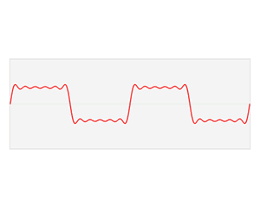
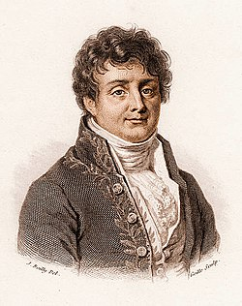
The Fourier domain
Image credits: Wikipedia
A special trigonometric series which could represent any arbitrary function
Notes:
\hat{f}(\omega) = \int\limits_{-\infty}^{\infty} f(x) e^{-2\pi \mathrm{\imath} \omega x} \mathrm{d}x

Slide 13
The continuous Fourier transform
Fourier
domain
primal
(space, time, etc.)
domain
Notes:
\hat{f}(\omega) = \int\limits_{-\infty}^{\infty} f(x) e^{-2\pi \mathrm{\imath} \omega x} \mathrm{d}x

Slide 14
The Fourier transform: `frequency’ domain
frequency
domain
frequency
projection onto sin and cos
Notes:
\hat{f}(\omega) = \int\limits_{-\infty}^{\infty} f(x) e^{-2\pi \mathrm{\imath} \omega x} \mathrm{d}x
\hat{f}(\omega) = \int\limits_{-\infty}^{\infty} f(x) \cos ({2\pi \omega x}) \mathrm{d}x + \mathrm{\imath} \int\limits_{-\infty}^{\infty} f(x) \sin ({2\pi \omega x}) \mathrm{d}x

Slide 15
A single sample:
phase
amplitude = 1
frequency
Notes:
\hat{f}(\omega) = \int\limits_{-\infty}^{\infty} f(x) e^{-2\pi \mathrm{\imath} \omega x} \mathrm{d}x
\hat{f}(\omega) = \int\limits_{-\infty}^{\infty} f(x) \cos ({2\pi \omega x}) \mathrm{d}x + \mathrm{\imath} \int\limits_{-\infty}^{\infty} f(x) \sin ({2\pi \omega x}) \mathrm{d}x

Slide 16
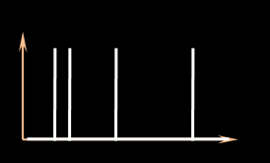
Fourier spectrum of the sampling function
sampling function
amplitude (sampling spectrum)
frequency
phase (sampling spectrum)
Notes:
To abstract away these approaches, we analyse the estimators based on the signature of the sampling function in the Fourier domain. eg. This plot shows the amplitude (yellow) and phase (blue) of the sampling signal.

Slide 17
sampling function = sum of Dirac deltas
+
+
+
Notes:
Any unweighted, sampling function can be expressed as the sum of impulses (or Dirac delta functions).

Slide 18
In the Fourier domain …
Fourier transform
Dirac delta
Frequency
Imaginary
amplitude
phase
Real
primal
Fourier
Complex plane
Notes:
The Fourier transform of a Dirac delta function is a constant (amplitude) with a phase that is linear in frequency (before the modulo 2pi)

Slide 19
Review: in the Fourier domain …
Fourier transform
Dirac delta
Frequency
Imaginary
Imaginary
Real
Real
primal
Fourier
Complex plane
Complex plane
Notes:
The Fourier transform of a Dirac delta function is a constant (amplitude) with a phase that is linear in frequency (before the modulo 2pi)

Slide 20
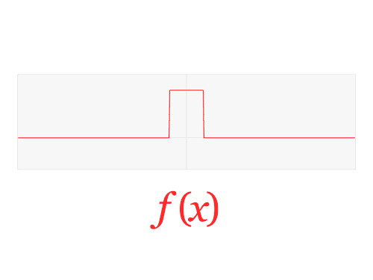
The Fourier Transform
high freq.
0
0
$$ξ$$
low-frequencies
$$x$$
high freq.

Slide 21
Fourier “duals”
$$f\left(x\right)$$
$$F\left(ξ\right)$$

Slide 22
What can you take the Fourier transform of?
xkcd.com

Slide 23
Convolution
$$h\left(x\right)= \int{f\left(x−y\right)g\left(y\right)dy}$$
$$h\left(x\right)= f\left(x\right)⊗g(x)$$
$$g$$
$$f$$
$$h$$

Slide 24
Fourier Transform of Convolution ?
$$h\left(x\right)= f\left(x\right)⊗g(x)$$
$$g$$
$$f$$
$$h\left(x\right)= \int{f\left(x−y\right)g\left(y\right)dy}$$
$$h$$

Slide 25
Fourier Transform of Convolution ?
$$h\left(x\right)= f\left(x\right)⊗g(x)$$
$$g$$
$$ℱ(h\left(x\right))=ℱ(f\left(x\right)⊗g\left(x\right))$$
$$f$$
$$h\left(x\right)= \int{f\left(x−y\right)g\left(y\right)dy}$$
$$h$$

Slide 26
Fourier Transform of Convolution ?
$$h\left(x\right)= f\left(x\right)⊗g(x)$$
$$g$$
$$ℱ(h\left(x\right))=ℱ(f\left(x\right)⊗g\left(x\right))$$
$$f$$
$$H\left(ξ\right)=F\left(ξ\right) G\left(ξ\right)$$
$$h\left(x\right)= \int{f\left(x−y\right)g\left(y\right)dy}$$
$$h$$

Slide 27
Convolution theorem
$$ℱ\left(f\left(x\right)⊗g\left(x\right)\right)=F\left(ξ\right) G\left(ξ\right)$$
Fourier transform of a convolution
product of Fourier transformed functions
$$h\left(x\right)= \int{f\left(x−y\right)g\left(y\right)dy}$$

Slide 28
Alternative way to calculate convolutions
$$h\left(x\right)= \int{f\left(x−y\right)g\left(y\right)dy}$$
Fast Fourier Transform
Obtain Fourier transforms F and G
Multiply, so H = F.G
Take the inverse Fourier transform of H
h = H⁻¹
Fast Fourier Transform

Slide 29
Remember our signal reconstruction problem?
$$f_{r} \left(x\right)= \int{f_{s}\left(x−y\right)g\left(y\right)dy}$$
$$=f_{s}⊗g$$
$$f(x)$$
$$g(x)$$
$$f_{s}(x)$$
$$f_{r}(x)$$

Slide 30
What if we apply the Fourier transform?
$$f_{r} \left(x\right)= \int{f_{s}\left(x−y\right)g\left(y\right)dy}$$
$$=f_{s}⊗g$$
$$f(x)$$
$$F_{r}(ξ) =F_{s}(ξ) G(ξ)$$
$$g(x)$$
$$f_{s}(x)$$
$$f_{r}(x)$$

Slide 31
First let us look at the sampling function ${f\left(x\right)⟺F}_{s}(ξ)$
$$F_{s}\left(ξ\right)$$
$$f_{s}\left(x\right)$$
$$x$$
$$ξ$$
$$F_{r}(ξ) =F_{s}(ξ) G(ξ)$$

Slide 32
First let us look at the sampling function ${f\left(x\right)⟺F}_{s}(ξ)$
$$F_{s}\left(ξ\right)$$
$$f_{s}\left(x\right)$$
$$x$$
$$ξ$$
$$F_{r}(ξ) =F_{s}(ξ) G(ξ)$$

Slide 33
First let us look at the sampling function ${f\left(x\right)⟺F}_{s}(ξ)$
$$F_{s}\left(ξ\right)$$
$$f_{s}\left(x\right)$$
$$x$$
$$ξ$$
$$F_{r}(ξ) =F_{s}(ξ) G(ξ)$$

Slide 34
Then, the reconstruction kernel $g\left(x\right)⟺G(ξ)$
$$G\left(ξ\right)$$
$$g(x)$$
$$x$$
$$ξ$$
$$F_{r}(ξ) =F_{s}(ξ) G(ξ)$$

Slide 35
Putting it all together … on paper

Slide 36
Then, the reconstruction kernel $g\left(x\right)⟺G(ξ)$
$$G\left(ξ\right)$$
$$g(x)$$
$$x$$
$$ξ$$
$$F_{r}(ξ) =F_{s}(ξ) G(ξ)$$

Slide 37
Then, the reconstruction kernel $g\left(x\right)⟺G(ξ)$
$$G\left(ξ\right)$$
$$g(x)$$
$$x$$
$$ξ$$
$$F_{r}(ξ) =F_{s}(ξ) G(ξ)$$

