Slide 1
Computer Graphics
Lecture 1: Introduction and Course Organisation
Kartic Subr

Slide 2
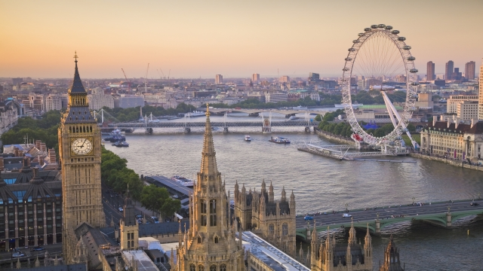
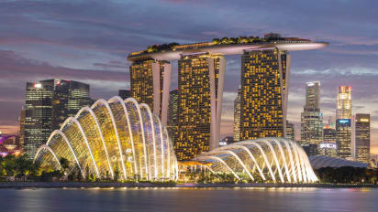
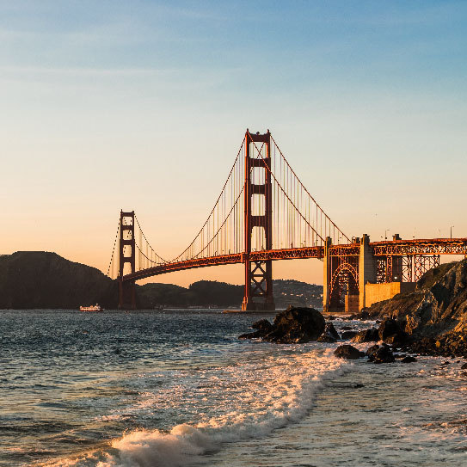

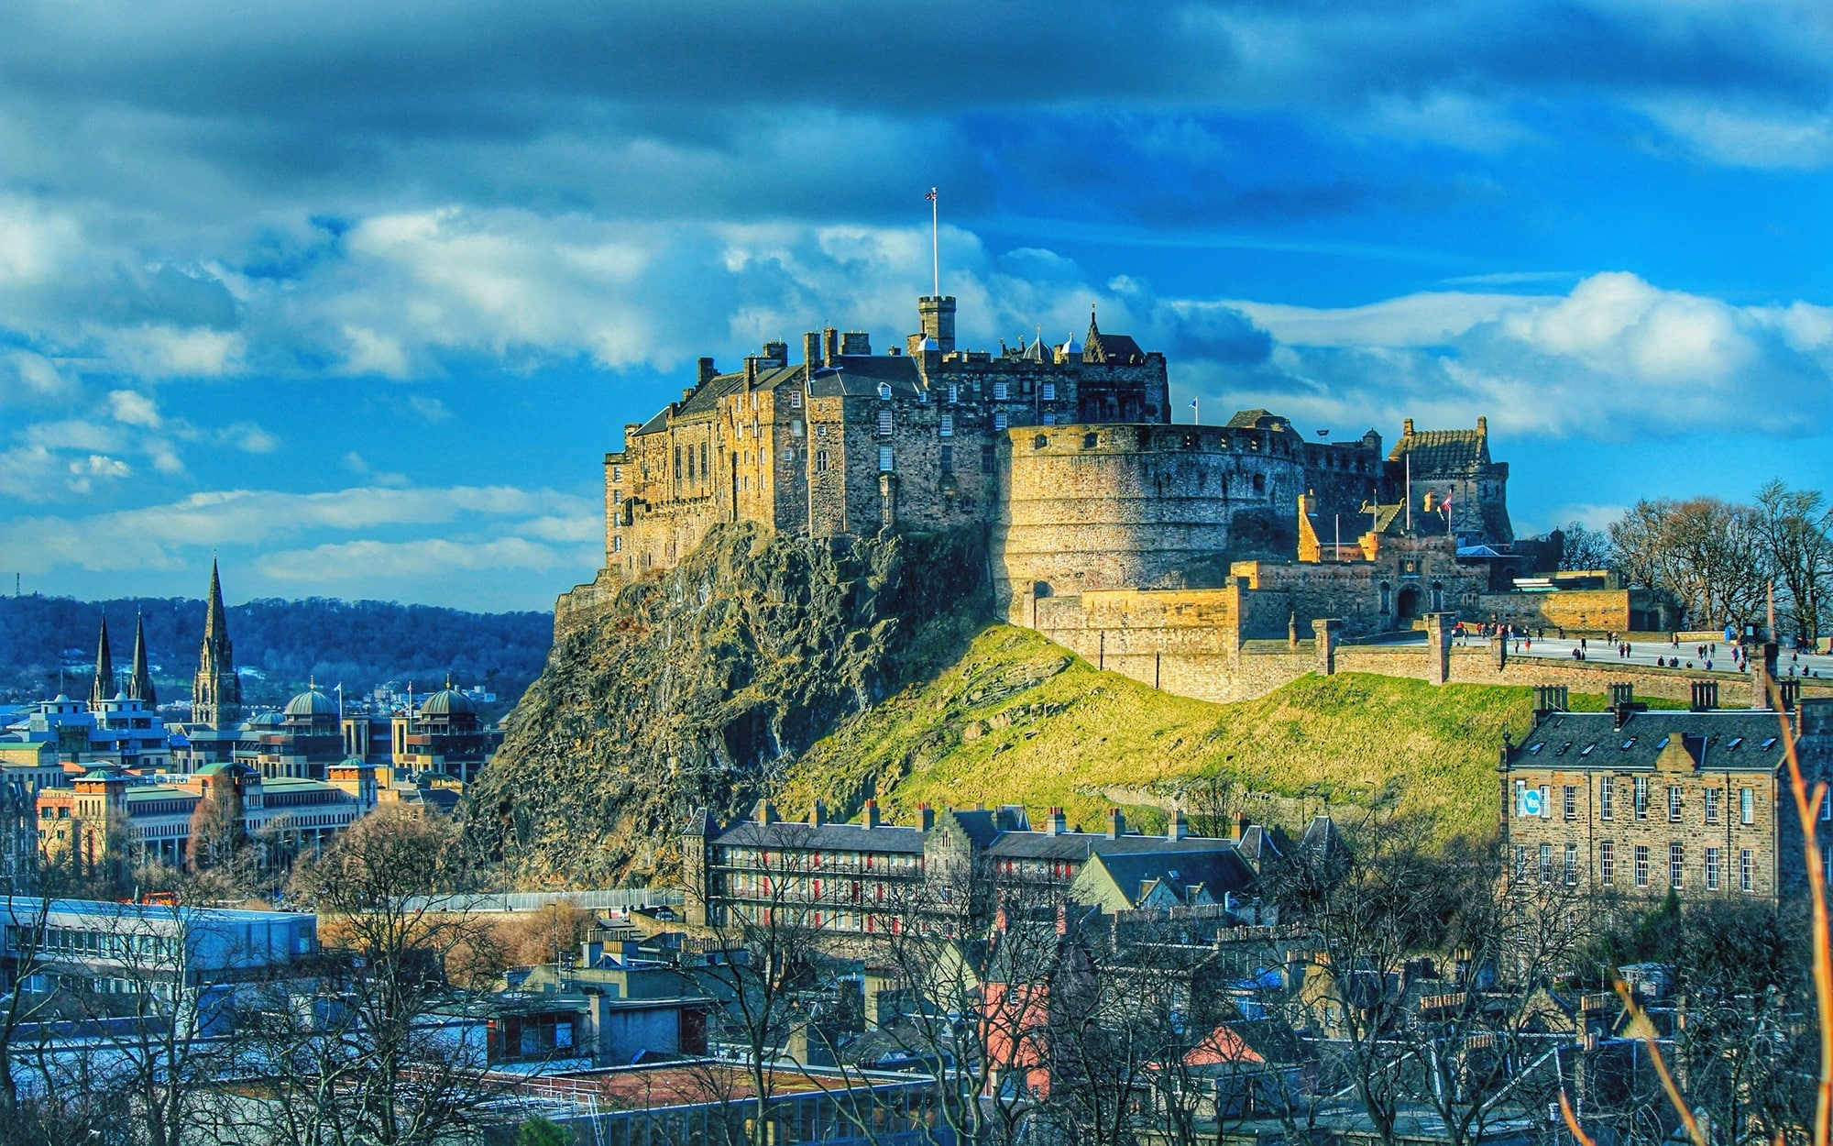
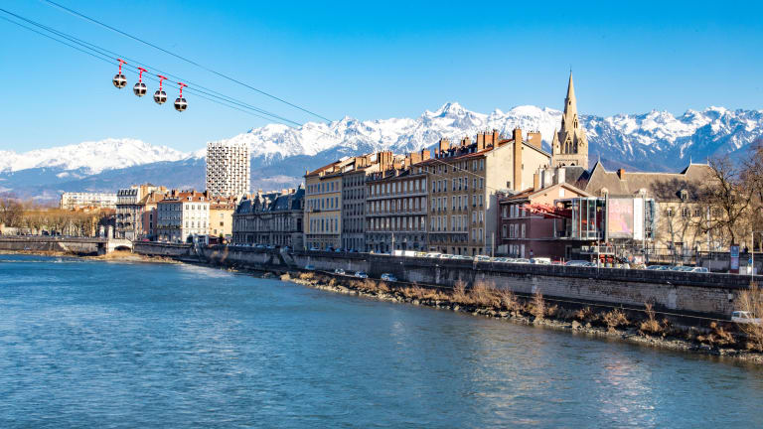

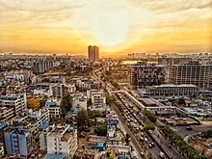
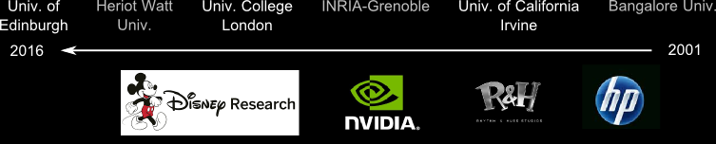
Me: A brief history

Slide 3
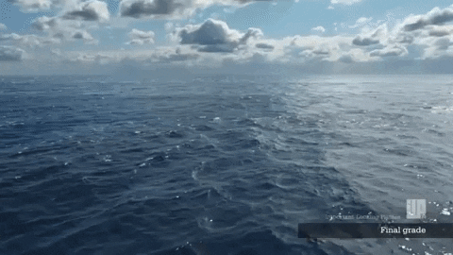
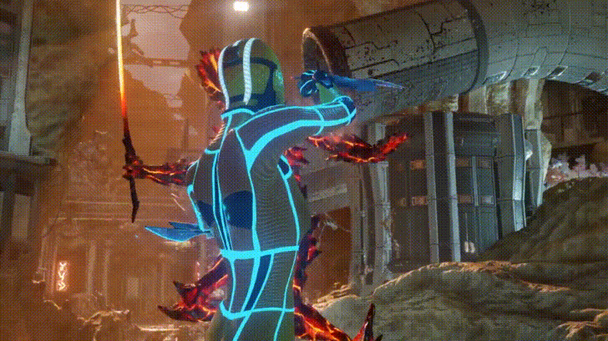
Special Effects
Important Looking Pirates VFX
Video Games
(real-time)
Google Stadia tech demo 2019

Slide 4


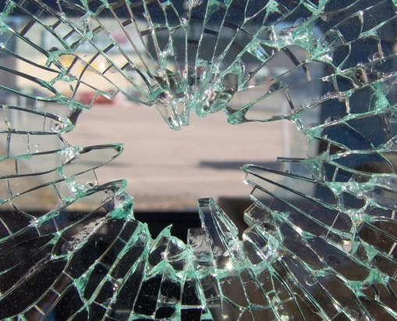

Notes:
A common goal is to develop models and simulation mechanisms that mimic reality as closely as possible. But how is this ‘closely as possible’ defined?

Slide 5
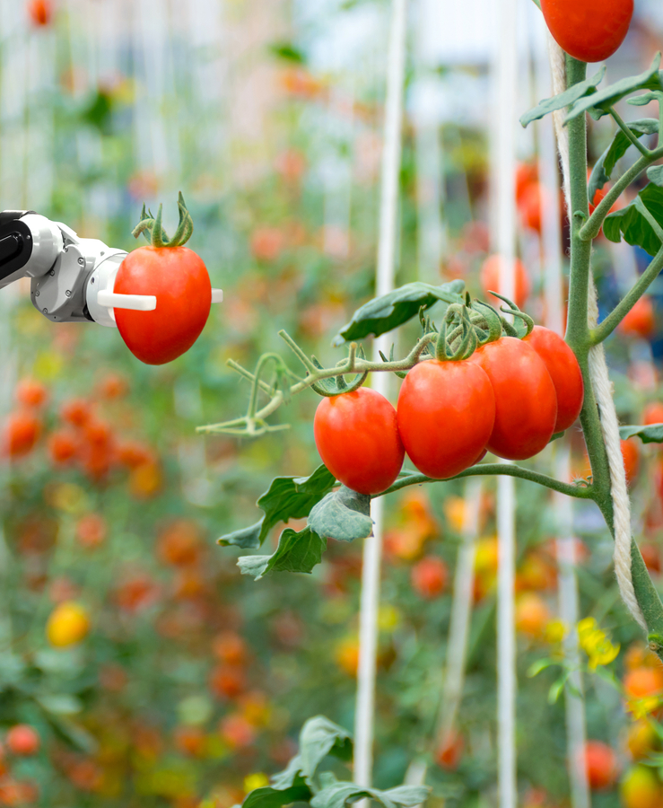
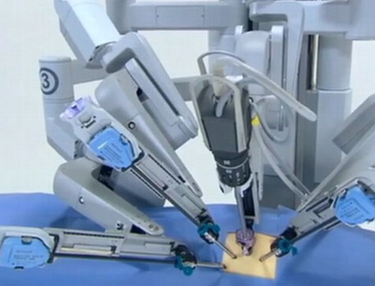
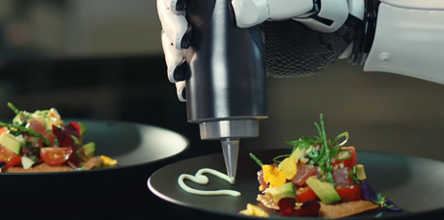
Autonomous Interaction

Slide 6
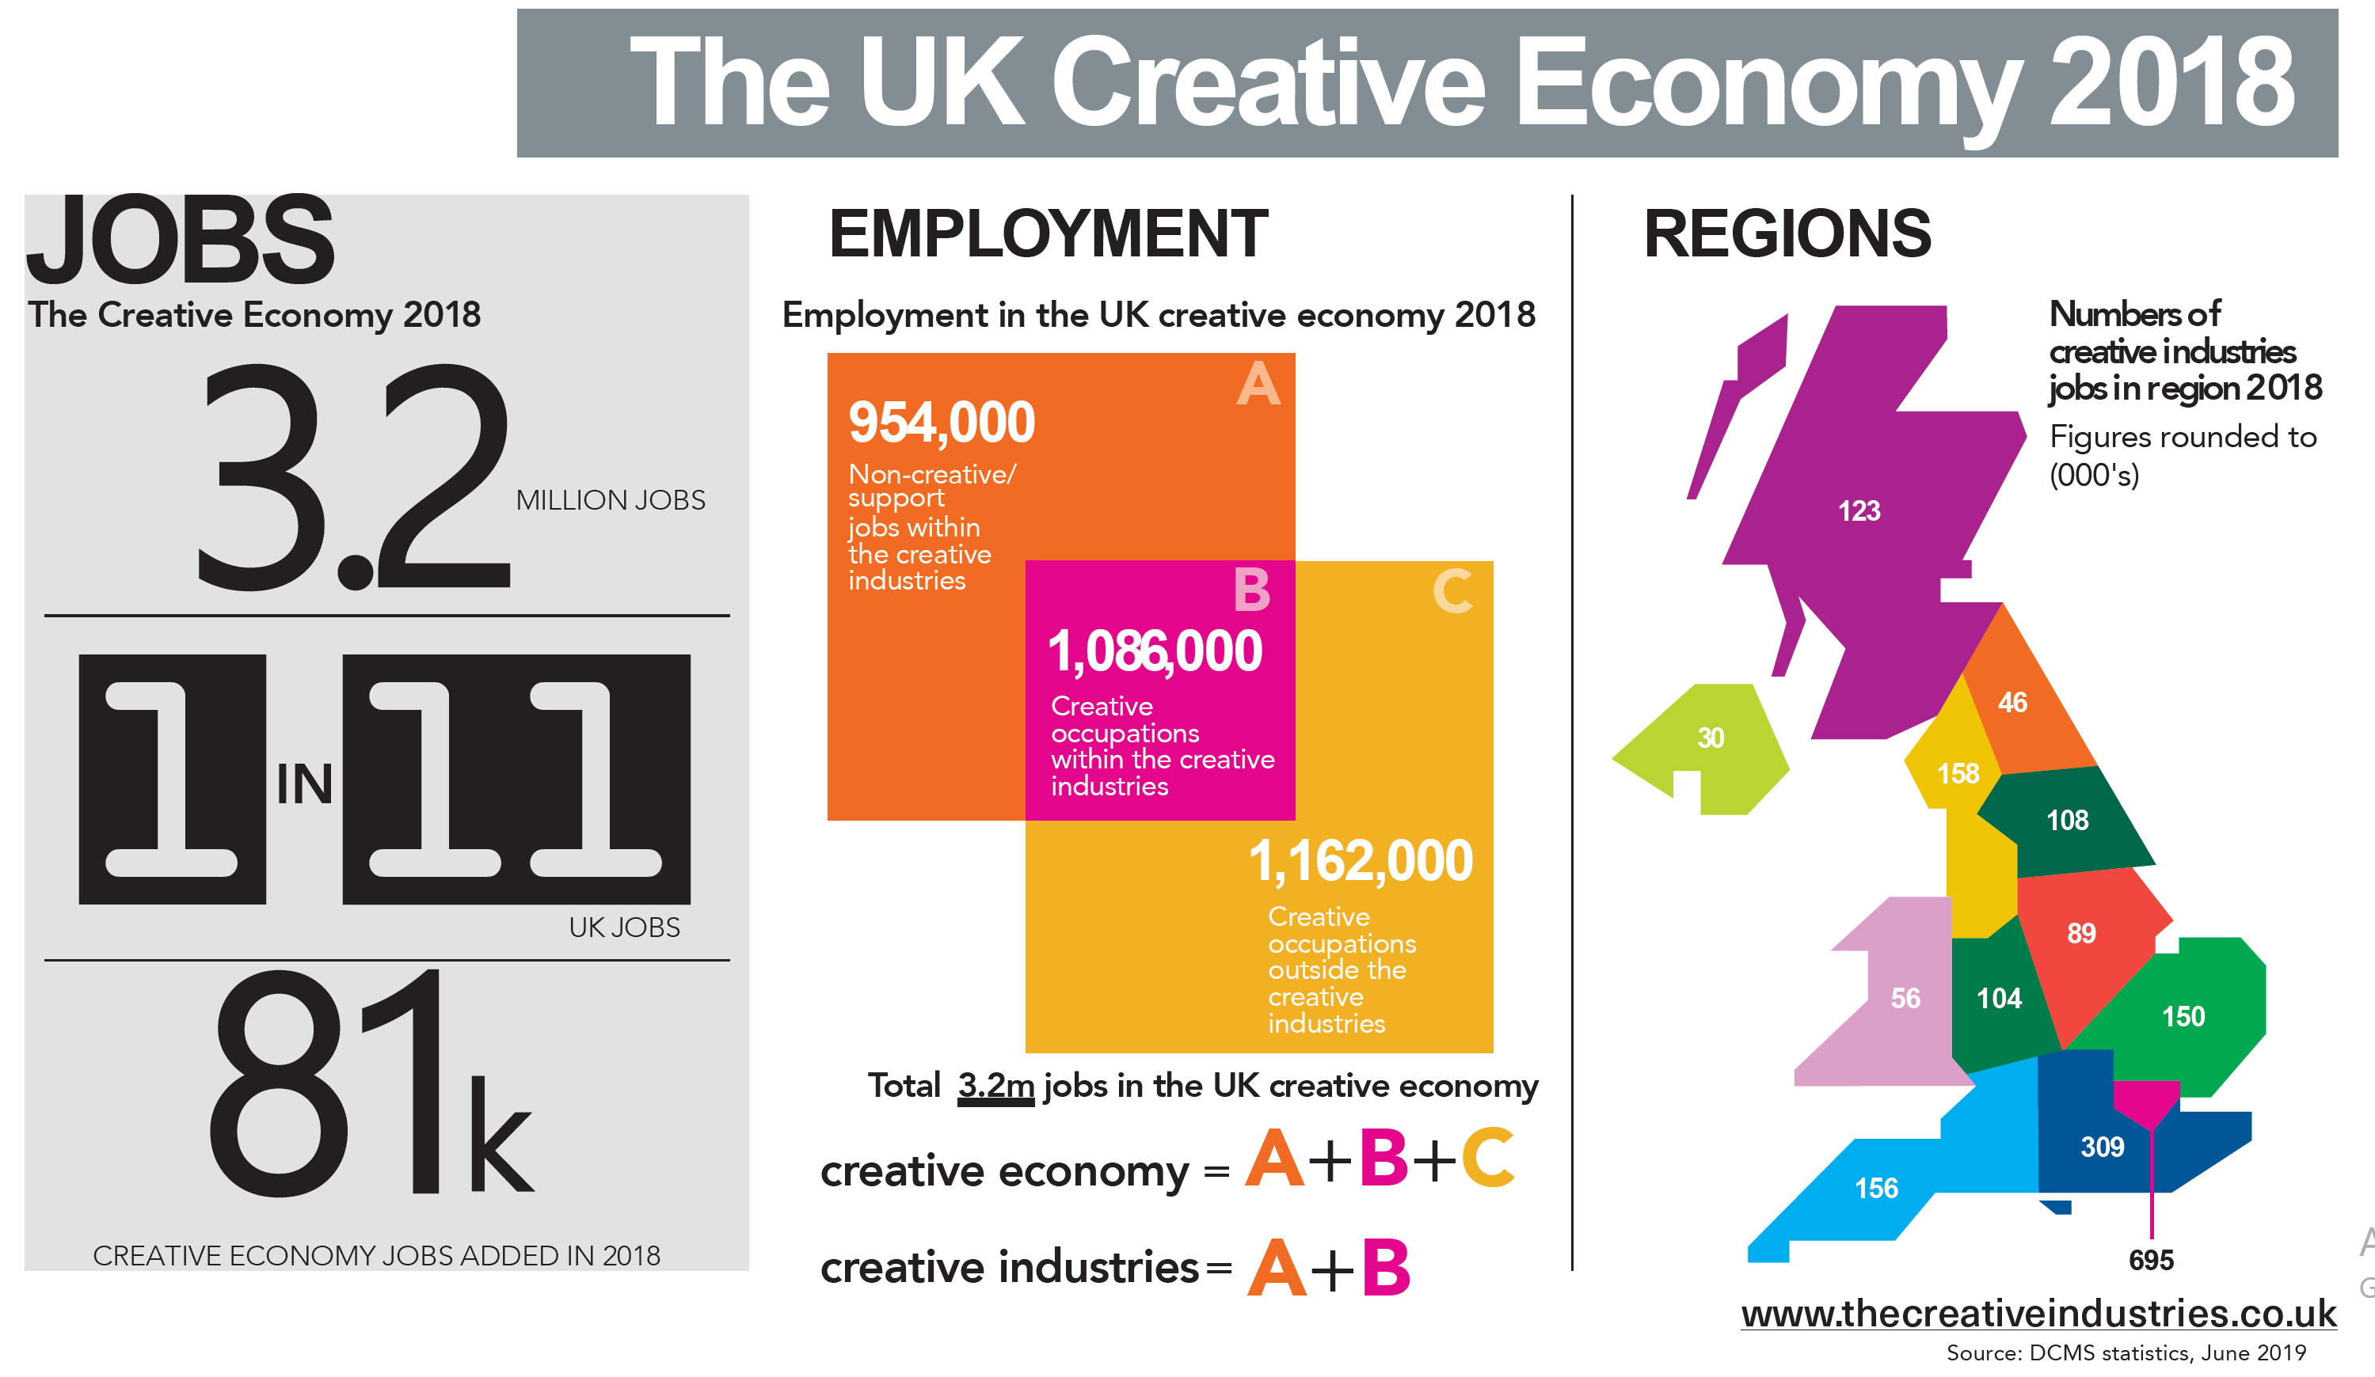
CG is central to the creative industries

Slide 7

It’s all happening in London now!
https://onelightvfx.com/studio-list/complete-list-of-2d-3d-animation-post-production-and-vfx-studios-in-england/
OSCAR NOMINEES, 2019-20

Slide 8
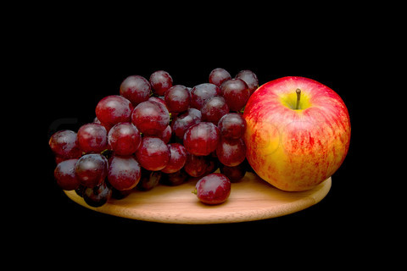
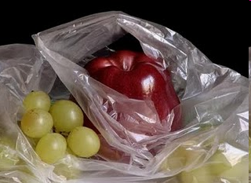

Simulating photorealistic pictures?
photograph
manually painted
computer generated
Colourbox.com
Pedro Campos

Slide 9
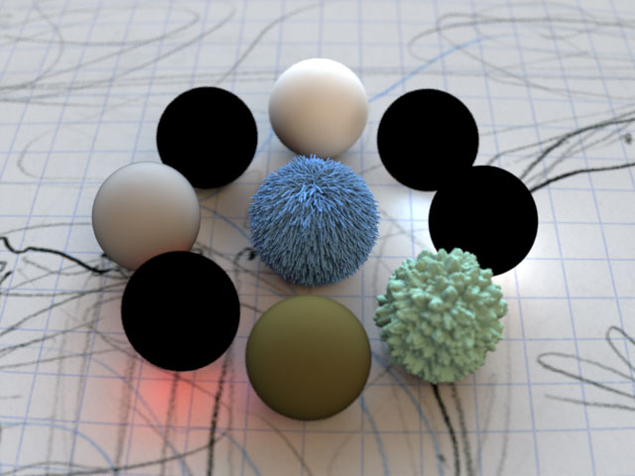
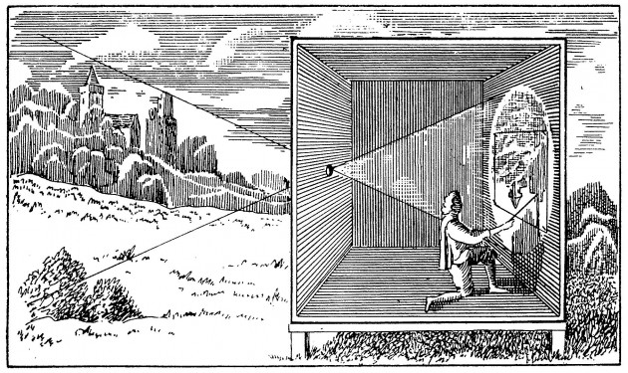
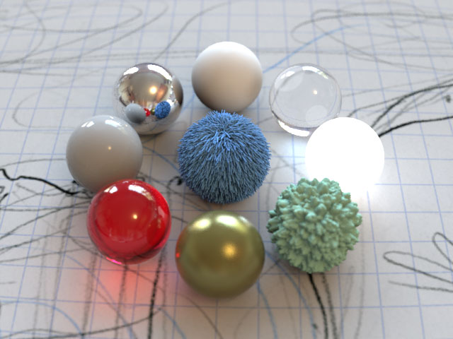
Physically based simulation, at its core!
Projective geometry
Energy
(light transport)

Slide 10
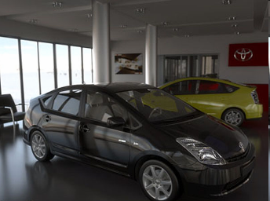
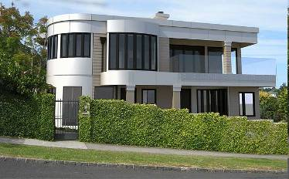
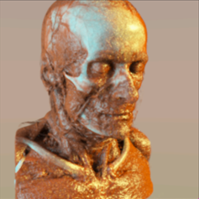
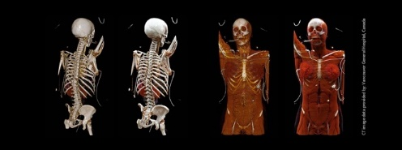
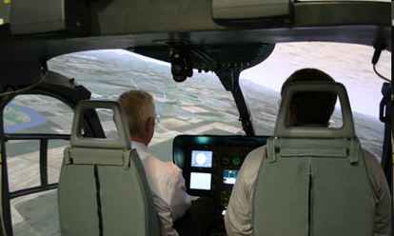
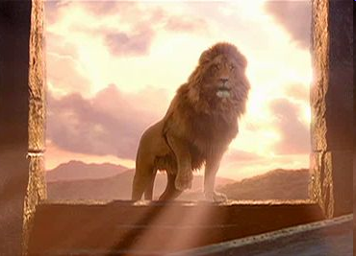
Advertising
Engineering
Medicine
Defense
Entertainment

Slide 11
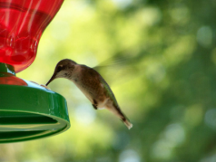
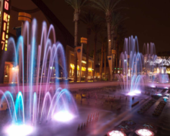
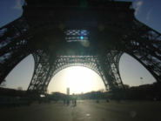
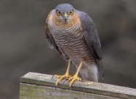
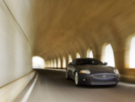
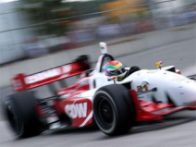
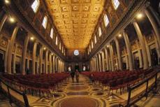
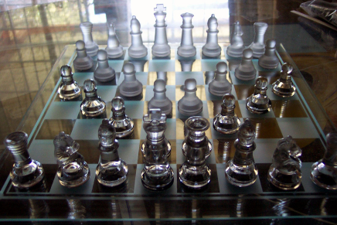
Simulate the physics of light
lenses
defocus
exposure time
light, media
materials

Slide 12
About the course …
http://www.inf.ed.ac.uk/teaching/courses/cg/index2019.html

Slide 13
Exam time!
https://prezi.com/view/fgJVmBlMT9RVpE7JzKZz/

