Slide 1
Weight Sharing in Reinforcement Learning for Continuous Control
Chau Luu, Julian Habekost, Nico Ring
Rude Boys ft. ssh-agent

Slide 2
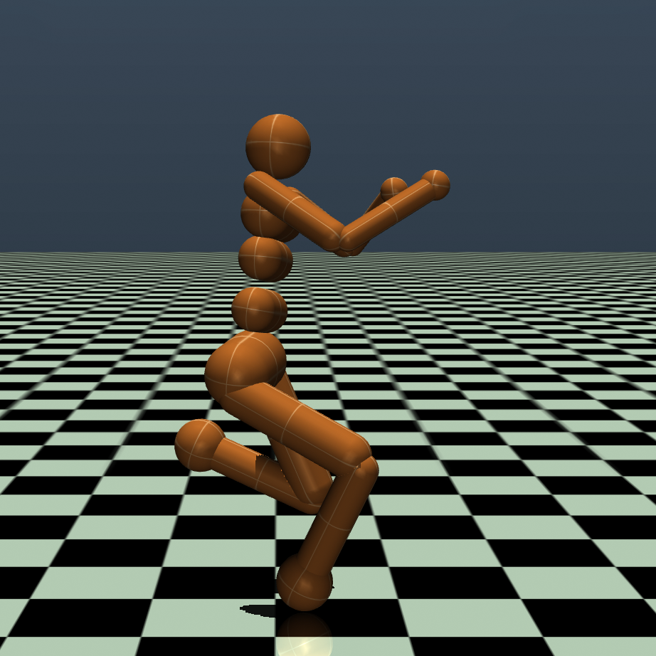
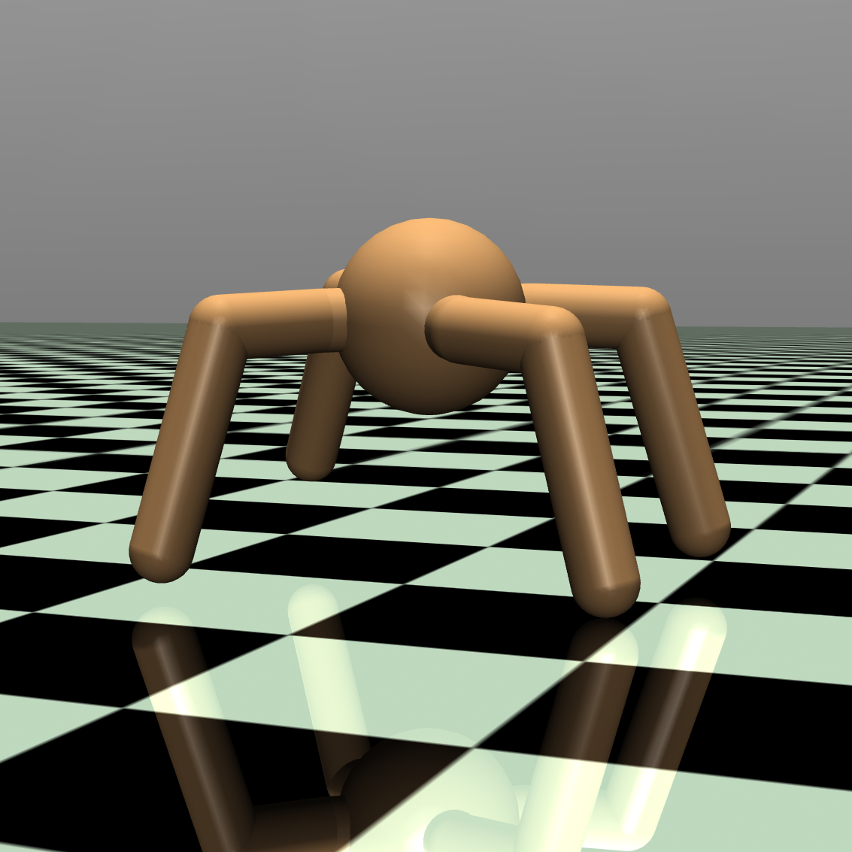
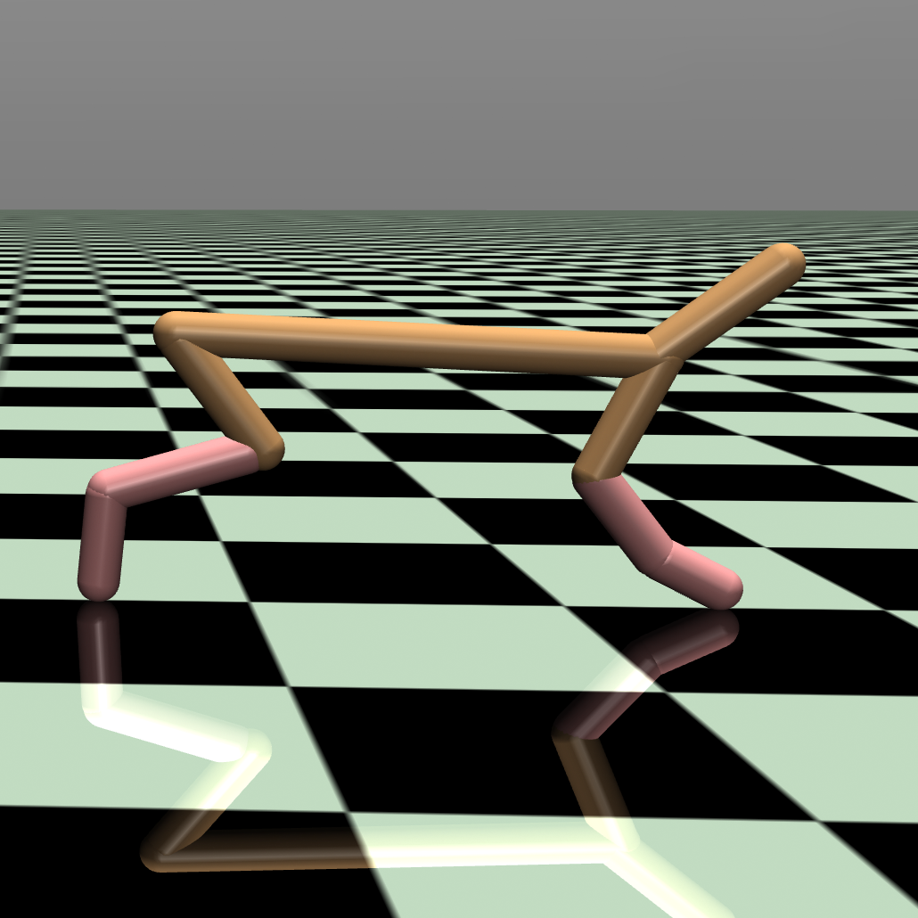
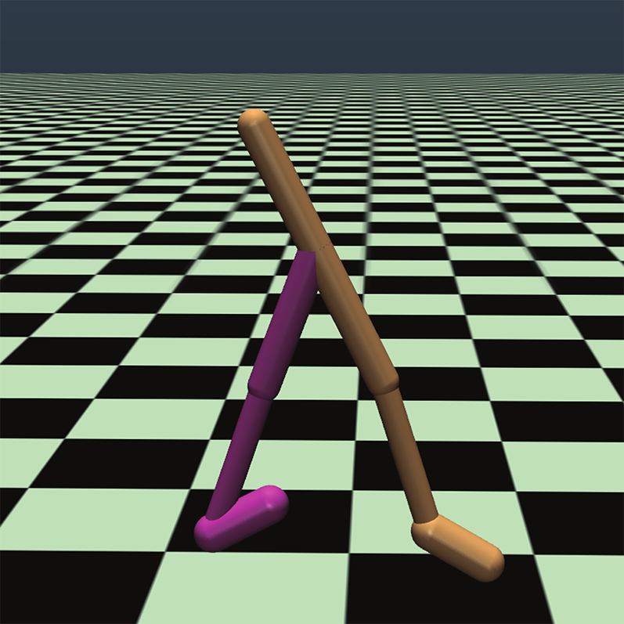
Deep Reinforcement Learning with Mujoco
Humanoid
Ant
HalfCheetah
Walker2d
Notes:
The Tasks you see here are physical simulation of robot agents.
They all get reward for moving forward.
The Humanoid and the Ant move in 3D space, the HalfCheetah and the Walker2D actually only move in a fixed 2D plane.
Any algorithm needs to learn to apply torques to the joints so that the reward is maximized.
What we observed ist, that there are structural parts that are equivalent, like left leg and right leg; we wanted to exploit that explicitly

Slide 3
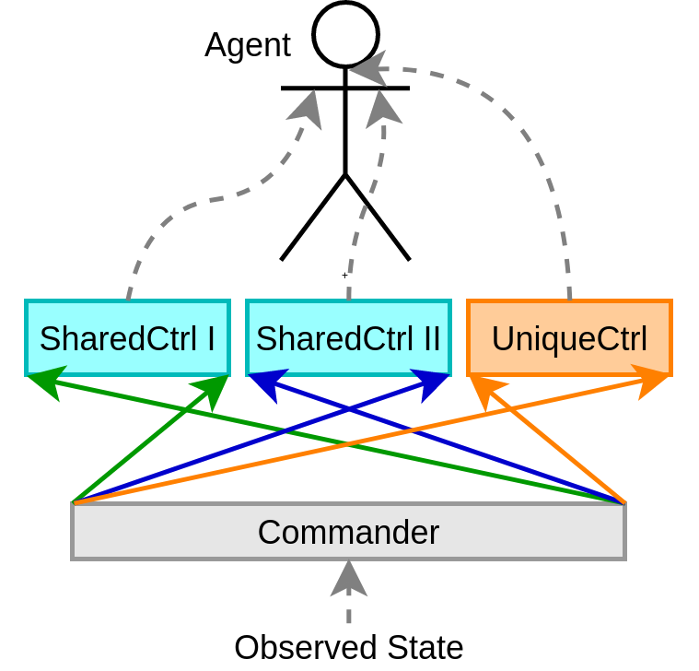
Weight Sharing Architecture
Inspiration: Convolutional networks
Motivation: High-level coordination with low-level control.
Solution: Use shared weights and local connectivity for structurally equivalent parts.
Instantaneous structural transfer learning
Notes:
Shared weights- equivalent networks

Slide 4
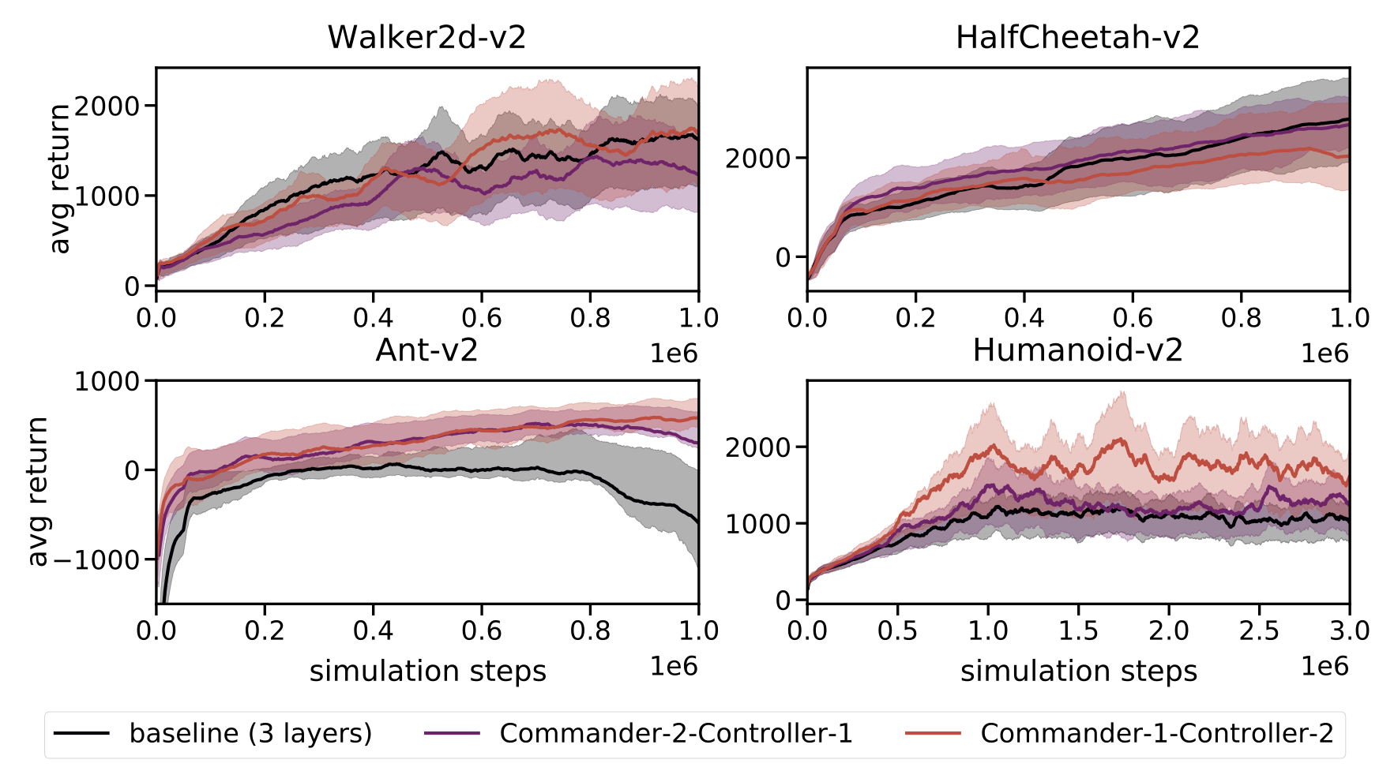
Notes:
compare to a baseline of 3 fully connected layers
one net with two layers in the commander and one in the controllers
and the other net with one fully connected layer in the commander and two in the locally connected controllers
the graphs show the mean performance over 10 seeds because RL includes a lot of randomness
the area is one std dev
as you can see for walker and cheetah all nets have a similar performance, we think the reason is that these tasks are fairly simple as they are 1d and there is not much to exploit
for ant and humanoid our nets show a better performance

