Slide 1
Building Data Processing Pipelines with Spark at Scale
Andy Dang
Notes:
Summary of Amazon’s approach to innovation (background)
Technology behind improving Amazon’s web/mobile search/discovery capabilities

Slide 2

About Me
Andy Dang
Software Development Engineer
Amazon Development Centre Scotland
At Amazon since graduating in 2014

Slide 3

Understanding Relationships in the Catalogue
Notes:
Iridium – quickly go over this

Slide 4






Understanding the Customer Decision Journey
Reads detail page and reviews
Compares brands
PURCHASE
Adds to Cart or List
CONSIDERATION
Customer sees ad
AWARENESS
Tells a friend
EXPERIENCE
Searches for product
Receives and uses product
Subscribes
Purchases brand again
ADVOCATE
LOYALTY
Writes a review
Notes:
Audience insights

Slide 5

Personalisation
Notes:
Personalization

Slide 6
Outline
Hardware Trend
Apache Spark
Resilient Distributed Datasets
Caching and Storage
Data Shuffling
Spark SQL
Big Data Platform Architecture

Slide 7
HARDWARE TREND
Notes:
Let’s take a look at hardware trend to understand the context of Spark vs Hadoop MapReduce design

Slide 8
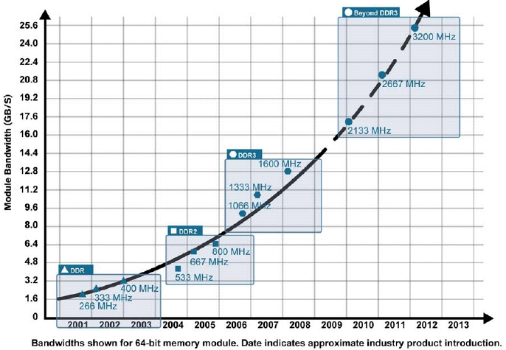
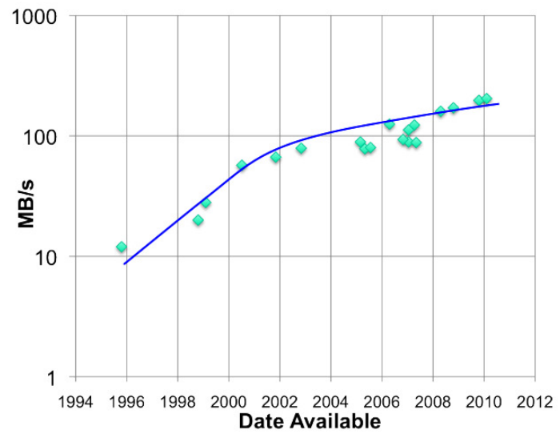
Memory Performance
RAM throughput
increasing exponentially
Disk throughput increasing slowly
http://www.slideshare.net/TachyonNexus/tachyon-an-open-source-memorycentric-distributed-storage-system
Notes:
There are 2 trends that are happening today.
RAM through put
Disk through put (note that this doesn’t include SSD)

Slide 9
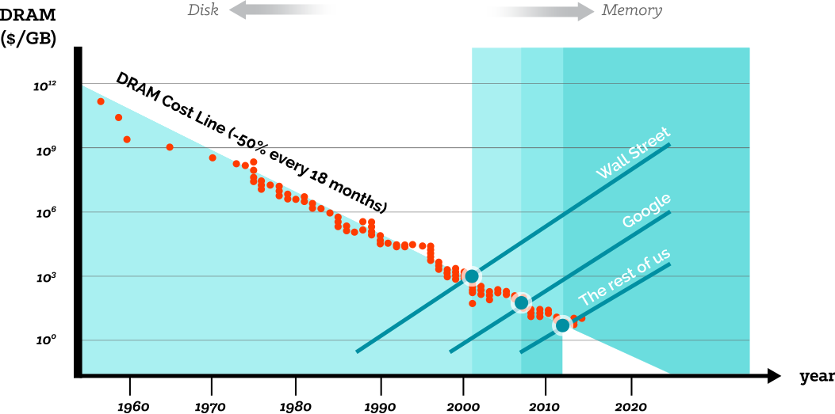
Memory Cost
http://www.slideshare.net/TachyonNexus/tachyon-an-open-source-memorycentric-distributed-storage-system
source: jcmit.com
Notes:
In memory becomes more important and popular
Cost / capacity of Memory is lower and lower, which makes it possible to handle huge size of data in memory
Many computation frameworks leverage memory
How to manage huge caching data is an interesting problem
Hadoop came out when RAM was not so cheap, but hard drive was super cheap

Slide 10
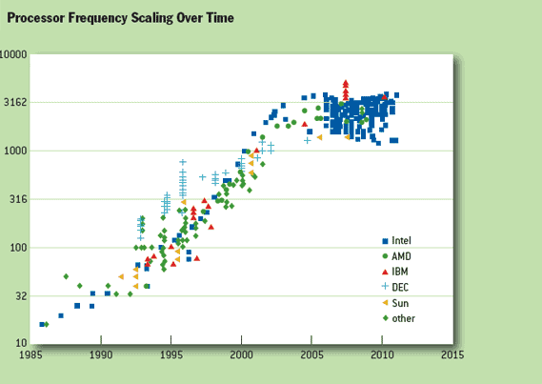
CPU Speed
http://www.slideshare.net/TachyonNexus/tachyon-an-open-source-memorycentric-distributed-storage-system
Notes:
CPU speed has been stagnating

Slide 11
APACHE SPARK
Notes:
Let’s take a look at hardware trend to understand the context of Spark vs Hadoop MapReduce design
Spark helps us go 3-20x faster at petabyte scale

Slide 12
Motivations
Software Engineer point of view:
  Hadoop ecosystem is fragmented
  Extending Hadoop is cumbersome
  Memory is getting cheap. Disk IO is expensive
Framework point of view:
  Unified pipeline
  Simplified data flow with re-usable logic
  Faster processing speed
Data abstraction:
  New fundamental abstraction (RDD)
  Simple, extensible API
  Descriptive computing model

Slide 13
Apache Spark
Fast and general purpose in-memory computing engine
Rich high level API based on MapReduce for multiple languages (Scala, Java, Python and R)
DataFrames
ML Pipelines
Spark
SQL
Spark Streaming
MLlib
GraphX
Spark Core
Standalone
YARN
Mesos
Notes:
Low latency
Sub-second
Runs everywhere
Standalone, EC2, Hadoop YARN, Apache Mesos
Data sources: HDFS, Cassandra, HBase, S3, ..
General Execution Engine
Diverse workloads & job sizes, e.g. ML, Graphs
Operators are superset of M/R → Simplicity
Failure is common
Performance
7 hours → 2.5 hours (more optimizations to come)
Hardware
Cluster of 80 machines → 10 with Spark
Codebase (excluding tests)
50K using Map/Reduce → 13K with Spark

Slide 14
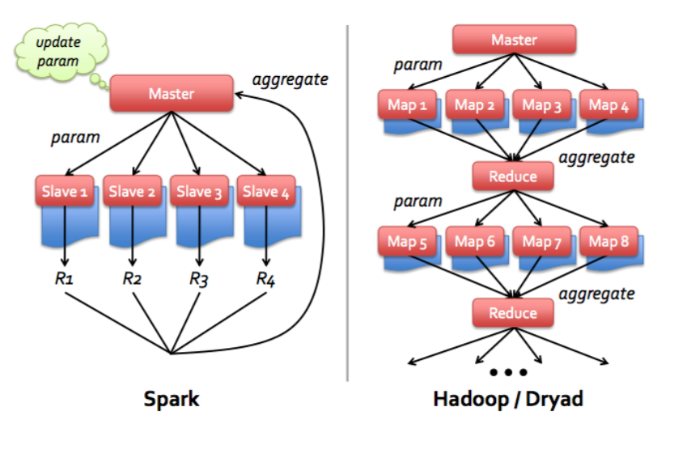
Spark vs. Hadoop MapReduce
In memory data flow model optimized for multi-stage jobs
Spark is memory-oriented (vs. disk-oriented in Hadoop MapReduce jobs)
Simple API: functional style
Source: tadpad.com

Slide 15
“Hello World”
Spark offers functional style API based on MapReduce paradigm
Word count example in Spark 2.0 (~50 lines of code in Hadoop)
JavaRDD<String> textFile = sc.textFile("hdfs//...");
JavaPairRDD<String, Long> counts = textFile.flatMap(word -> new Scanner(word).useDelimiter(" "))
.map(String::toLowerCase)
.mapToPair(word -> Tuple2.apply(word, 1L))
.reduceByKey((l, r) -> l + r);
counts.saveAsTextFile("hdfs//...");
Want to test Spark?
  DataBricks offer a free community edition with a mini cluster
  AWS EMR offers a fully managed stack for Spark on YARN
Notes:
Compared to 50 lines in Spark

Slide 16
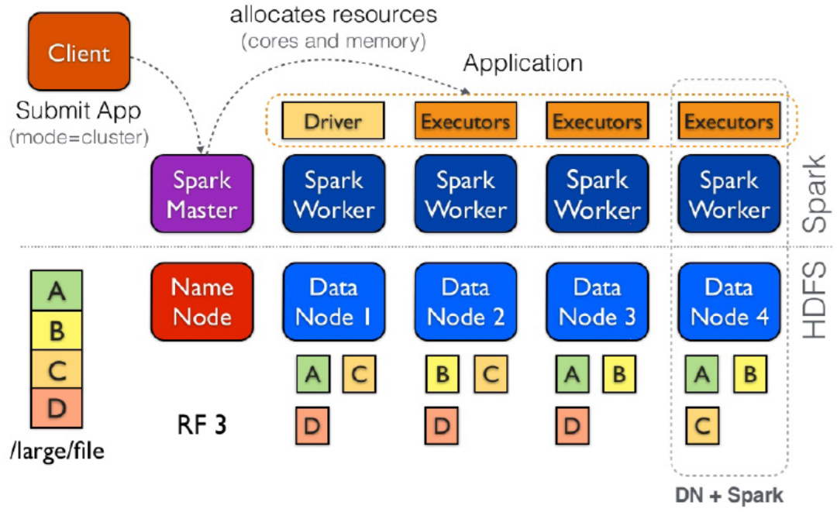
Anatomy of a Spark Application
Notes:
Don’t talk too much, go to the next slide

Slide 17
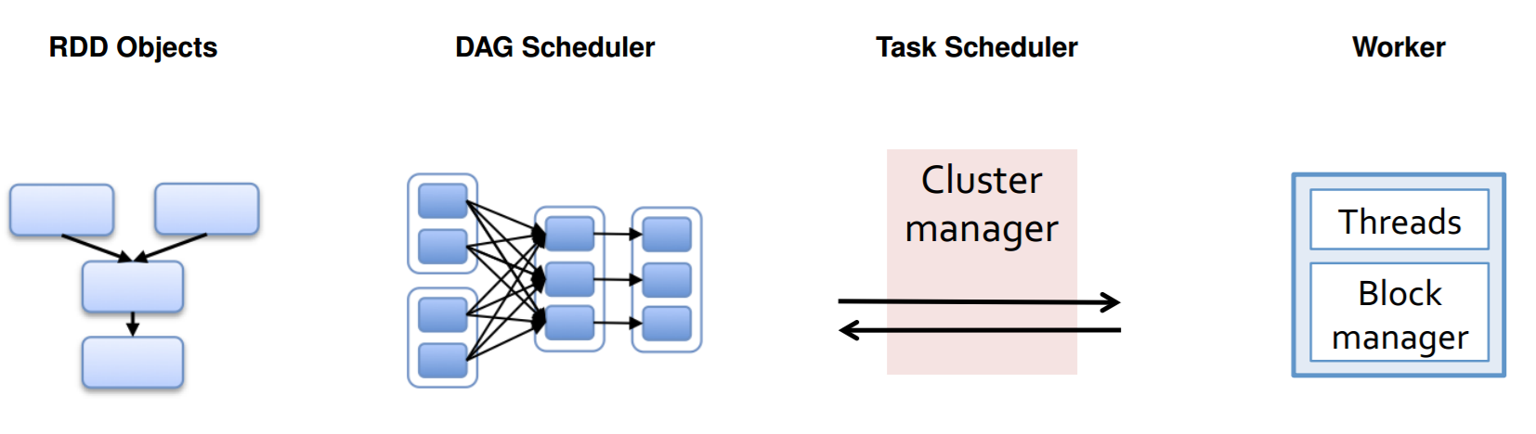
Anatomy of a Spark Application
rdd.map(…)
.flatMap(…)
.reduceByKey(…)
Launch tasks
Execute Tasks
Split the DAG into stages of tasks
Retry failed or slow tasks
Store and serve blocks
Build the operator DAG
Submit each stage when its upstream inputs are ready
Notes:
The DAG Scheduler I Gets:
RDDs, functions to run on each partition and a listener for results
Builds Stages of Tasks objects (code + preferred location)
Submits Tasks to the Task Scheduler as ready
Resubmits failed Stages
The Task Scheduler
Launches Tasks on executors
Relaunches failed Tasks
Reports to the DAG Scheduler

Slide 18
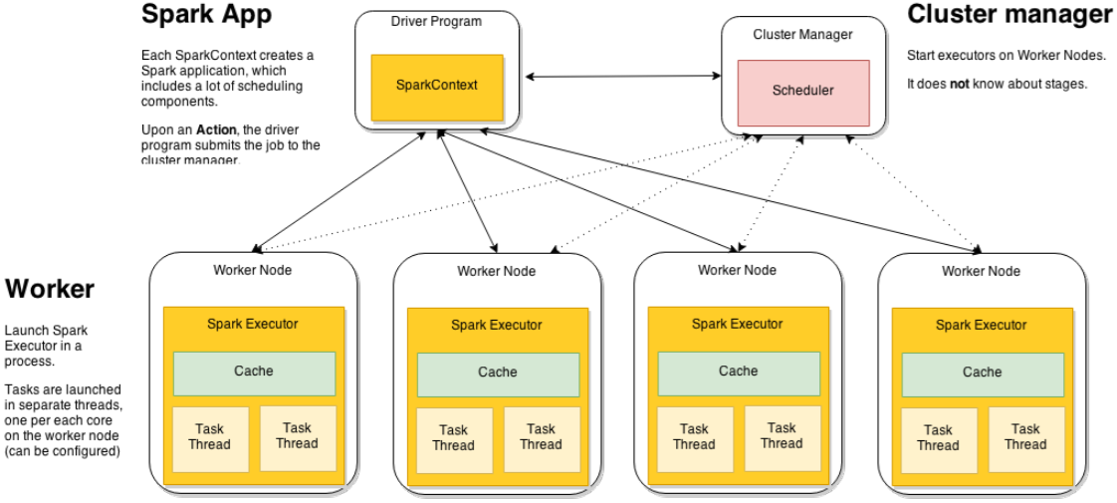
System-level View
Notes:
Worker nodes are machines that run executors
Host one or multiple Workers
One JVM (= 1 UNIX process) per Worker
Each Worker can spawn one or more Executors
Executors run tasks
Run in child JVM (= 1 UNIX process)
Execute one or more task using threads in a Thread Pool

Slide 19
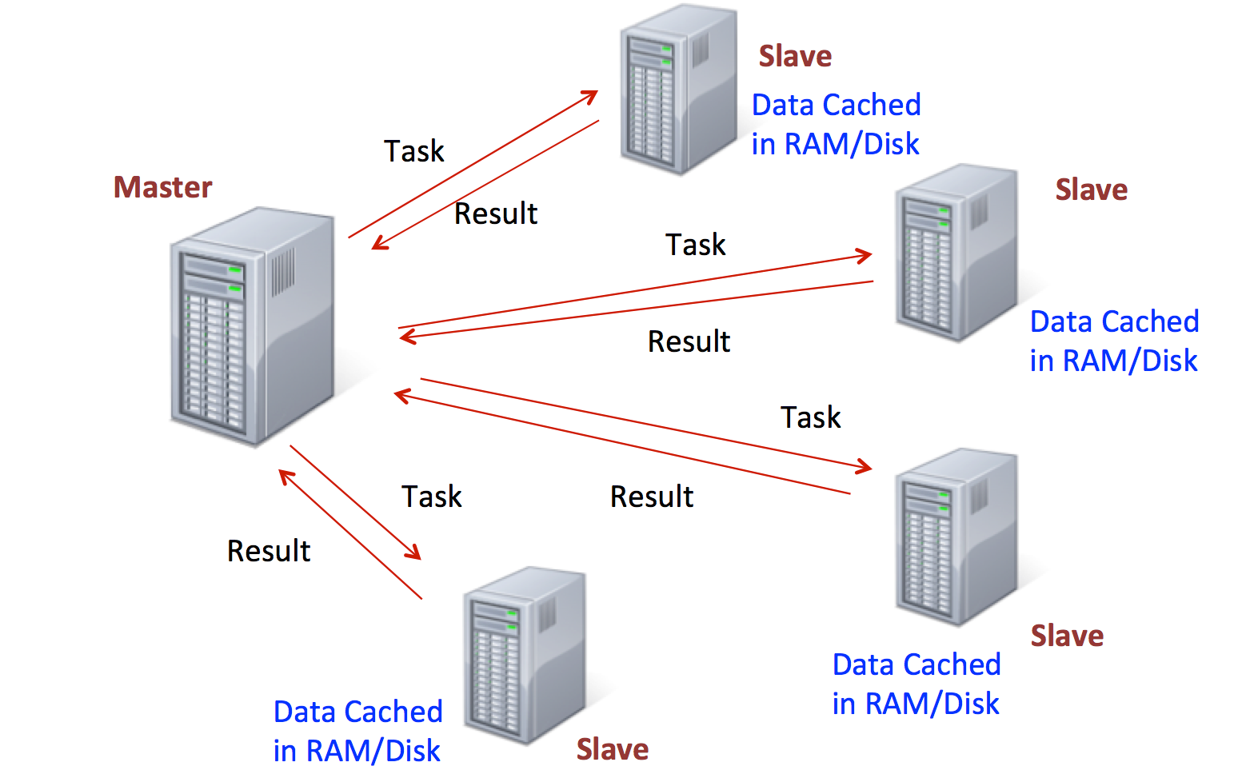
Job Execution
Source: Dzone.com

Slide 20
Compare with Hadoop MapReduce
Hadoop MapReduce
One tasks per JVM
Short-lived executors
  One large tasks/executor
Spark
Tasks run in one or more Threads, within a single JVM
Long live executors
  Many small tasks
Notes:
Isolation
Applications are completely isolated
Task scheduling per application
Low-overhead
Task setup cost is that of spawning a thread, not a process
10-100 times faster
Small tasks → mitigate effects of data skew
Sharing data
Applications cannot share data in memory natively
Use an external storage service like Tachyon
Resource allocation
Static process provisioning for executors, even without active tasks
Dynamic provisioning

Slide 21
Resilient Distributed Datasets
Notes:
Let’s take a look at hardware trend to understand the context of Spark vs Hadoop MapReduce design

Slide 22
Resilient Distributed Datasets
Resilient distributed datasets
Memory
Cores
RDD
Disk
{1, 3, 7}
{2, 6, 9, 10}
Memory
Cores
{4, 5, 8}
Disk
….
Notes:
Immutable collection of Objects
RDD are data structures that either points to a direct data source (S3, HDFS), or apply some transformations to its parent RDD
Lazily evaluated
Partitioned and Distributed
Stored in Memory (but can be spilled to disk)
Partitions recomputed on failures
Re-usable
Overall objective
Support a wide array of operators (more than just Map and Reduce)
Allow arbitrary composition of such operators Simplify scheduling
Avoid to modify the scheduler for each operator

Slide 23
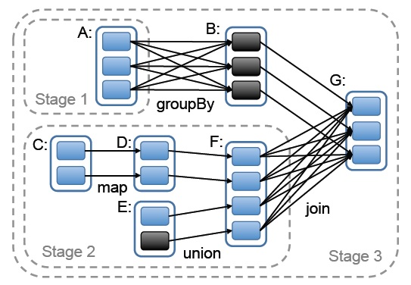
RDD: The Lineage
Downstream RDD just keeps reference (never copies) of its parent
toDebugString() on word count RDD:
(2) ShuffledRDD[6] at reduceByKey at <console>:25 []
+-(2) MapPartitionsRDD[5] at map at <console>:24 []
| MapPartitionsRDD[4] at map at <console>:23 []
| log.txt MapPartitionsRDD[1] at textFile at <console>:21 []
| log.txt HadoopRDD[0] at textFile at <console>:21 []
Notes:
Current cluster computing frameworks handle repetitive / redundant tasks inefficiently
Interactive: multiple queries on same data subset filtered/sorted in different ways
Iterative: PageRank, K-means clustering, logistic regression, etc
RDD := transform({storage|RDD})
Only log source transformations (the lineage)
Each partition can independently recover
Customizable persistence (memory, disk, mix)
Initial computation is lazy --> pipelining
Stragglers through backup tasks (speculative execution)
Supports check-pointing for long lineages

Slide 24
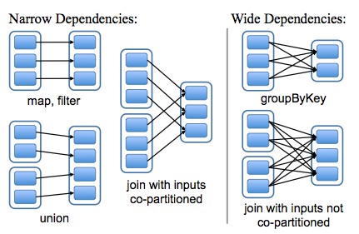
RDD Dependencies
Narrow dependencies:
  Pipelined execution
  Efficient recovery
  No shuffling
Wide dependencies:
  Requires shuffling, unless parents are hash-partitioned
  Expensive to recover

Slide 25
Dependency Types: Optimisations
Lazy evaluation:
  DAG scheduler optimizes Stages and Tasks before submitting them to the Task Scheduler
  Pipelining narrow dependencies
  Join plan selection based on partitioning
  Cache reuse
Notes:
Current cluster computing frameworks handle repetitive / redundant tasks inefficiently
Interactive: multiple queries on same data subset filtered/sorted in different ways
Iterative: PageRank, K-means clustering, logistic regression, etc
RDD := transform({storage|RDD})
Only log source transformations (the lineage)
Each partition can independently recover
Customizable persistence (memory, disk, mix)
Initial computation is lazy --> pipelining
Stragglers through backup tasks (speculative execution)
Supports check-pointing for long lineages

Slide 26
RDDs: Transformations
RDD[String]
RDD[String, Long]
RDD[String, Long]
…
…
…
RDD[String]
<Hello, 20L>
Hello
<Hello, 1L>
…
Hello world
word
<word, 1L>
<word, 10L>
Welcome to
Welcome
<Welcome, 1L>
<Welcome, 1L>
Spark
…
…
…
…
.flatMap(…)
.mapToPair(…)
.reduceByKey(…)
Transformations represent the logic applied on the data. The actual execution doesn’t happen until you perform an Action.
Notes:
Set of operations on a RDD that define how they should be transformed
As in relational algebra, the application of a transformation to an RDD yields a new RDD (because RDD are immutable)
Transformations are lazily evaluated, which allow for optimizations to take place before execution
map(func), flatMap(func), filter(func) I grouByKey() I reduceByKey(func), mapValues(func), distinct(), sortByKey(func) I join(other), union(other) I sample()

Slide 27
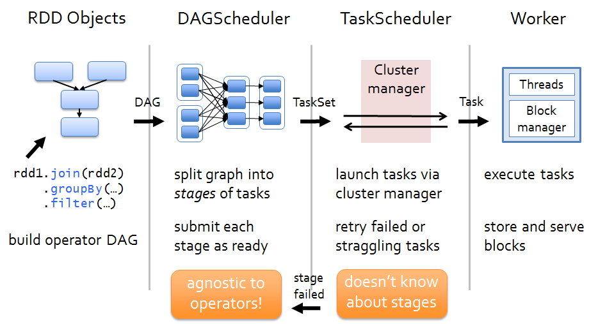
RDDs: Actions
Examples: count(), saveAsText(), reduce(), collect()
Notes:
ctions I Apply transformation chains on RDDs, eventually performing some additional operations (e.g., counting) I Some actions only store data to an external data source (e.g. HDFS), others fetch data from the RDD (and its transformation chain) upon which the action is applied, and convey it to the driver

Slide 28
Caching and Storage
Notes:
Let’s take a look at hardware trend to understand the context of Spark vs Hadoop MapReduce design

Slide 29
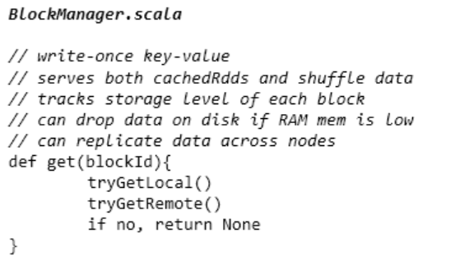
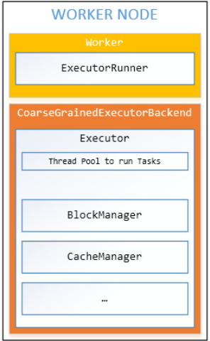
Caching Basics: Block Manager
Write-once” key-value store
  One node per worker
  No updates, data is immutable
Main tasks
  Serves shuffle data (local or remote connections) and cached RDDs
  Tracks the “Storage Level” (RAM, disk) for each block
  Spills data to disk if memory is insufficient
  Handles data replication, if required
Notes:
http://www.slideshare.net/michiard/introduction-to-spark-internals

Slide 30
RDDs: Storage Levels
RDD
…
….
= persist(MEMORY_ONLY)
…
.cache()
…
.persist(storageLevel)
…
StorageLevel:
(org.apache.spark.storage.StorageLevel)
MEMORY_ONLY
MEMORY_ONLY_SER
MEMORY_AND_DISK
MEMORY_AND_DISK_SER
DISK_ONLY
OFF_HEAP
…
(lazy persistence)
…
…
Caching RDDs can cause OOM!
…
…
Notes:
Data format
Serialized or as Java objects
Replicated partitions

Slide 31
Data Shuffling
Notes:
Shuffling is one of the most important operation in Spark: key aspect of big data processing
Sort & Shuffle

Slide 32
Spark Shuffle Mechanism
Same concept as for Hadoop MapReduce:
  Store intermediate result on local file-system
  Partitioning of intermediate data
  Serialisation/Deserialisation
  Pulling data over the network
Transformation requiring a shuffle phase:
  groupByKey(), reduceByKey(), sortByKey()
  join() operations
  repartition()*
Shuffle behavior: sort-based shuffle and hash-based shuffle
Notes:
Shuffle comes with IO cost

Slide 33
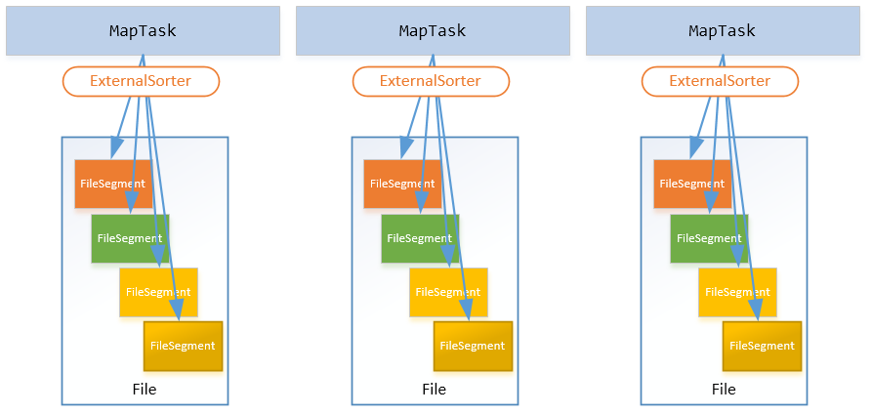
Sort-based Shuffling
Notes:
With the consolidate hash shuffle, we reduced the number of shuffle files from M*R to R files per Executor. Why can we do as Hadoop MR does: each MapTask spills only one shuffle file containing segments, and one index file. This will save significant memory for compression and serialization buffers and result in more sequential disk I/O.

Slide 34
Shuffling in Action
RDD[(String, Long]
RDD[(String, Iterator[Long]]
RDD[(String, Long]
hello
1
hello
1
1
hello
2
word
1
spark
1
spark
1
sql
1
sql
1
hello
1
.groupByKey
.mapValues
spark
1
world
1
world
1
java
1
_.reduce(…)
java
1
java
1
sql
1
(a,b) => a+b
.reduceByKey((a, b) => a + b)
Notes:
This is a simplistic way of reduceByKey(). Spark actually performs a treeReduce in practice.

Slide 35
Partitioning your Data
Essence of big data processing frameworks: sort, aggregation and join
Spark requires all the keys to be in memory for a sort-based shuffle:
  Under-partitioned data will cause OOM
Parallelism of a join is determined by:
  Number of partitions of upstream RDDs
  spark.default.parallelism setting for RDDs
  spark.sql.shuffle.partitions for Spark SQL

Slide 36
Spark SQL
Notes:
Let’s take a look at hardware trend to understand the context of Spark vs Hadoop MapReduce design

Slide 37
Spark Dataset
Dataset<Row>
…
….
…
RDD of Row + Schema
Row
…
Query with SQL or Dataset API
Row
Row
Support for Reflection, JSON, Parquet, CSV, Arvo…
…
Row
Notes:
Schema allows lots of optimization:
Memory optimization: using raw binary data instead of boxing into Java object for many operations
Binary format is more efficient: a string takes up a lot of space: reference, encoding etc 40 character -> 80 bytes
Better memory management
Columnar format such as Parquet makes querying more efficient

Slide 38
Spark Dataset
Dataset<Row>
…
….
…
case class Word(text: String, n: Long)
val wordsFreq = freq.map {
case (text, count) => Word(text, count)
}.toDF() // Dataset<Word>
wordsFreq.createOrReplaceTempView(“wordsFreq”)
//Dataset<Row>
val topWords = sparkSession.sql(“select text, n
from wordsFreq
order by n desc
limit 20”)
topWords.collect().foreach(println)
Row
…
Row
Row
…
Row
Notes:
Can use Scala or Java API as well
Prefer using programmatic expression because SQL is hard to test
Same underlying engine

Slide 39
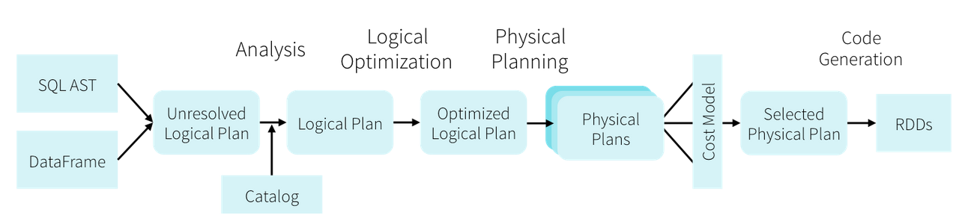
Spark SQL Engine
Data with Schema allows low-level optimisation
  Objects are stored in binary format
Code generation to translate the query to byte code
Notes:
As an engineer, mixed feeling about SQL
Hate seeing raw sql code in production. Hard to test.
However, SQL is very powerful for interactive analysis
Most work is focus on this area
Spark SQL engine also allows you to register java/scala/python code as SQL functions -> powerful

Slide 40
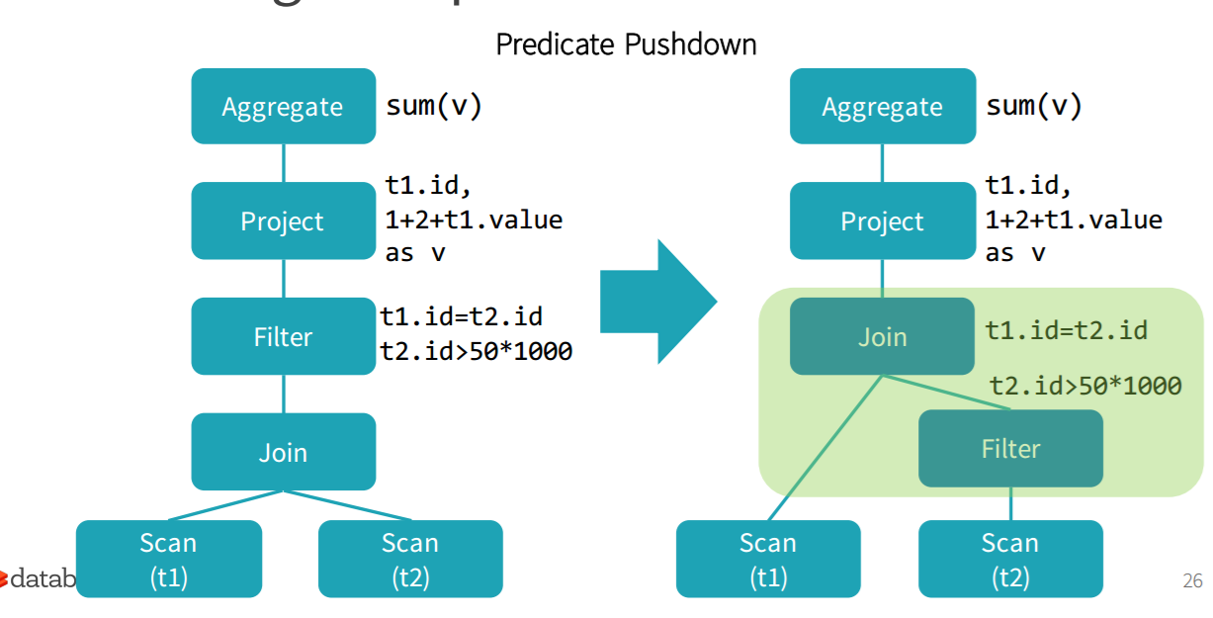
Catalyst Optimiser
DataBricks.com
Notes:
Catalyst optimizer translates SQL operations to byte code
Also, sql planning allow predicate filter pushdown
Collapsing of operations into 1 single operation

Slide 41
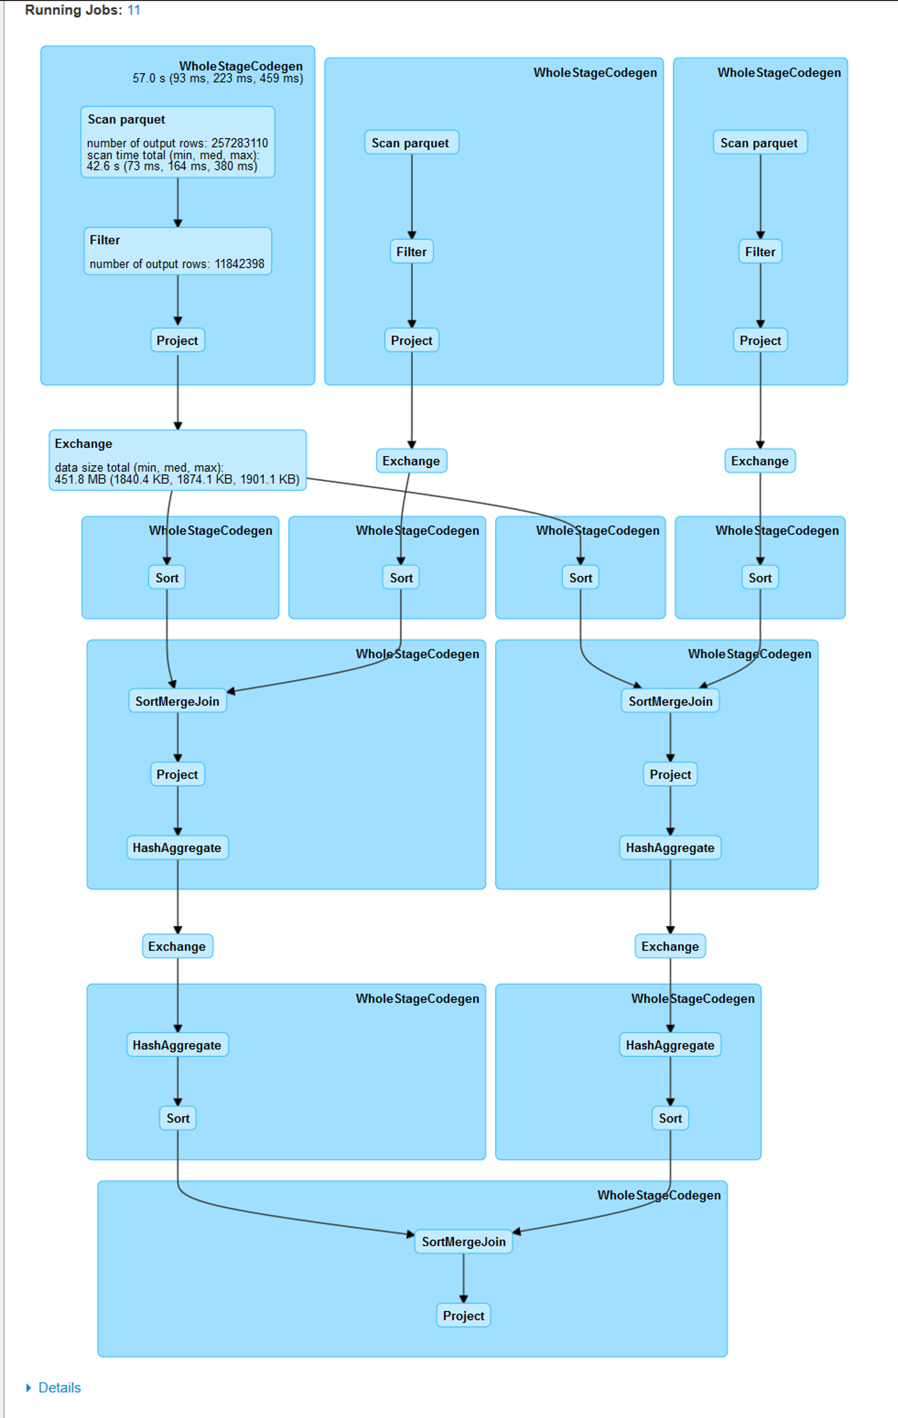
SQL: Logical Plan
Notes:
An example of a SQL logical plan in production. This plan gets translated into a DAG for the underlying RDD that backs Dataset

Slide 42
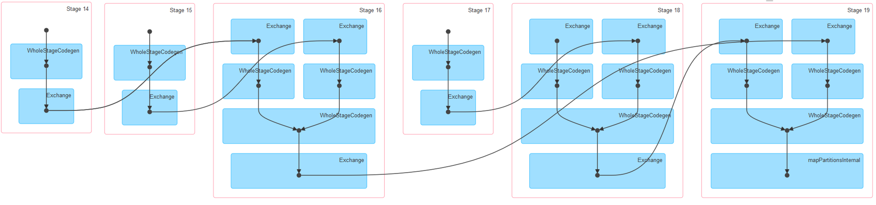
SQL: DAG for RDD
Notes:
Note the step called “WholeStageCodeGen” -> all operations get squashed into a single one -> less context switching

Slide 43
Big Data Platform Architecture
Notes:
Scale – most of our teams tend to focus on scale in one way or another.
Teams processing petabytes of data per month, using Apache Spark to process data and carry out machine learning at massive scale.
Teams running high-scale low latency distributed systems that can scale to millions of transactions per second.
Creating products and services that can run all over the world.

Slide 44
Production ‘ilities’
Scalability: many jobs, running day-in and day-out
High availability: durable system that can operate continuously without failure for a long time
Maintainability: minimize bugs and broken features
Evolvability: the ability to adapt to new technology
…

Slide 45










Technology Stack
Scheduled Batch Jobs
Notebook
Spark
HDFS
YARN
EMRFS
Provided by EMR
Amazon S3
Notes:
EMR also provides the ability to monitor jobs and clusters
We provision our clusters on demand, and the sizes of the clusters depends on the nature of the jobs

Slide 46
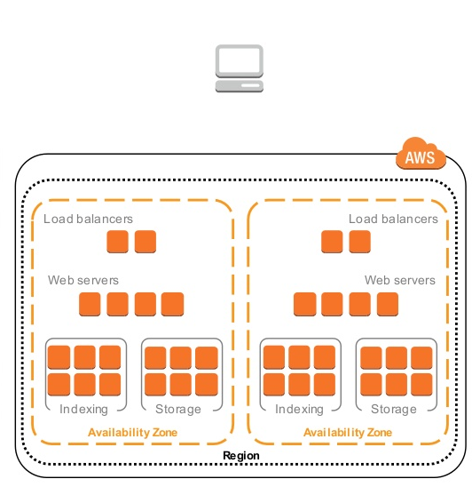
Amazon S3
Simple Storage Service
Supports files between 1 byte and 5 terabytes
Lifecycle policies
Versioning
Access controls
Through replication:
  Availability 99.99%
  Durability 99.999999999%
Notes:
S3 is scalable and cheap
Use S3 as central data store in Amazon

Slide 47
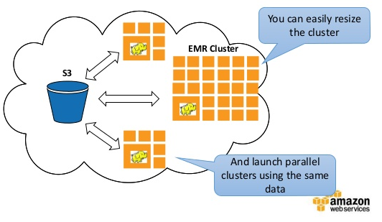
Amazon Elastic MapReduce
Bundle Spark, YARN, Hive… etc.
S3 as your persistent data store
HDFS as temporary storage for jobs
EMRFS makes it easier to leverage S3:
  A layer on top of HDFS
Notes:
Spark supports S3 via HDFS (ecosystem is very important)

Slide 48

Data Format: JSON
JSON is our primary data format
  Self-descriptive
  Highly exchangeable
JSON is expensive!
  Serialisation/Deserialisation cost
  Unless all data fits in memory, JSON is bad for interactive querying
  Spark tends to underestimate the memory required for JSON RDD
Notes:
Json as primary data
Json is prevalanet on the web
Self-expressiveness is important
JSON objects are expensive because it’s structured as a tree in memory: to estimate the size of objects (for spilling), we have to walk the tree

Slide 49
Data Format: Parquet
Binary columnar format
  Spark supports parquet via Dataset API
  Tungsten optimisation and Catalyst optimiser
  Spark can use off-heap memory for shuffling
Disadvantages:
  Binary format: not everyone can read
Notes:
Read only the columns you need

Slide 50
Scalability
Process datasets of TBs in size
  Still haven’t hit Spark scaling limit
Petabytes of data managed and monitored by the platform
Automatic job retry when failure occurs
Notebooks on Spark/EMR:
  Query billions of rows of records
  Fast business metric reporting
  Fast prototyping of machine learning models
Notes:
Spark is really scalable: most work is about data (partitioning & tuning)
Tuning is hard: lots of parameters. No one-size fits all

Slide 51
Operation
S3 makes durable storage simple
Scaling up is easy when data grows:
  Use larger clusters in EMR
Spark are sensitive to memory issues:
  Flame graphs built for jobs
EMR are fast to keep up-to-date with latest Spark release:
  Little pain in upgrading software
Notes:
A lot about understanding metrics in FlameGraph and Spark metrics UI

Slide 52
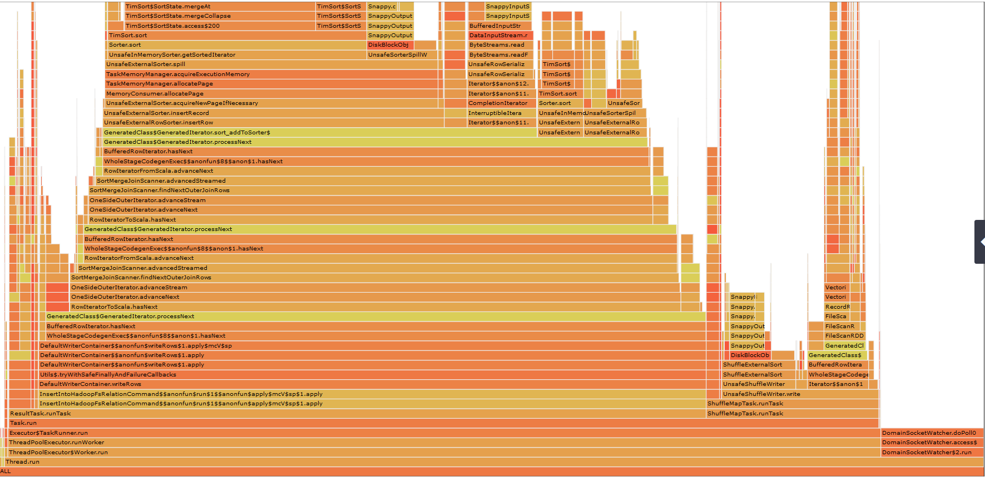
Flame Graph
http://techblog.netflix.com/2015/07/java-in-flames.html
Notes:
Flame graphs can be produced by the technique described in: http://techblog.netflix.com/2015/07/java-in-flames.html
We have internal tools that allow us to produce this for our Spark job

Slide 53
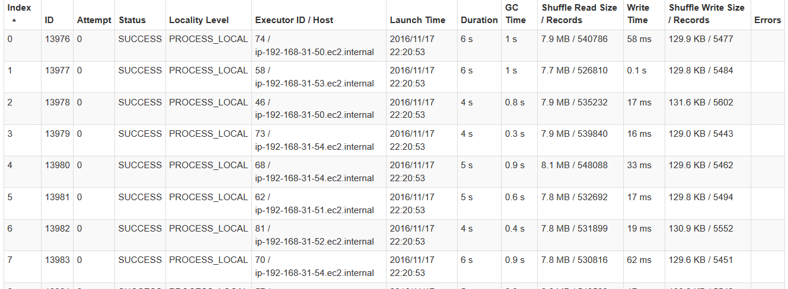
Spark Task UI
Notes:
Metrics are important
Focus on GC time and shuffle read and write (hinting data skew issue)

Slide 54
Spark Gotcha’s
Partitioning is hard:
  Manual tuning can be tedious
More memory doesn’t mean less OOM’s:
  Could be a key distribution/partitioning issue
  Be generous with spark.yarn.executor.memoryOverhead
Code serialization versus data serialization
Tuning the right configuration for Spark is difficult

Slide 55
Take Away
Scalability is hard:
  Don’t re-invent the wheel (seriously, don’t)
Minimise external dependencies:
  If you depend on something, make sure it provides high availability
Transient systems are good:
  More resilient to failures
Immutable data:
  Build once, and forget (or delete) it

Slide 56

Learn More: Resources
Learning Spark (O’Reilly)
Apache Spark Documentation
DataBricks blog
Apache Spark Mailing Lists
Spark Summit video series
AWS Blog

Slide 57
References
Tachyon: An Open Source Memory-Centric Distributed Storage System
Apache Spark website
Apache Spark Internals, Michiardi
www.trongkhoanguyen.com
https://aws.amazon.com/blogs/aws/

Slide 58
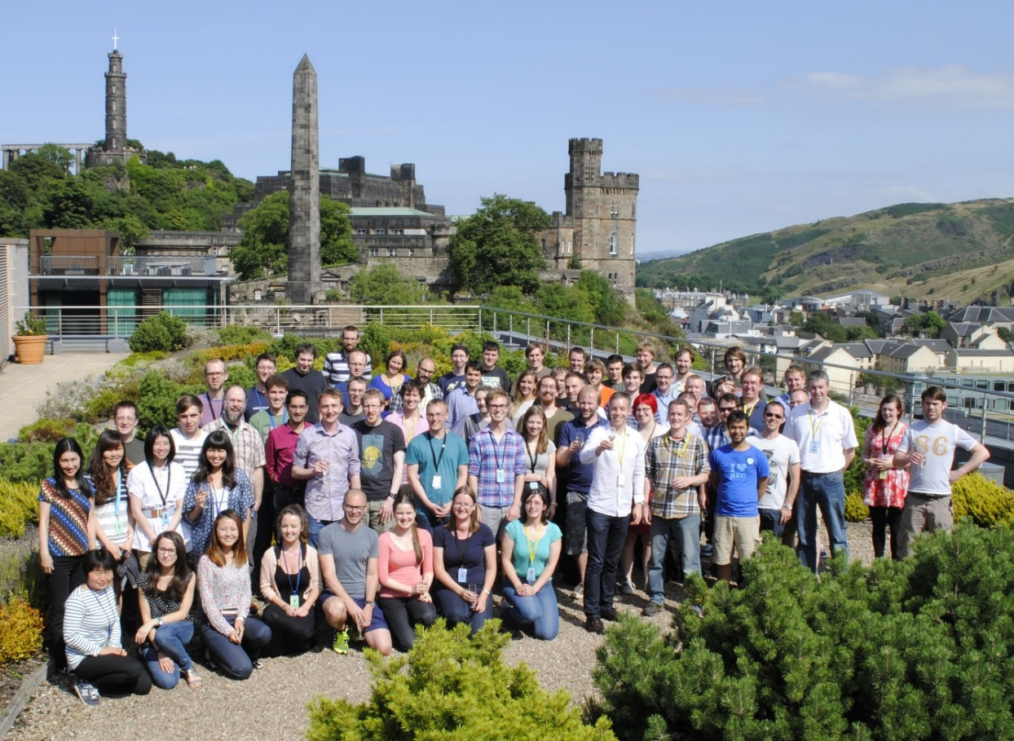
Learn More: We’re Hiring
Apply for 2017 Intern and Graduate roles
amazondc.com/jobs
dangnam@amazon.com

